Slide 1
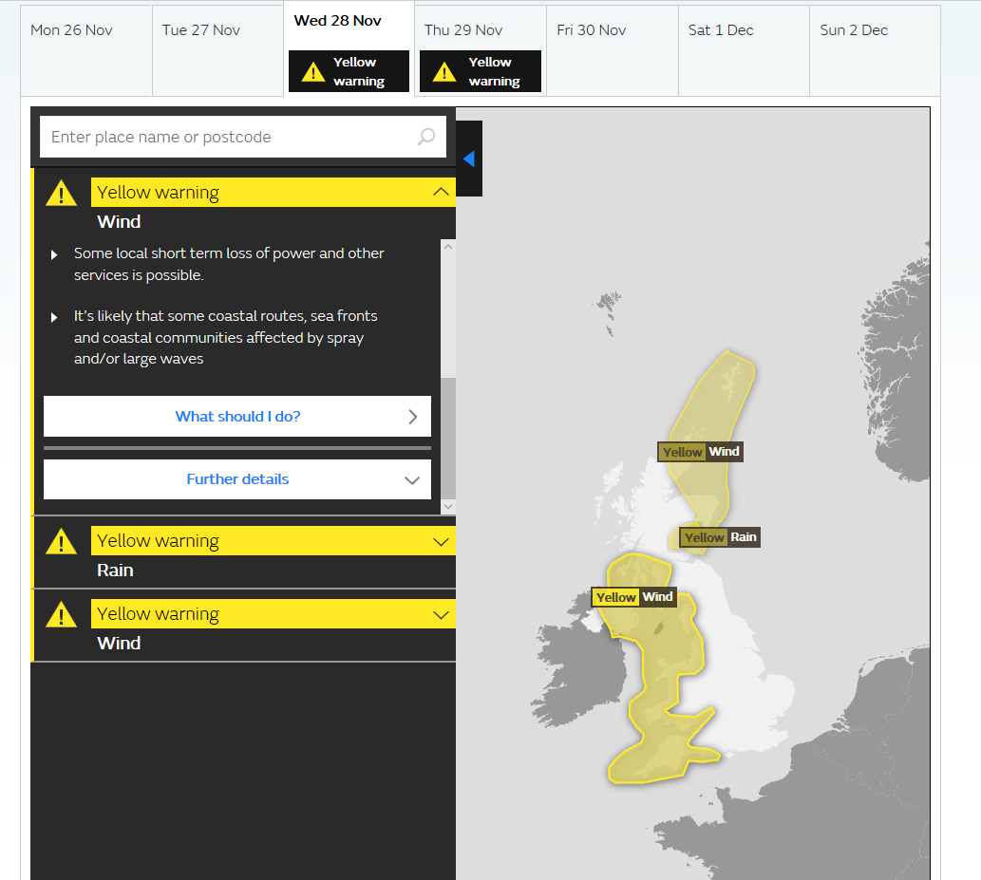
Met Office
Yellow Wind Warning issued 26 Nov 2018
Valid from Wed 0900 to 2100 28 Nov 2018

Slide 2
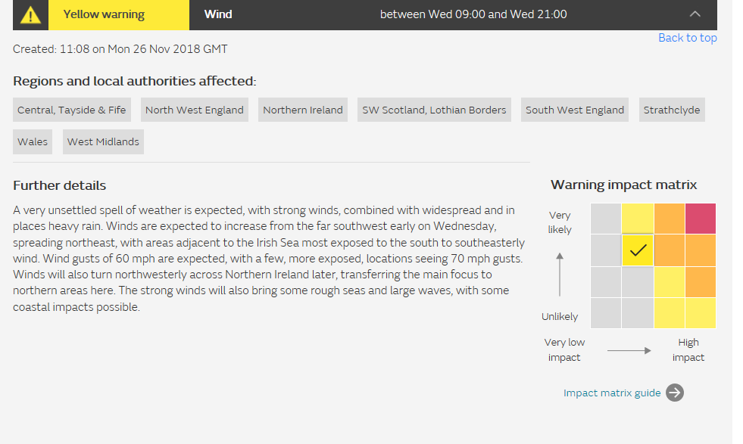

Slide 3
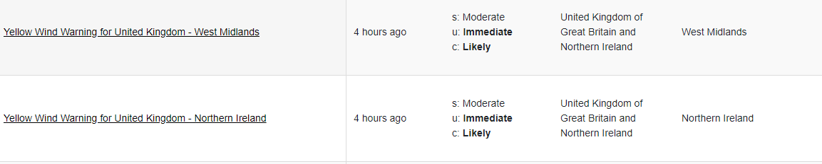
‘Moderate’ is not the equivalent severity/impact level
The warning is not valid for another two days – it is not immediate
The wind/weather? Or the impacts?
From Severe Weather Information Centre Beta: http://www.wmo.int/pages/index_en.html#alertwidget
26 Nov 2018

