Slide 1
WMO, Sixth High-Level Session
Open Consultative Platform (OCP-HL-6)
Public-Private Engagement on Artificial Intelligence (AI)
Dr Arlene Laing
Permanent Representative
British Caribbean Territories (BCT) with WMO
Caribbean Meteorological Organization

Slide 2
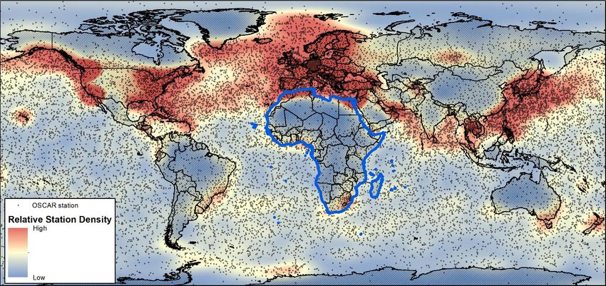
Training Data Limitations in Tropics
Data-sparse regions
Depend on satellite remote-sensing and Reanalysis (large-scale)
What is optimal for small-island scale?
Worldwide distribution of stations in the Observing Systems Capability Analysis and Review tool (OSCAR) (WMO, April 2018)

Slide 3
2024
> 250 participants

Slide 4
Takeaways from 2024 RA IV Webinar on ML/AI in Weather Prediction
AI Weather Prediction Models (AI-WP), in general
Perform as well or better than traditional NWP at a fraction of computational cost
Possibility to democratize access to weather forecast models (Open source code for AI/ML systems from private sector; packages developed by ECMWF to install and run AI systems)
Tropical Cyclone forecasting
Simple Machine Learning models used successfully to forecast Tropical Cyclones for many decades
AI-WP models show great promise for Tropical Cyclone forecasting
Comparable or better track forecasts than best operational models
Challenges with accurate intensity forecasts may require new training set and loss function
Physics & Predictability
Do AI-WP models capture the underlying physics?
Can AI-WP simulate the butterfly effect, the limited atmospheric predictability?
AI, Satellite Imagery and Natural Hazard Management
Remote sensing & Deep Learning: Ideal for monitoring
and mapping floods

Slide 5
Open Principle
A
P
P
Why should AI-based Earth System Prediction (AI-ESP) systems be open, transparent and traceable and what is the willingness of the public and private sectors to engage in a shared, open research [and operational] platform for AI-ESP?
Meteorology – Global Interdependence, Openness benefits all
Tradition of collaboration, e.g., technology transition from academia to private sector. Access to open data has unleashed innovation in private sector.
How can we ensure that the AI-ESPs are trained on open, high-quality data and will all the training data be accessible both to public and private sector?
WMO Infrastructure – WIGOS, WIS, WIPPS
How we evaluate forecast skill really matters in all forecast assessment.
Need expertise of WMO and Co-sponsored Research bodies to ensure appropriate evaluation of AI Prediction, Operationally-meaningful metrics.

Slide 6
Small National Meteorological and Hydrological Services
How will AI help small NMHSs / developing countries, rather than jeopardize their activities / mandate?
Lower computational cost of AI models - Democratize access and capacity for operational weather forecast modelling
If AI models can learn to assimilate observations directly, then reanalysis at small-island scale could be made with AI and used to train prediction models
Need WMO partners, like ECMWF, to train and build AI-ESP capacity
Already done for existing NWP, could build on those capacity development efforts

Slide 7
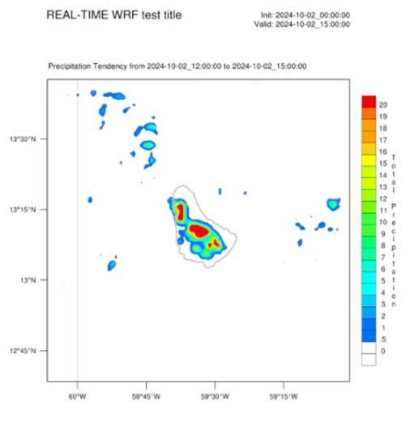
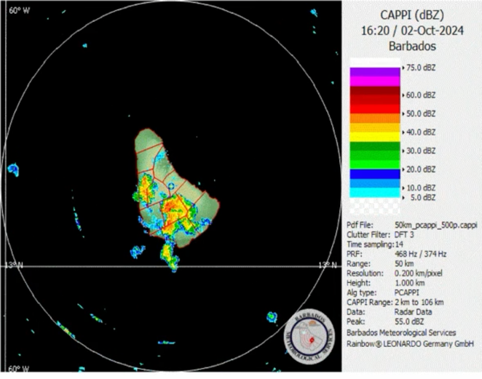
Roles and Single Authoritative Voice of NMHSs
In your opinion, how do you see the roles of National Meteorological and Hydrological Services in the future?
Trusted source of information, mission for safety, public good, answer to governments
Can the products of private companies be trusted as the main course of forecasts?
Providing greater value for high impact events, outside of limited data sources used to train AI.

Slide 8
Roles and Single Authoritative Voice of NMHSs
What will be the roles that you envision for public and private entities?
Private entities are more agile, better resourced, but, rely on body of data from public sector. Optimally, should be partners in development and deployment of AI-ESP.
How can AI-based systems serve to support authoritative extreme weather warnings services provided for the protection life and property
Tropical Cyclone Track Forecasting – Similar or better track forecasts to physics-based models support early warnings.
NMHSs - Use AI to mine hazards catalogues to improve forecast guidance and understanding of specific hazard risks
Remote sensing and AI – supports early warnings
THANK YOU FOR YOUR TIME AND ATTENTION

