Slide 1
What would it take?
… For all to benefit from AI in Earth System Predictions
Roar Skålin, Jørn Kristiansen, Jordis Tradowsky, Norwegian Meteorological Institute
Florian Pappenberger, Florence Rabier, ECMWF

Slide 2
An open and collaborative approach
The changes we experience are not just technological, they also reshape how and by whom forecasts are produced.
To build trust & accountability, avoid lock-in and enable all NMHSs to benefit from this change, the systems should be truly open - open models, weights, tools and training data.
The European Meteorological Infrastructure combines resources for open AI developments
The EUMETNET E-AI Programme develops open tools covering the entire value chain - observations to services.
E-AI and ECMWF provides training sessions - these are recorded and can benefit the wider, global community.
A framework for testing and comparing models and tools

Slide 3
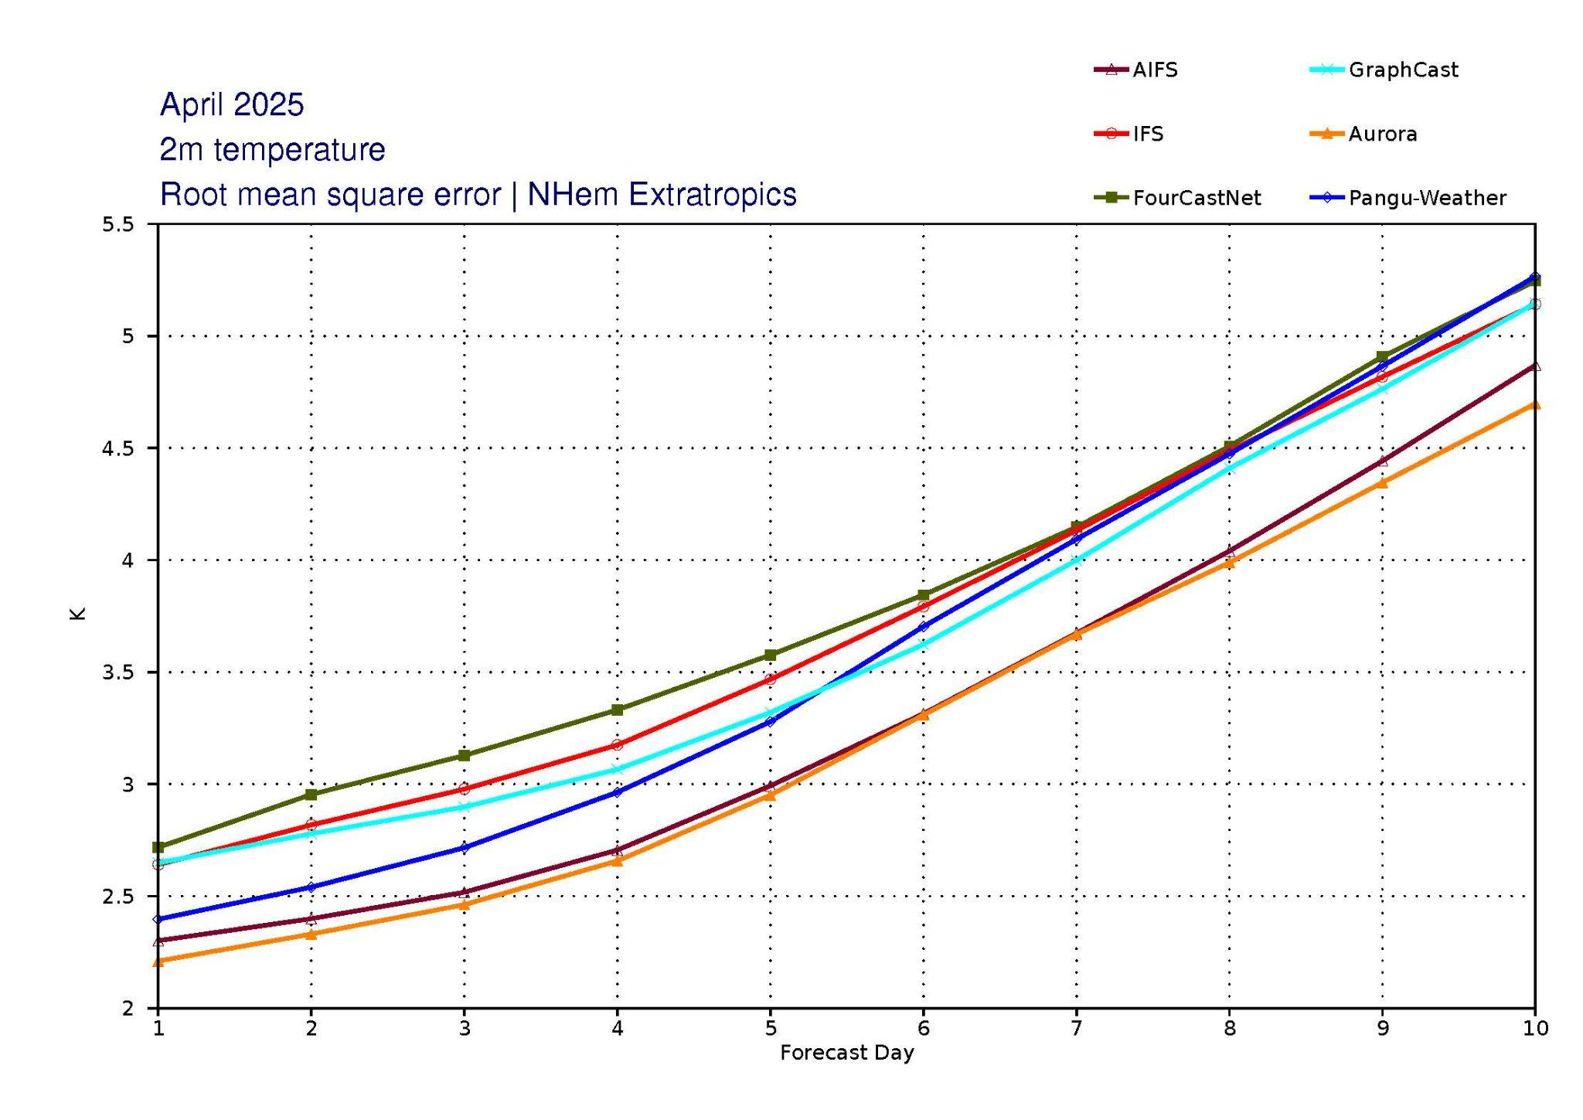
Developments by and with ECMWF
ECMWF’s Artificial Intelligence Forecasting System (AIFS) became operational February 2025.
Anemoi - an open-source ML software framework for earth system modelling.
“forecast-in-a-box” - comprising AI models and the entire workflow from input data to visualisation.
Anemoi won the 2025 EMS Technology Achievement Award
Goal to make open-source AI easily available to NMHSs globally.
Run AIFS yourself: https://huggingface.co/ecmwf/aifs-single-1.0​
Notes:
Notes from Florian:
Ensemble version of AIFS (AIFS CRPS) expected 1 July.
1. Operational maturity - I would suggest explicitly highlighting that AIFS/etc is already operational. AIFS Single v1.0 was implemented in February and the ensemble version is planned for this summer. It shows skill comparable to, or exceeding, both IFS and private-sector systems like GenCast — showing that AI is not just under development in the public sector but is already transforming operations. Which is more exciting than some research project somewhere

Slide 4
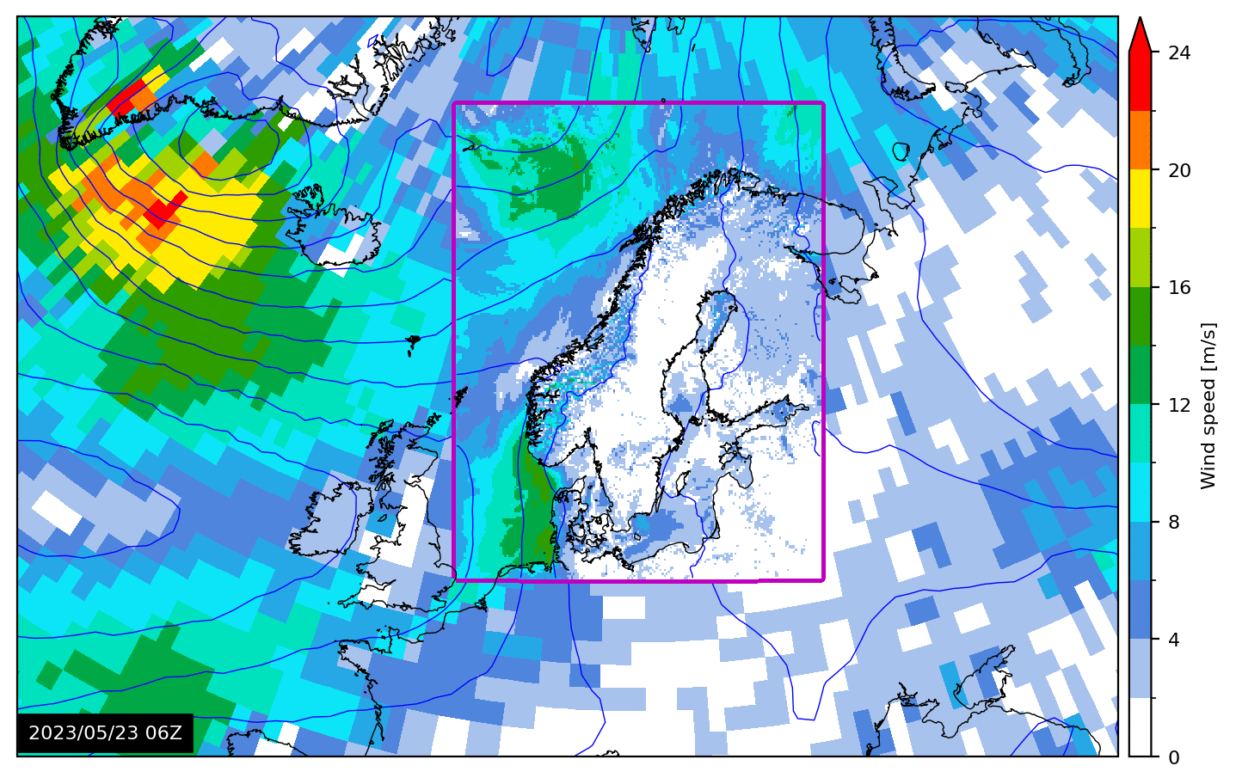
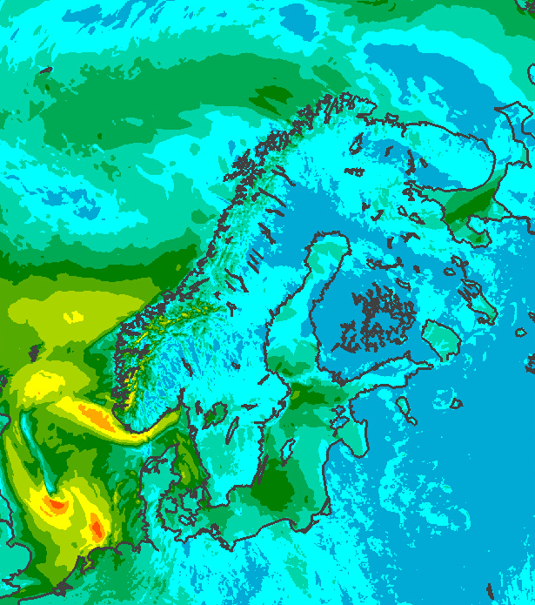
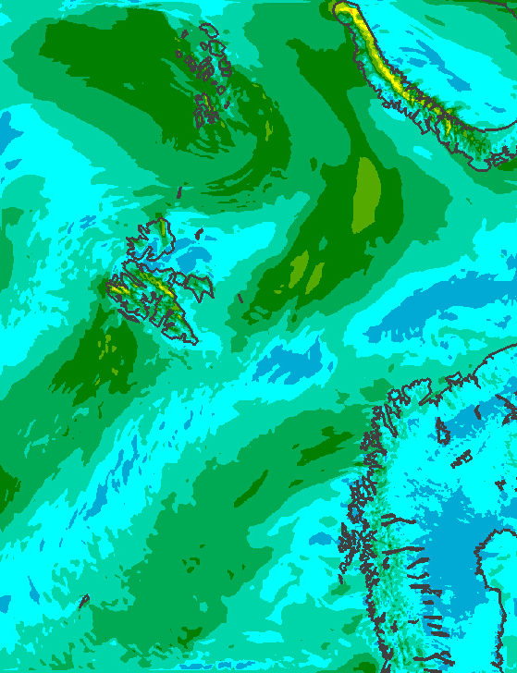
Bris [bri:s] - Developed by the Norwegian Meteorological Institute
A global, open-source AI-based model with high resolution over our focus area(s)
Aim to seamlessly cover nowcasting (next hour) to long-range (21 days)
Based on AIFS and developed within the Anemoi framework together with European partners.
Testing to move high resolution area to other countries both in Europe and in other regions.
Anemoi in action: developing weather model for the Nordics​
Global
Nordic
Arctic
4

Slide 5
AI that scales to every NMHS: Malawi
Aims to empower Malawi’s national meteorological service to independently operate AI-based weather predictions.
Wider goal: Test how AI can be used in the value chain of producing early warnings in Least Developed Countries and Small Island Developing States.
Partnership between:
Malawi’s Department of Climate Change and Forecasting Services (DCCMS) - local expertise and data;
MET Norway - Bris, domain and AI expertise;
ECMWF - forecast-in-a-box
Sustainability: Bris is maintained and used by MET Norway; forecast-in-a-box is maintained by ECMWF.
WIPPS pilot project on forecast-in-a-box and Bris.

