Slide 1
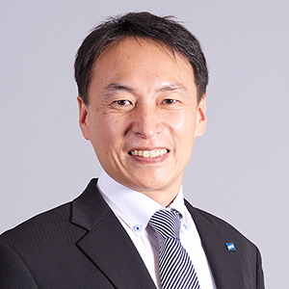
Launch of the High-Level Regional Forum of the OCP in the Regional Association III
An Efficient PPE/PPP Framework
from a Private Sector Perspective
Daisuke Abe
Executive Officer
Service Operation and Development
Weathernews Inc. (WNI)

Slide 2
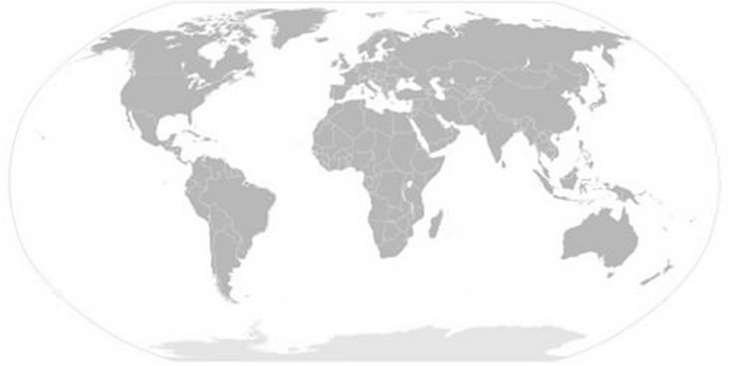
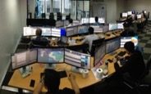
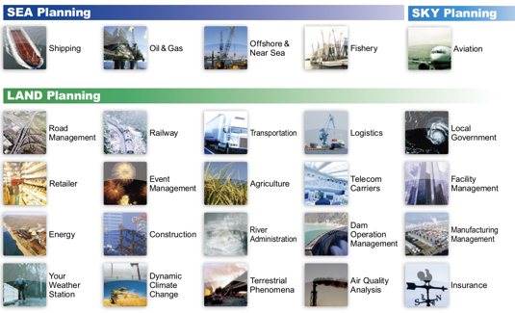
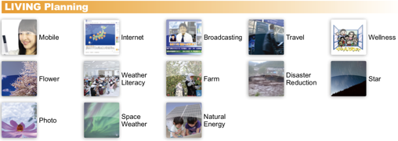
Weathernews Inc. (WNI) in Brief
Global Operation Network
Supporting 24 x 7, from 32 offices in 21 countries
Copenhagen
Operations Center
Oklahoma Operations Center
Athens
Operations Sub-Center
Amsterdam
Operations Center
Tokyo Global Operations Center
Yangon
Operations Center
Established in 1986
Sales in 44 areas of global market
1,100+ employees
(including 200 Certified Forecasters,
300 Risk Communicators & 250 IT Experts)
2,500+ BtoB customers in 50 countries
2,000,000+ BtoS “Supporters”
180,000 Weather Reports / Day
Manila
Operations Center

Slide 3
Public Private Engagement (PPE)
Legal Framework for Meteorological Services in Japan - Meteorological Service Act - (1952)
1993: Enhancement of Public-Private Partnership
- Establishment of an authorized organization for dissemination of meteorological data to the private sector
- Establishment of “certified meteorological forecasters” system
- Authorization of Public Weather Forecast by the Private Sector

Slide 4
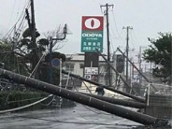
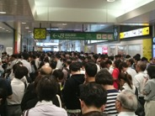
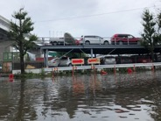
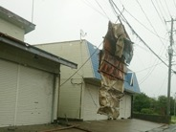
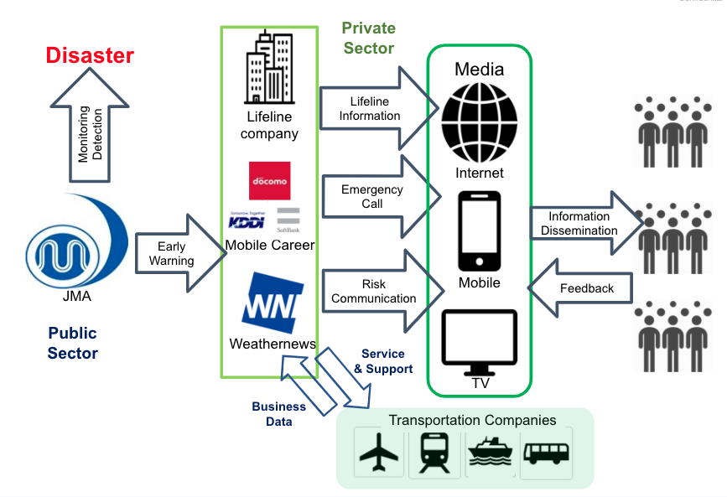
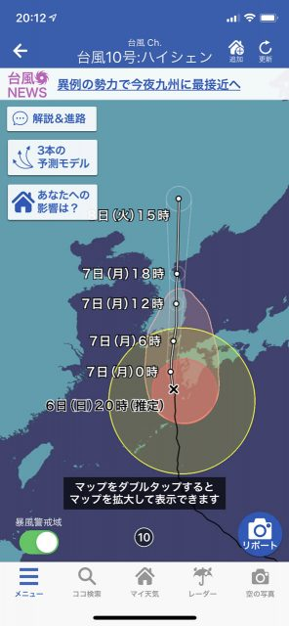
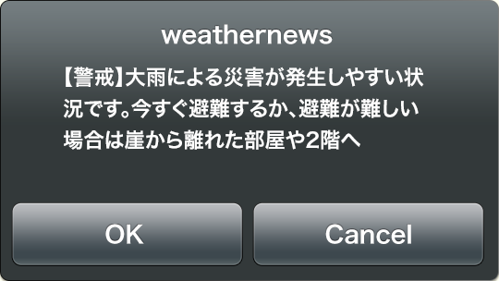
PPE: Warning Dissemination in Japan
Private Sector plays a key role
in organizing and disseminating
the information on disaster
and warning to end-users

Slide 5
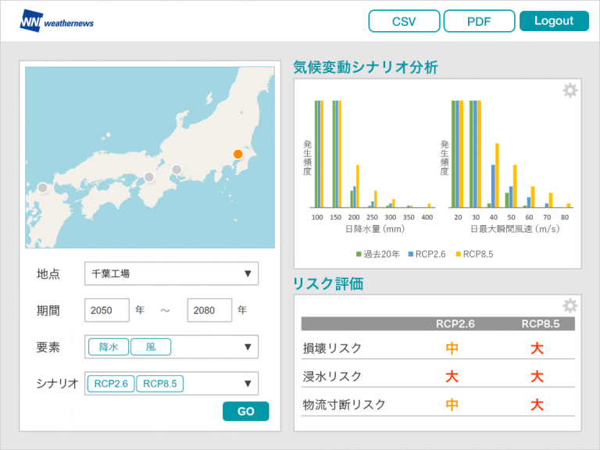
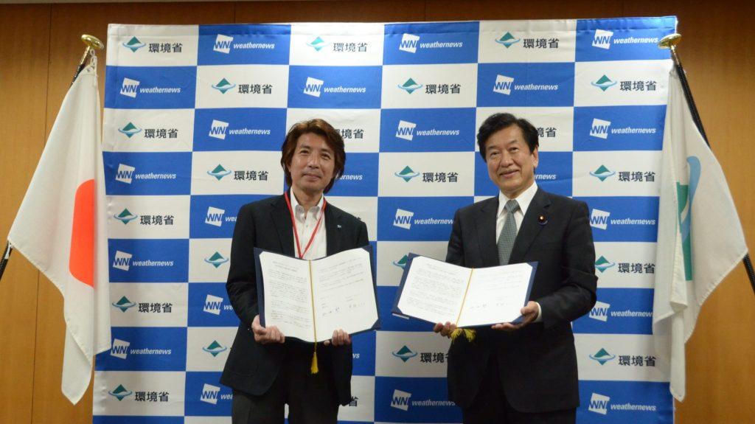
PPP: Joint Project for Climate Action
Weathernews entered into an agreement with The Ministry of the Environment (MOE) of Japan to collaborate in raising awareness of climate change adaptation and promoting adaptation measures by the private sector and local governments.
Through this agreement, Weathernews will engage in ongoing discussions to promote the development and provision of climate risk information in Japan and the Asia-Pacific region, to examine the sustainable use of natural capital to ensure disaster prevention and mitigation and the conservation of natural ecosystems, and to promote climate change adaptation efforts including measures against heat stroke.

Slide 6
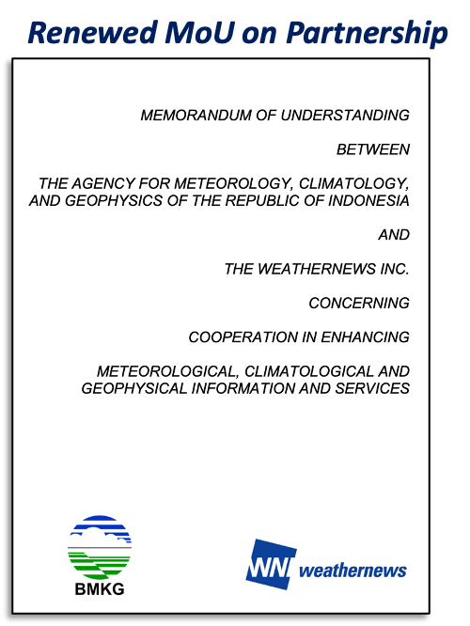
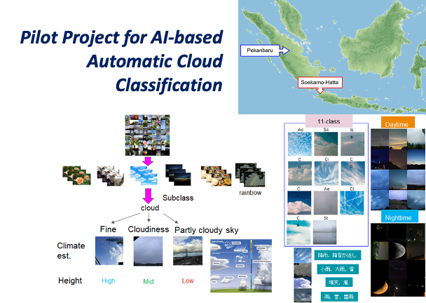
PPP: Joint Research with NMHS
Weathernews Inc. renewed the MoU on partnership in 2022 with the Agency for Meteorology, Climatology and Geophysics (BMKG) of Indonesia, and initiated a research and development project for AI-based Automatic Cloud Classification, with using webcams.

Slide 7
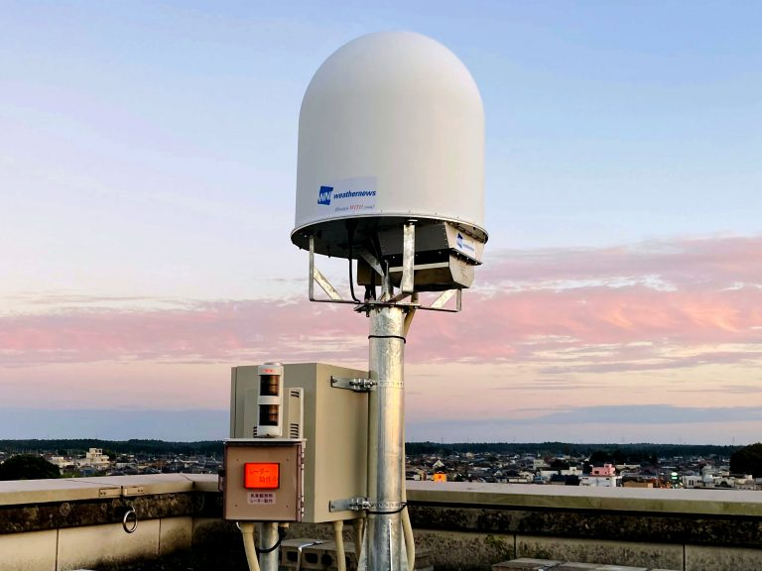
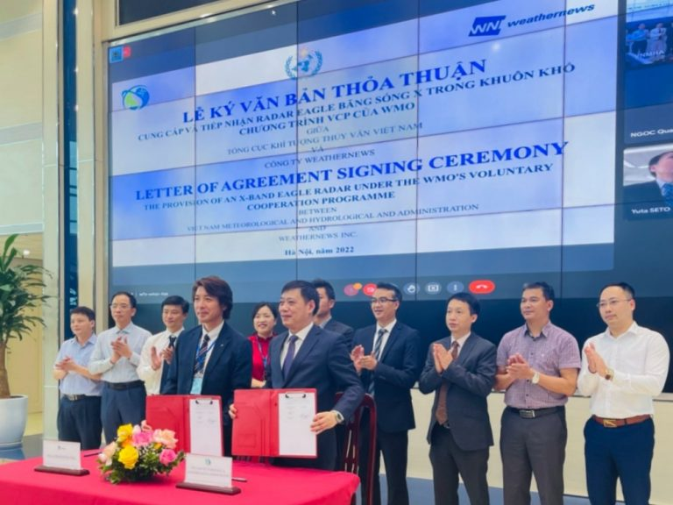
PPP: VCP (Voluntary Cooperation Programme of WMO)
Weathernews Inc. in cooperation with Viet Nam Meteorological and Hydrological Administration (VNMHA), initiated the overseas deployment of high-frequency compact meteorological X-band radar - “EAGLE Radar,” the first of which is to be installed in Hanoi, Viet Nam. Weathernews entered into an agreement on provision of a radar to the VNMHA in 2022.
Weathernews works together with VNMHA to install and commence the operation of an EAGLE radar in Hanoi through an international technical cooperation programme “VCP” of the World Meteorological Organization and in cooperation with Japan Meteorological Agency (JMA).
The EAGLE radar is a new meteorological radar that performs 3D observation of 50-km periphery in 30 seconds.

Slide 8
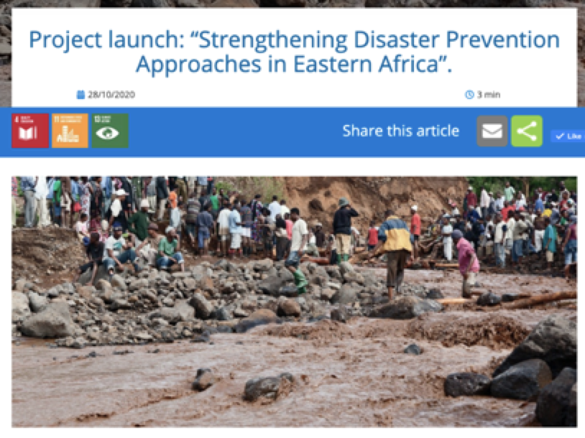
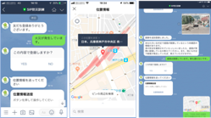
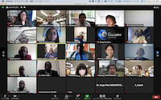
PPP: Joint Project for East Africa
Weathernews is joining the “SIP” national program led by the Council for Science, Technology and Innovation (CSTI) of the Japanese Government and developing “AI Chatbot” system for disaster prevention with the collaboration of National Research Institute for Earth Science and Disaster Resilience (NIED), National Institute of Information and Communications Technology (NICT) communicating through the mobile app platform of LINE.
In collaboration with UNESCO, Weathernews attempts to contribute to disaster prevention in East Africa nations by collecting and providing information related to disasters through mutual communication with users by utilizing the mobile app platform, which is most used in Japan as well as other countries. This joint workshop has been organized with UNESCO and local governments.

Slide 9
Conclusion
With an Appropriate Mechanism for PPE/PPP, will enable:
Improved service delivery with the private sector by:
Through PPE, disseminating timely and reliable information to end-users, as a key component of People-centered EWS
Increasing accuracy of information and data with user feedback
collected and analyzed by private sectors
Broadening the meteorological service market through creating new value of the weather and climate information
Maximizing socioeconomic benefits of meteorological services with clearly defined roles and responsibilities of public and private sectors regulated in the legal framework

Slide 10
Our Hope
We hope,
appropriate mechanism/system for PPE/PPP will
enhance and maximize the contribution of
Weather and Climate Enterprise to the Society
Gracias
https://global.weathernews.com/

