Slide 1
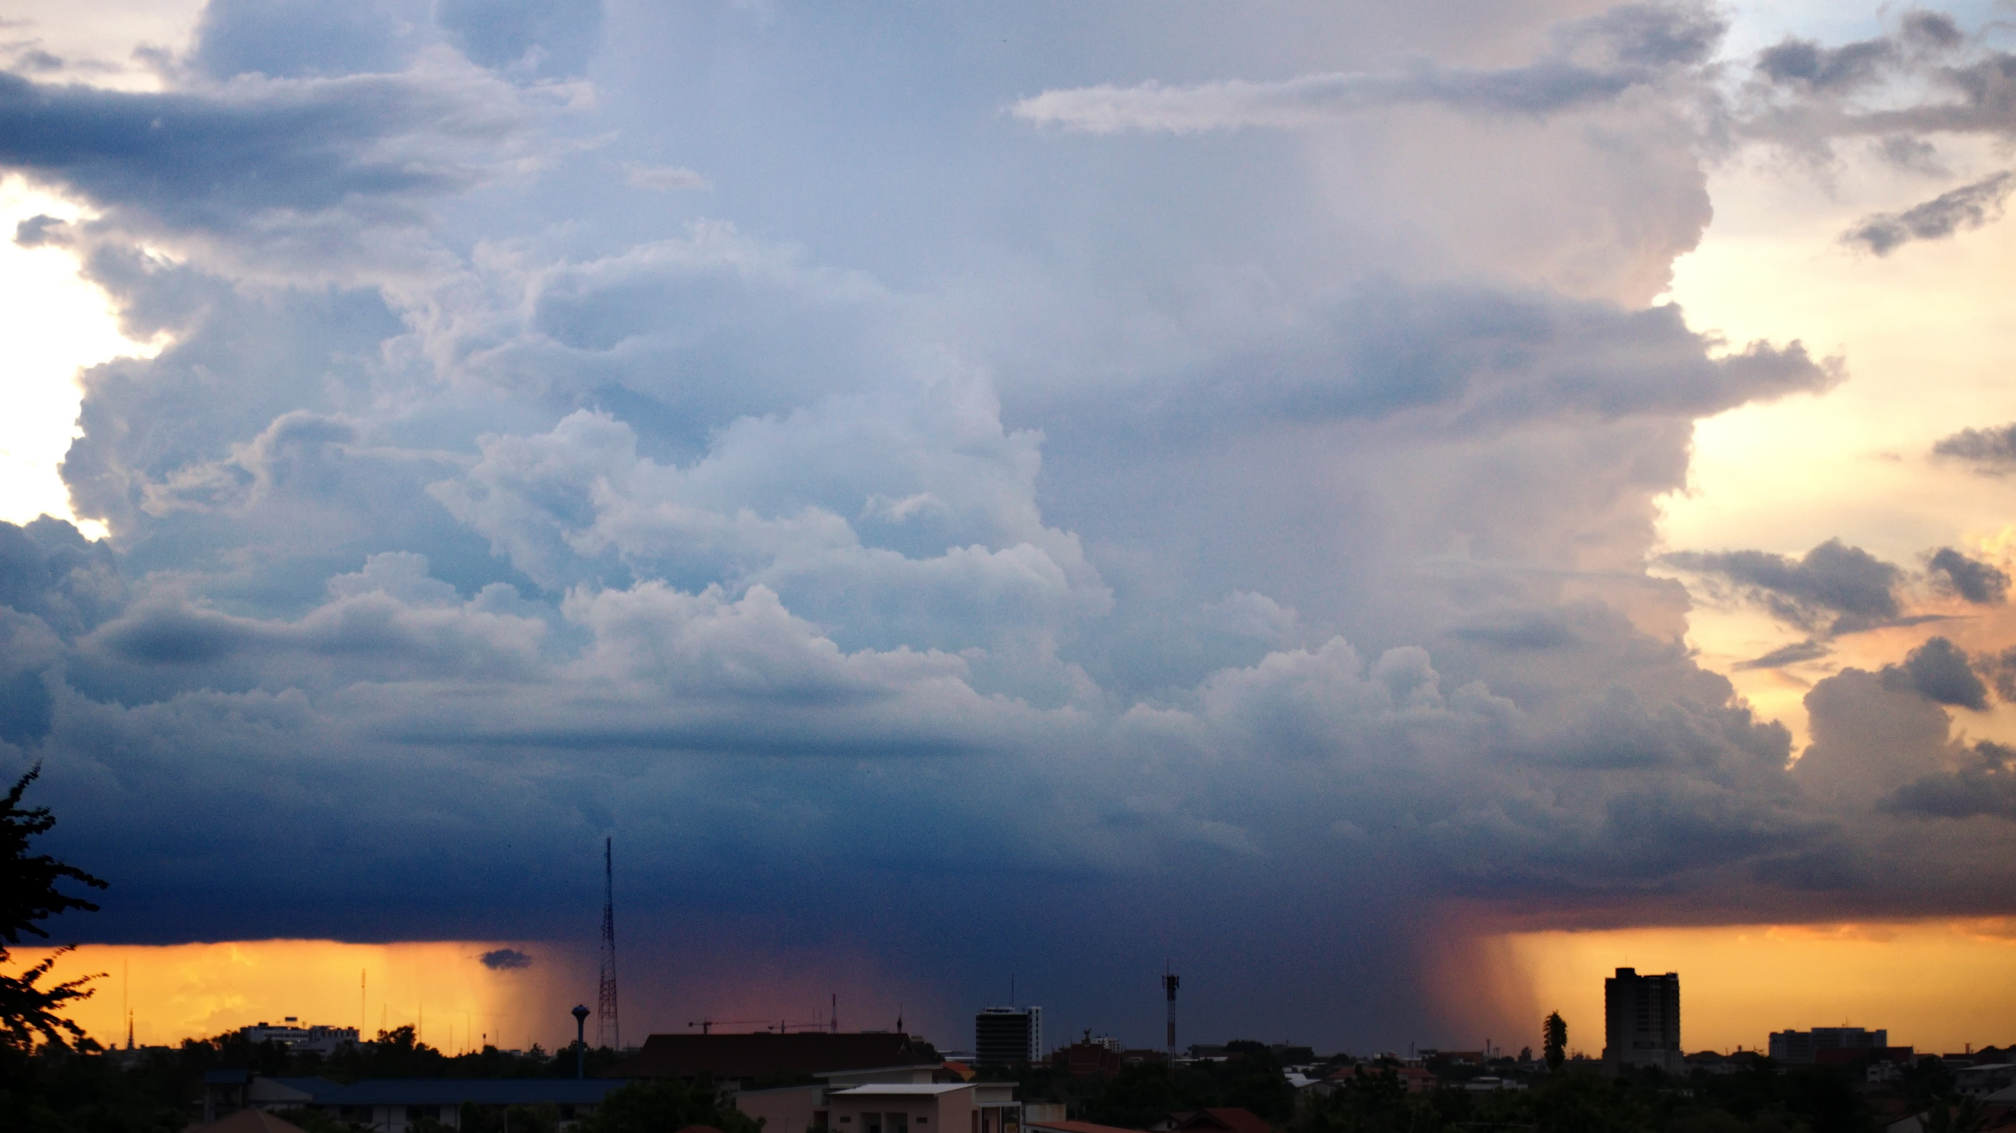
Developing high performance meteorological services
Hydromet LatAm 2021
Leo Garcia
Business Developer Manager, Meteorological Infrastructure and Capability Development

Slide 2

Content
The goal of a hydro-meteorological institute
Weather information value chain
Developing high performance
Vaisala Meteorological Infrastructure and Capability Development MICD
Reference projects
Summary

Slide 3
Authority to answer for the national safety
Generally, the goal of a hydro-meteorological institute
Forecast the impacts of climate change
Create socio-economic value for the entire society
Produce services for a vast user group
Contribute to research

Slide 4

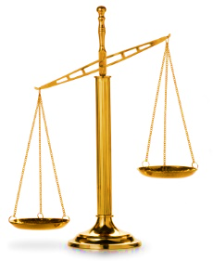
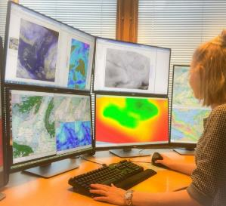
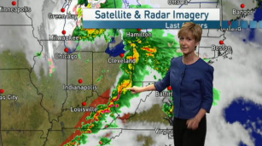
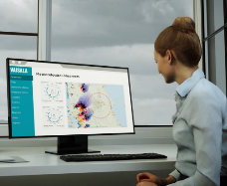

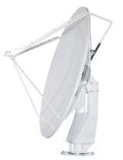

Weather information value chain
WEATHER
OBSERVATIONS
FORECASTING
DISSEMINATION
SOCIO-ECONOMIC VALUE
DECISION MAKING
1
10
COST
BENEFIT
Notes:
Según la OMM, cada dólar invertido en servicios meteorológicos e investigación genera diez dólares en beneficios socioeconómicos. Y el retorno puede ser aún mayor en países con un punto de partida muy simple.
¿De dónde viene el valor? El valor que la infraestructura y los servicios meteorológicos aportan a la sociedad proviene de las acciones que la información y los servicios pueden provocar.
Las necesidades están pasando de proporcionar datos meteorológicos tradicionales y productos de pronóstico a proporcionar pronósticos de impacto. P.ej. llueve mucho en un área, esto debemos pronosticarlo con anticipación y observarlo una vez que ocurra, pero cuál es el impacto local de la lluvia, si el área es propensa a inundaciones si esto ocurrirá, si hay infraestructura crítica que pueda dañarse, hay necesidad de evacuar, deben cerrarse las carreteras, hay ayuda disponible? Ser capaz de pronosticar impactos puede crear nuevos usuarios potenciales para estos productos, campos que no sabían que pueden aumentar sus rendimientos o evitar costos con esta información.
Para poder crear acciones e impactos reales, todo el proceso desde la comprensión de los fenómenos, su observación inicial y la creación de servicios y productos específicos significativos que se difunden a las autoridades pertinentes y al público debe estar en su lugar. (toda la cadena de valor)
Para tener toda la cadena de valor en su lugar, debemos dejar de pensar en la infraestructura meteorológica como un rompecabezas de sistemas y software separados, sino como una solución holística es decir, el todo y cada una de las partes se encuentran ligadas con interacciones constantes.
Pero el proceso no solo se arregla con buenas observaciones del estado inicial. Estos por sí mismos no aportan ningún valor real. El valor se crea después de convertir los datos en pronósticos y productos que se difunden a las partes interesadas relevantes en un formato comprensible de manera oportuna.
La fase de difusión es típicamente donde se pierde más valor

Slide 5
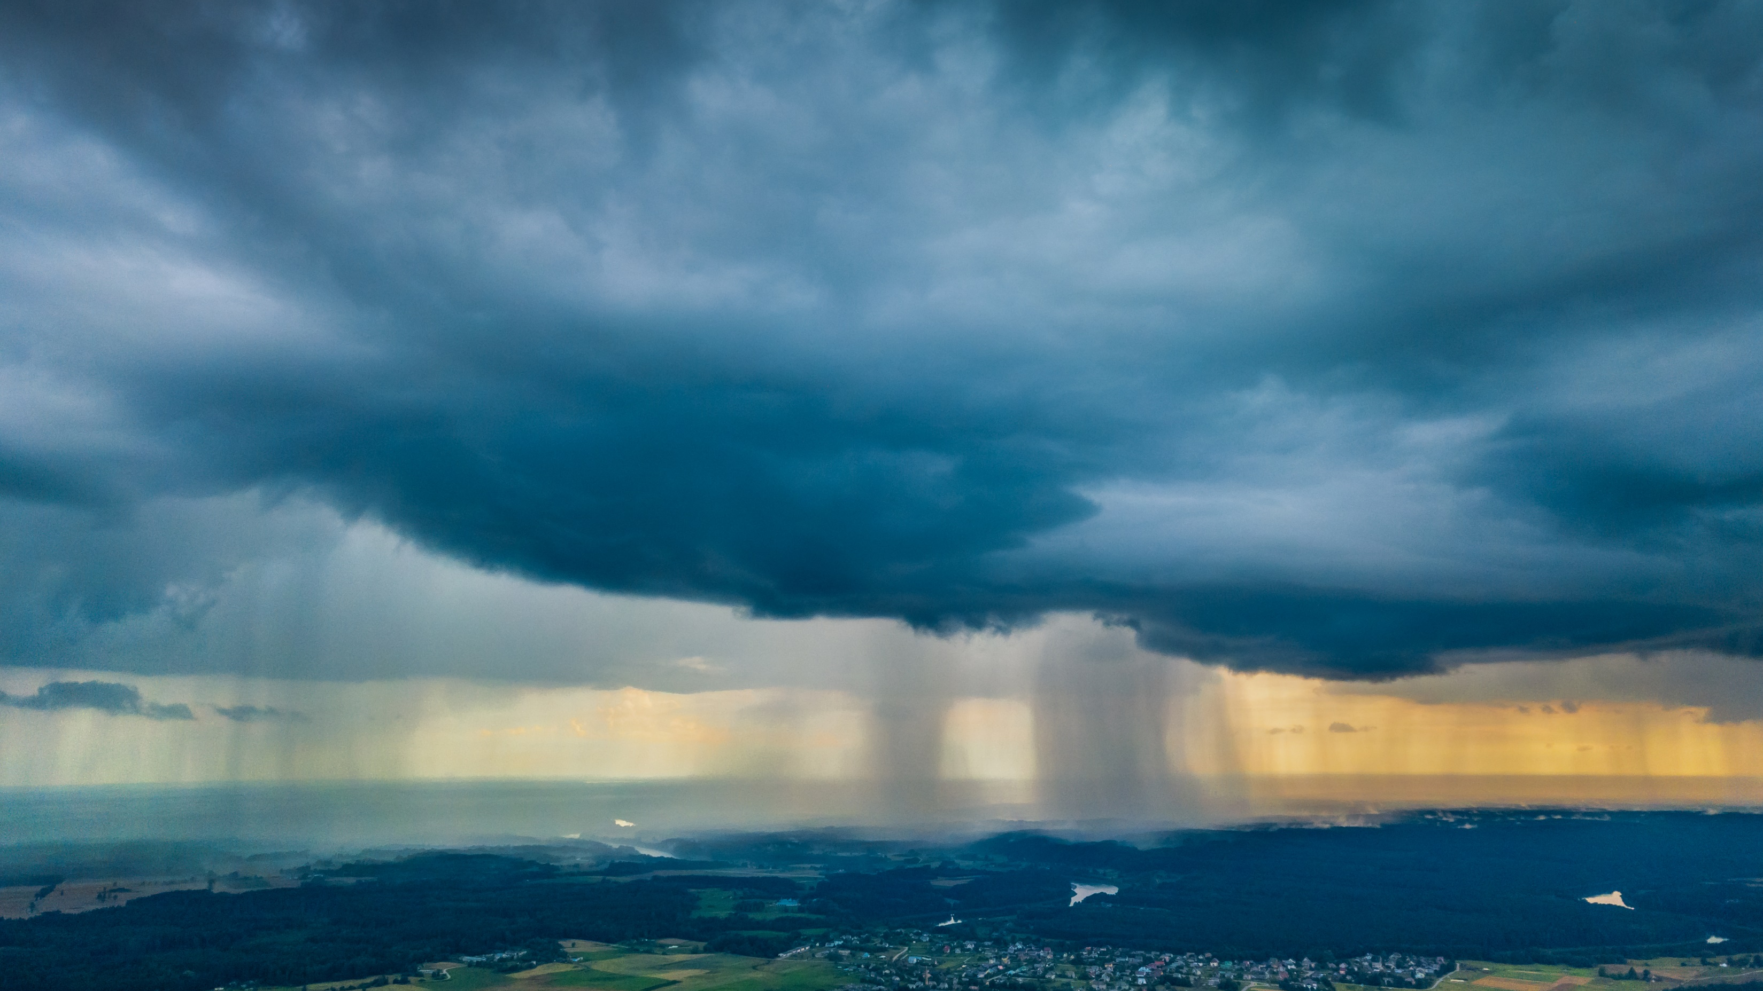
Developing high performance

Slide 6

Developing high performance
Build on existing infrastructure

Slide 7

Developing high performance
Build on existing infrastructure
Integration of data and systems

Slide 8

Developing high performance
Build on existing infrastructure
Integration of data and systems
Automatization

Slide 9

Developing high performance
Build on existing infrastructure
Integration of data and systems
Automatization
Human capacity building

Slide 10
Meteorological Infrastructure and Capability Development
MICD
The Vaisala solution

Slide 11








Vaisala Meteorological Infrastructure and Capability Development MICD
Holistic projects that aim to create large impact in a short period of time
Public & Private Users
Manager
Forecasts & Warnings
Network
Forecast Production
Observation System
System
Integrated modern infrastructure & systems
Human capacity building

Slide 12
MICD - Integrated modern infrastructure and systems
Automatized and integrated solutions
  Prevent value losses
  Easy to operate and maintain
  Optimize human resources
  Cost savings (Total Cost Ownership)
Reliable weather observations form the backbone of all further data processing
  Accuracy and representativeness matters
Data turns into value when it is processed
  Modern forecasting and service provision solutions
  Utilize all available data sources
  Create products for local needs
Integrated solutions for optimal management

Slide 13
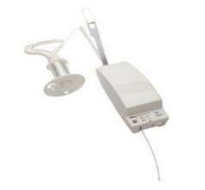
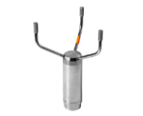

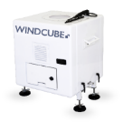
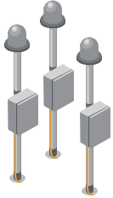

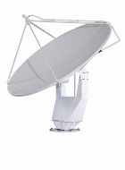

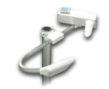

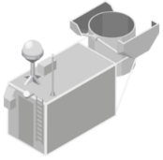
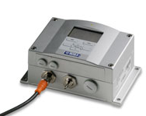


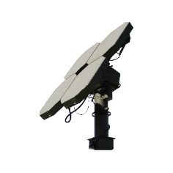


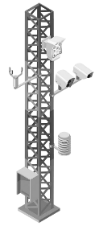

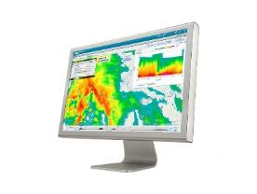
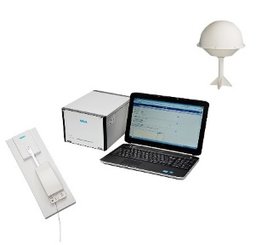
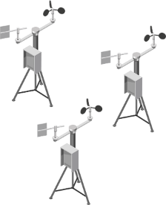
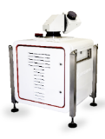
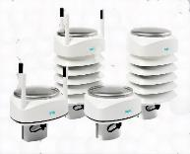
MICD - Observation network tailored to your needs:
Soundings
Pressure, wind, humidity, multiweather
Visibility, Present weather
Ceilometers
Remote wind measurement
Lightning sensors
Road and aviation weather systems
Weather radars
Air quality sensors
Technical solutions for all environments
Notes:
Vaisala brinda a sus clientes una amplia oferta de productos y servicios para una mejor toma de decisiones, mayor productividad y mayor seguridad y calidad.
Las tecnologías y soluciones de Vaisala ayudan a salvaguardar la vida y la propiedad, al tiempo que permiten la toma de decisiones críticas que facilitan operaciones productivas, eficientes y de alta calidad. El denominador común es que, al medir el entorno con precisión, nuestros clientes pueden tomar decisiones más confiables y garantizar operaciones más eficientes, seguras y sostenibles en cualquier área de aplicación.
Las tecnologías, los instrumentos y las soluciones de observación del tiempo de Vaisala, líderes en la industria, sientan las bases para la estrategia del área de negocios del tiempo y el medio ambiente, lo que permite a nuestros clientes mejorar su capacidad para medir y pronosticar el tiempo y los fenómenos meteorológicos.
Continuamos fortaleciendo nuestra posición como proveedor de productos de observación meteorológica líderes.
Impulsamos el éxito con grandes proyectos de creación de capacidad relacionados con el desarrollo de infraestructura climática.
Adoptamos la transformación digital y hacemos crecer nuestro negocio de sistemas de soporte de decisiones.
Desarrollamos nuevos negocios en mediciones ambientales.
Vaisala provides its customers with a wide offering of products and services for better decision-making, increased productivity, and improved safety and quality.
Vaisala’s technologies and solutions help safeguard life and property, while enabling critical decision-making that facilitates productive, efficient, and high-quality operations. The common denominator is that by measuring the environment accurately, our customers can make more reliable decisions and ensure more efficient, safer, and more sustainable operations in any application area.
Vaisala’s industry-leading weather observation technologies, instruments, and solutions lay the foundation for the Weather and Environment business area’s strategy, enabling our customers to improve their ability to measure and forecast weather and weather phenomena.
We continue to strengthen our position as the provider of leading weather observation products.
We drive success with large capacity building projects related to weather infrastructure development.
We embrace digital transformation and grow our decision support system business.
We develop new business in environmental measurements.

Slide 14
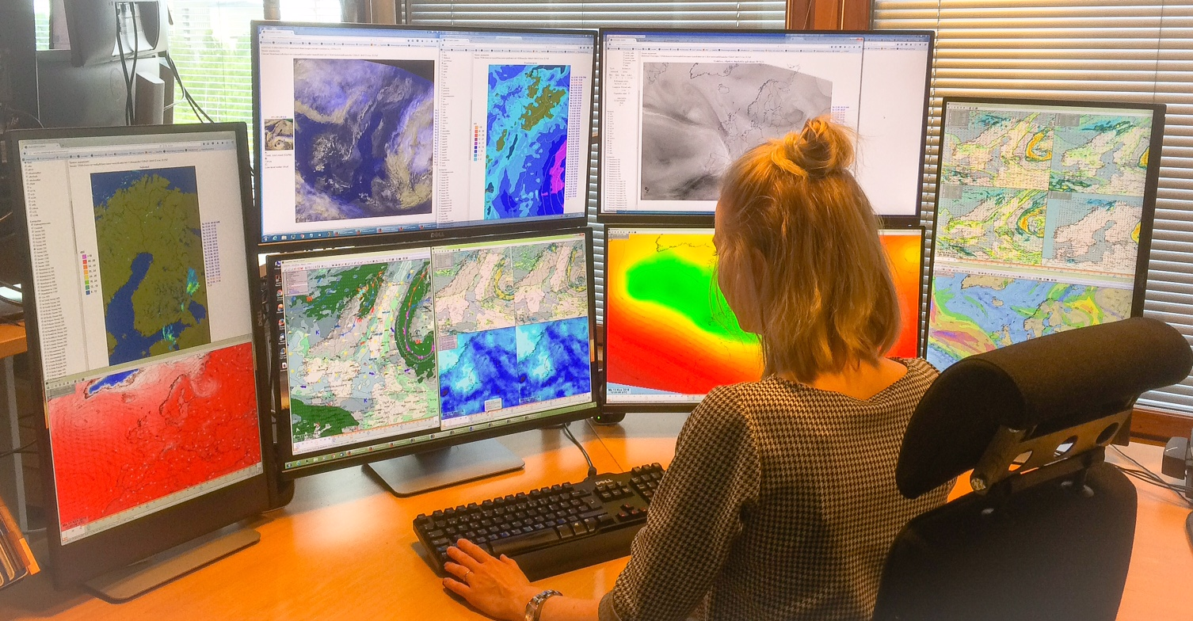
MICD– modern visualization and service creation
Centralized network management
State-of-the-art software for forecasting and EWS
  Integration of all available data sources
Partnering with world leading meteorological institutes
  The Finnish Meteorological Institute
Projects include creation of tailored end-user products

Slide 15
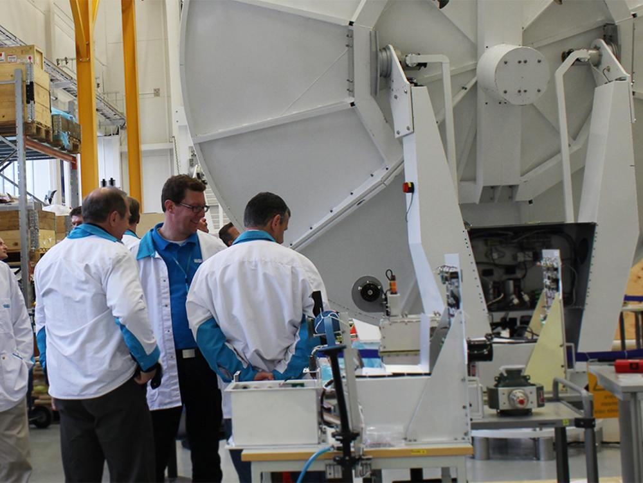
MICD– human capacity building
Large amount of training
  Technical and meteorological
  Customized levels and topics
  Permanent upgrade
Goal is to independently operate the solution and further develop services
Possibility of expert consultancy and training in e.g. meteorological service cost-recovery mechanisms

Slide 16
MICD – Project phases
PLANNING
EXECUTION
AFTER PROJECT
Scope is created in cooperation
  Tailored to fit your local needs
  Integration of existing infrastructure
Support in applying for funding for the investment
One prime contractor
  Seamless integration of systems
  Fast delivery with parallel installations and training throughout the delivery
  Quality guarantee
Overall responsibility
  Maintenance services
  Spare parts
  One warranty
  Centralized support

Slide 17
Reference projects

Slide 18
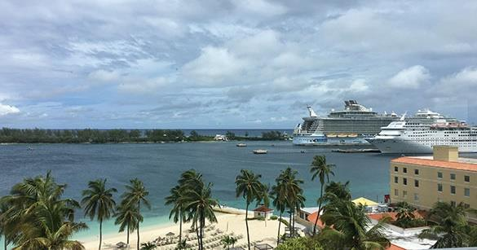
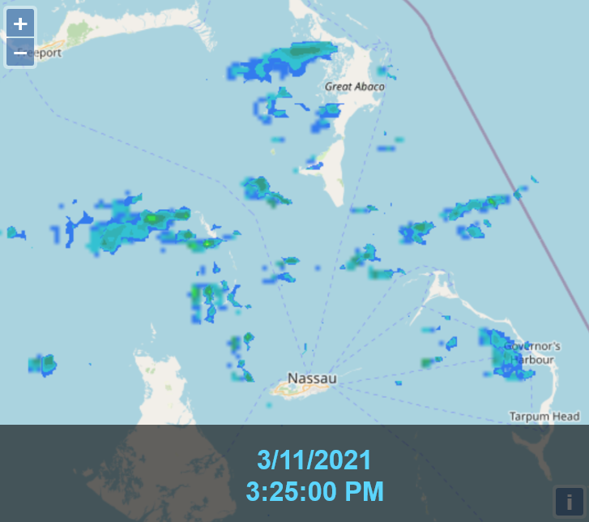
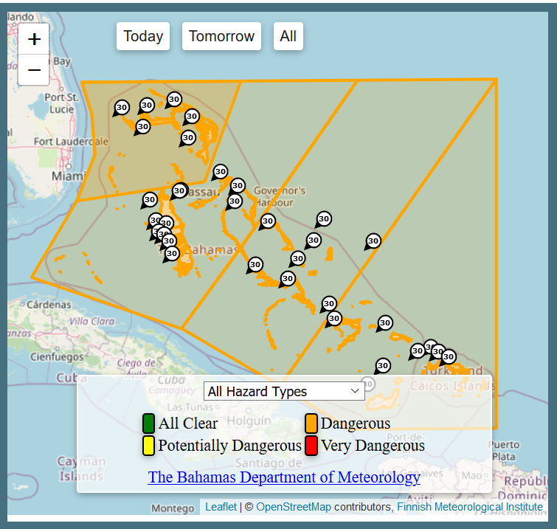
MICD - Reference Project: The Bahamas
SCALING UP
THE OBSERVATION NETWORK
INTEGRATED FORECASTING SYSTEM
CAPACITY BUILDING AND EXTENSIVE TRAINING
New weather radar and surface weather observation networks, airport AWOS systems and centralized network management
Forecast and service production system by the FMI
Meteorological
TV studio
Training program, warranty and maintenance services
RADAR MOSAIC
ALERT MAPS
Notes:
Scope
4 new Weather Radars
9 Airport AWOS Systems
16 Surface Weather Stations AWS
Centralized network management software NM10
SmartMet forecast and service production system
Alerting software
By the Finnish Meteorological Institute
Meteorological TV -studio
Training 100+ days
5 year warranty & maintenance

Slide 19
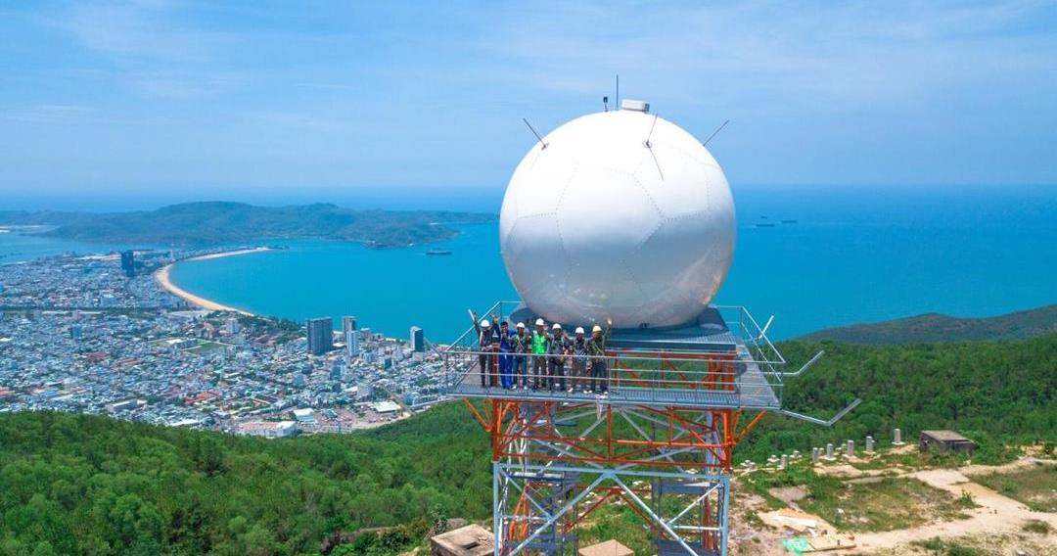
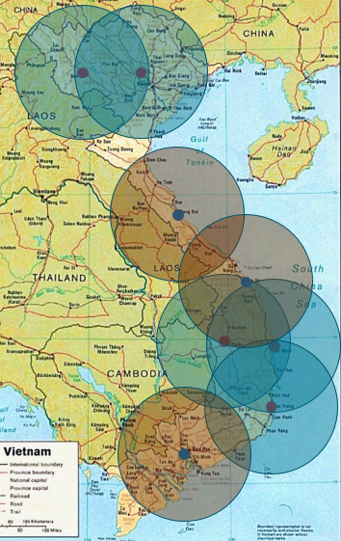
MICD - Reference Project: Vietnam
SCALING UP
THE OBSERVATION NETWORK
INTEGRATED FORECASTING SYSTEM
CAPACITY BUILDING AND EXTENSIVE TRAINING
New and renewed weather radar and lightning detection networks
Forecast and service production system by the FMI
Training program, warranty and maintenance services
Notes:
Scope
5 new Weather Radars
3 Weather Radar Upgrades
Lightning Detection Network
SmartMet forecast and service production system
By the Finnish Meteorological Institute
Training 235 days
1.5 year warranty & maintenance

Slide 20

Summary
Modernization efforts are needed on several fronts
  Integration and automatization for full efficiency
Holistic projects offer large impact in short amount of time
Common project goal is to upgrade permanently the national capability

Slide 21
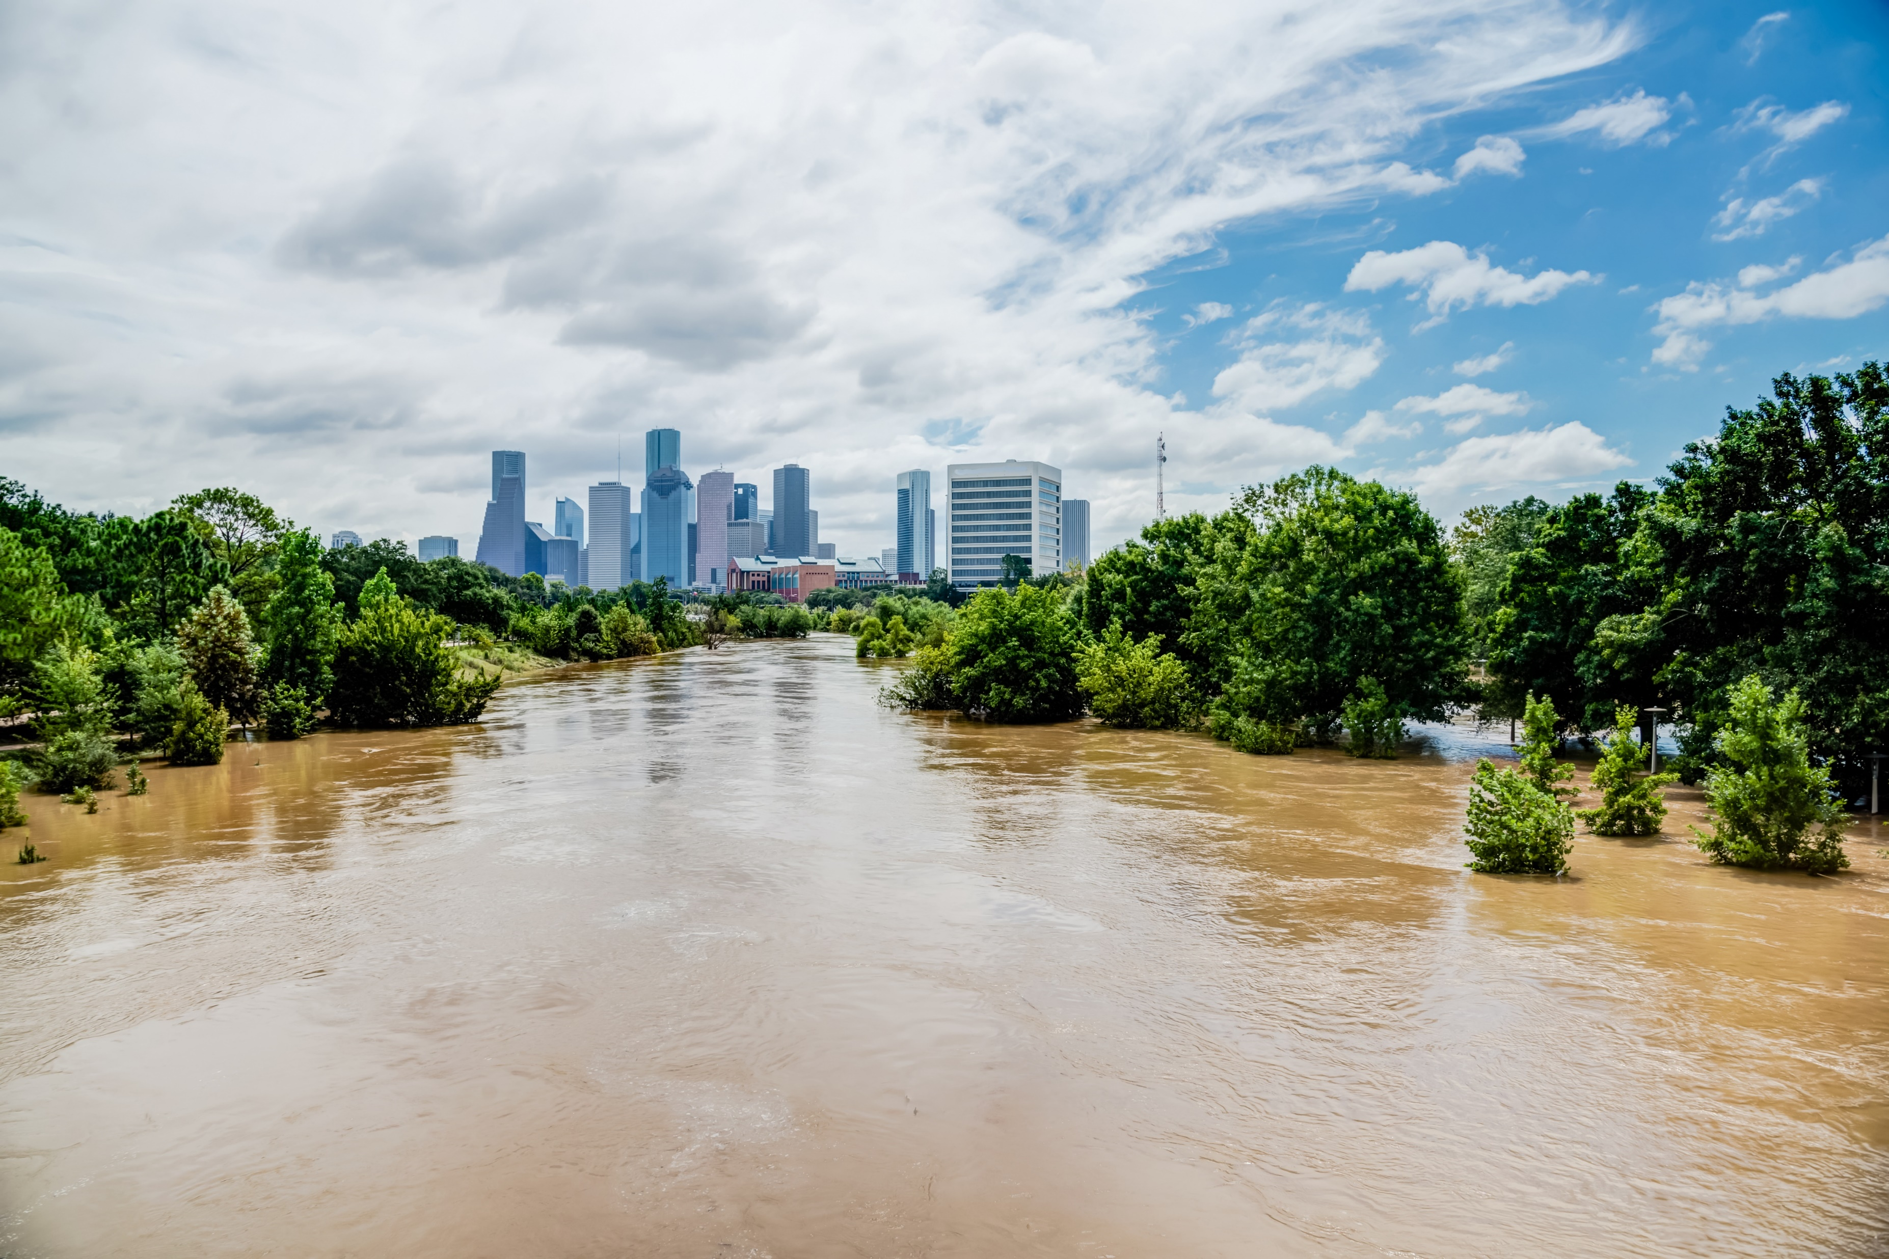
Interested in a similar project?
Please be in contact with our Vaisala team!

