Slide 1
INMET’s Public-Private Engagement
and Support to Agribusiness
Gustavo Luís de Souza Motta
National Institute of Meteorology (INMET), Brazil
Advisor to the Director and Head of International Affairs
World Meteorological Organization
21 July 2022, Cartagena de Indias, Colombia
HIGH-LEVEL REGIONAL FORUM OF THE
OPEN CONSULTATIVE PLATFORM IN REGIONAL ASSOCIATION III (RA III OCP-RF)

Slide 2
Status before 2021
Financial, budgetary and personnel problems hamper INMET's operations
Lack of integration of Brazilian meteorological agencies

Slide 3
New management of INMET from 2021
Financial and budgetary problems begin to be solved
Authorization for civil service examinations for recruitment and admission of new employees is in course
New strategic planning focused on INTEGRATION, PARTNERSHIPS AND INSURANCE/FINACIAL MARKET
Development of the National Meteorology Network (RNM)

Slide 4
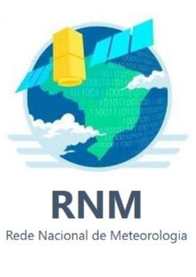
National Meteorology Network (RNM)
NATIONAL LEVEL
Meteorological observation networks
Meteorological data telecommunications networks
Meteorological products
Official meteorological database
Meteorological applications
Official meteorological disclosure
Weather warnings and alerts
Presidential Decree to be published soon
Attribution for proposing a bill to institute the National Meteorology Policy
NATIONAL LEVEL
Data processing and meteorological models
AMAZON AREA
Meteorological products
Meteorological applications
Official meteorological disclosure
Weather warnings and alerts

Slide 5
Meteorological Information System (SIM INMET)
The INMET database used to develop meteorological products to mitigate risks associated with climate change: Parametric Insurance and
Climate Risk Analysis
Leads to partnerships with
agricultural, insurance and tech companies
and the stock market

Slide 6
Generating value for meteorological information
Meteorological Data
Climate
Risk Analysis
Parametric Insurance (index-based)
Financial
Derivatives
Development of derivatives backed by insurance policies in which part of the income is destined to finance the meteorology infrastructure
Organized and information provided by INMET
Climatic factors that may affect the asset to be insured
A contract in which the claim is triggered according to the occurrence of pre-established weather conditions

Slide 7
Private Partnerships
Risk Analysis
Insurance
generating value for meteorological information

Slide 8
Agrometeorological Services
Agroclimatological Monthly Bulletin
Analysis of climatalogical conditions Brazil
Agroclimatological prognosis
Oceanic trends and conditions

Slide 9
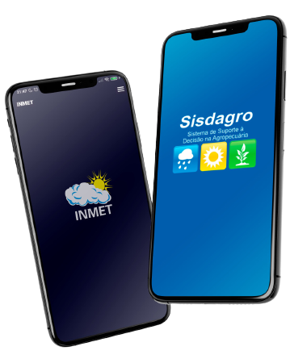
Agrometeorological Services
Decision Support System for Agriculture (SISDAGRO)
Support users of the agricultural sector in their decision-making
Tools for monitoring current agrometeorological conditions
Forecasts favorable conditions for the formation of frost

Slide 10
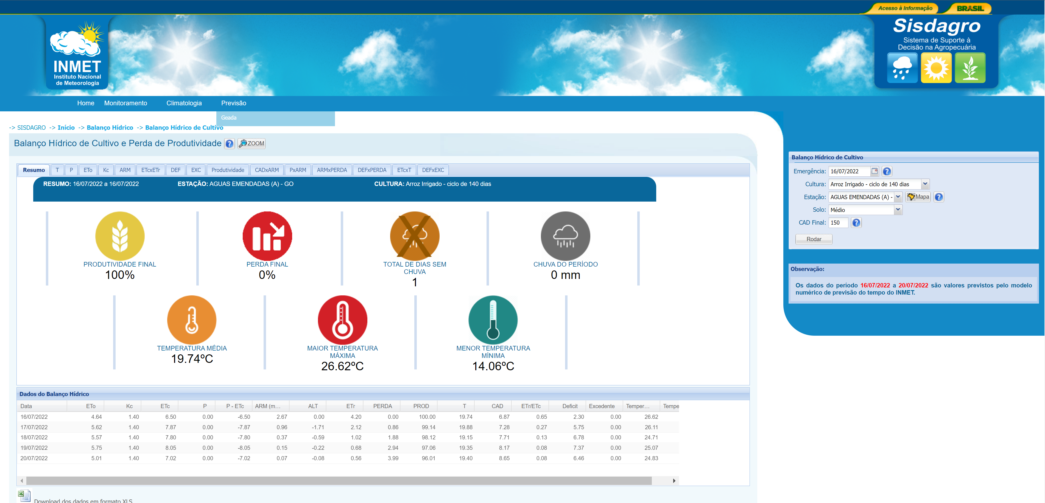
SISDAGRO

Slide 11
Gracias!
Thank You!

