Slide 1
EC-78 Side Event: Fifth High-Level Session of the Open Consultative Platform (OCP-HL-5)
Public-Private Engagement
for Sustainable Satellite Data Service
13 June 2024, Geneva, Switzerland

Slide 2
Introduction
The public sector has historically played a role as an entrepreneurial force in space market: today, the private sector is more and more active in the space market.
This has resulted in an increase in commercial opportunities produced from space.
We invited the public sector (space agencies) and commercial satellite companies to share their strategy and policy on engagement as well as collaboration models.

Slide 3
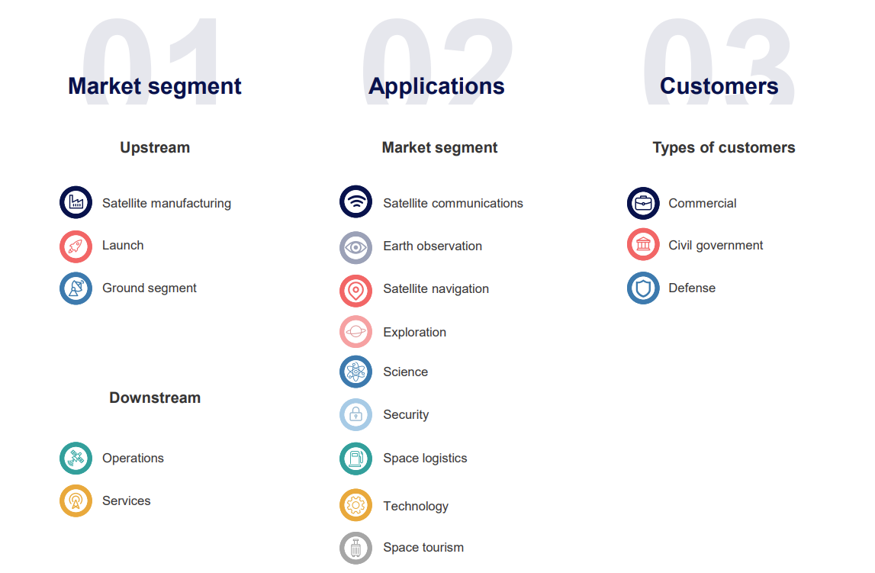
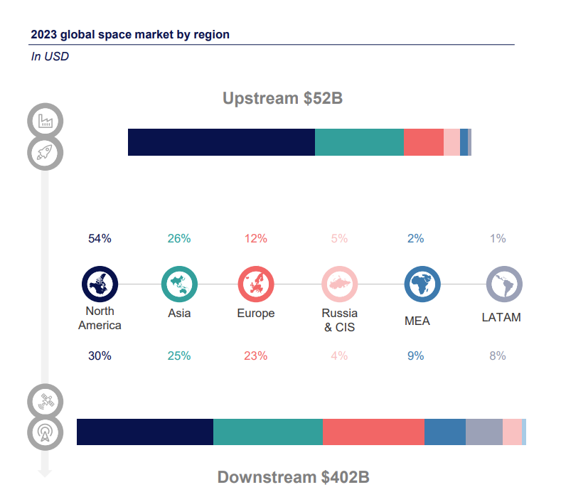
The Space Economy: Main Facts and Figures
Credit: Euroconsult Space Economy Report, 2023
Notes:
Revenues in the space market are essentially concentrated North America, Europe and Asia.

Slide 4
WMO Space Programme
The WMO Space Programme promotes availability and utilization of satellite data and products for weather, climate, water and related applications of WMO Members – in close relationship with the Coordination Group on Meteorological Satellites (CGMS, focus on operational missions) and Committee for Earth Observing Satellites (CEOS, all space agencies)
Integrated Space-based Observing System,
Availability and Use of Satellite Data and Products,
Capacity Building and User Engagement,
Space Weather Coordination,
Coordination for the use of radio frequency spectrum.

Slide 5
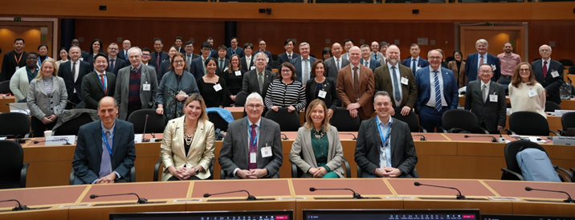
Consultative Meetings on High-Level Policy on Satellite Matters (CM-15)
The 15th Session of the Consultative Meetings on High-level Policy on Satellite Matters (CM-15) was held at WMO 6-7 February 2024
The role of the Consultative Meetings on High-level Policy on Satellite Matters is to facilitate a formal and substantive communication between leadership of space agencies and representatives of the World Meteorological Organization (WMO)
Six key topics were raised during the roundtable discussion, including coordinated Involvement of the Private Sector.
Support a three-way dialogue, with space agencies and the private sector, on commercial sector engagement related to space-based observing systems using the Open Consultative Platform;

Slide 6
PPE-related discussions within satellite community
Many dedicated programmes are flourishing at national and international level.
Motivations range from stimulating space economy and the competitiveness of national industry to the provision of novel products and services complementing the traditional “big” satellite missions.
PPP and anchor tenancy are the most common arrangements methods.
The use of commercial data are also being explored for scientific and operational applications, thus creating synergies between industry, academia and government.
CGMS Futures 2022+ Project: Relationship to the Private Sector
Relationship with the Private Sector theme is to leverage the opportunities of a rapidly growing commercial space sector while maintaining operational data standards and open data sharing
CEOS: New Space Task Team
The topic of “New Space” has been introduced in CEOS by the 2022-2023 CEOS Strategic Implementation Team (SIT) Chair

