Slide 1
HydroMeteorological
and Environmental
Industry Association
WMO OCP-HL-5 at EC-78
Sustainable Satellite Data Service
13 June 2024
Joshua Campbell | Chair of HMEI
2024 © HMEI
Notes:
HYDROMETEOROLOGICAL AND ENVIRONMENTAL INDUSTRY
HMEI GENERAL ASSEMBLY
Twenty fourth Session (HMEI GA-24) GENEVA, Palexpo 5 October 2023
Agenda item X (Name), Doc. X

Slide 2
HMEI – Introduction
HMEI seeks to build trust by aligning public, private, and academic capabilities through initiatives and resolutions that will empower WMO Members to carry out their duty to protect and enhance the lives and livelihoods of their citizens.
HMEI Vision:
Empowering the weather, water and environmental community, strengthening partnerships across public, private and academic sectors, protecting lives and enabling prosperity for all.
HMEI Mission:
We execute our Vision by facilitating open communication and close collaboration, helping implement standards, and fostering innovation that promotes sustainability.
2024 © HMEI - One Globe, One Industry, One Voice
Notes:
HYDROMETEOROLOGICAL AND ENVIRONMENTAL INDUSTRY
HMEI GENERAL ASSEMBLY
Twenty fourth Session (HMEI GA-24) GENEVA, Palexpo 5 October 2023
Agenda item X (Name), Doc. X

Slide 3
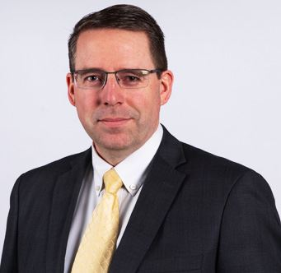
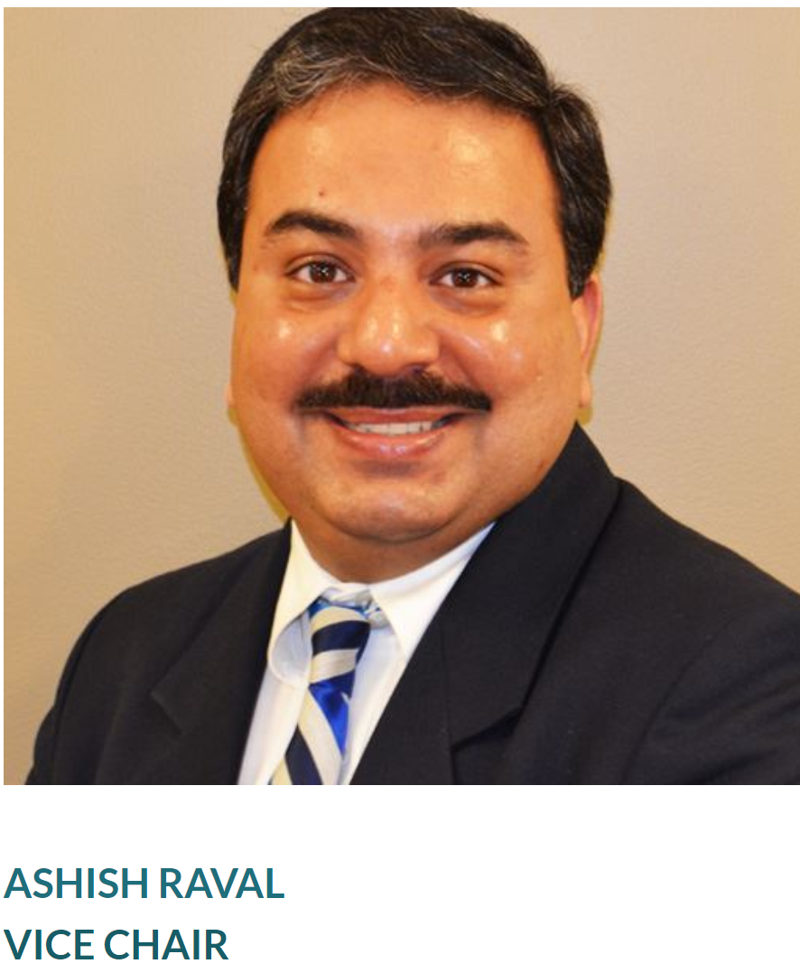
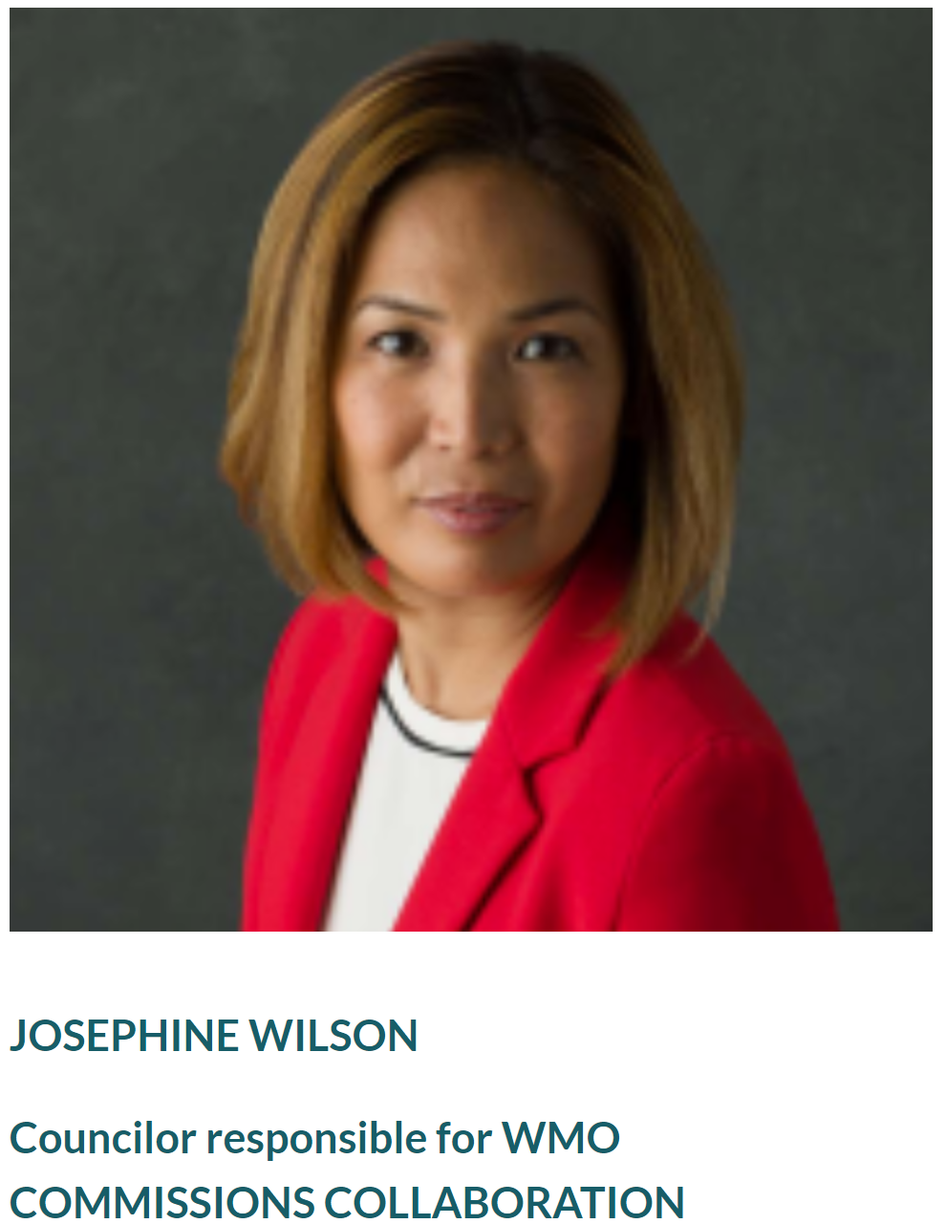
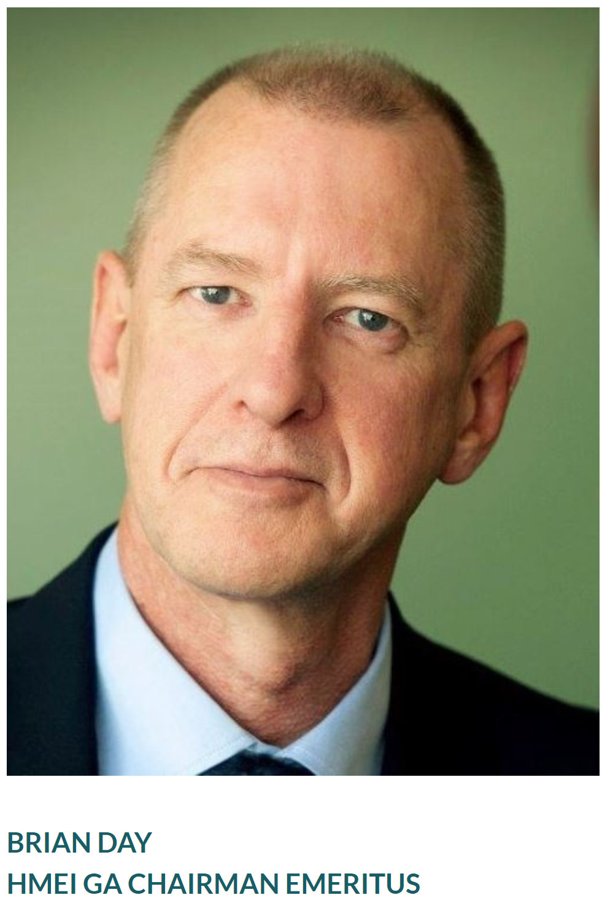
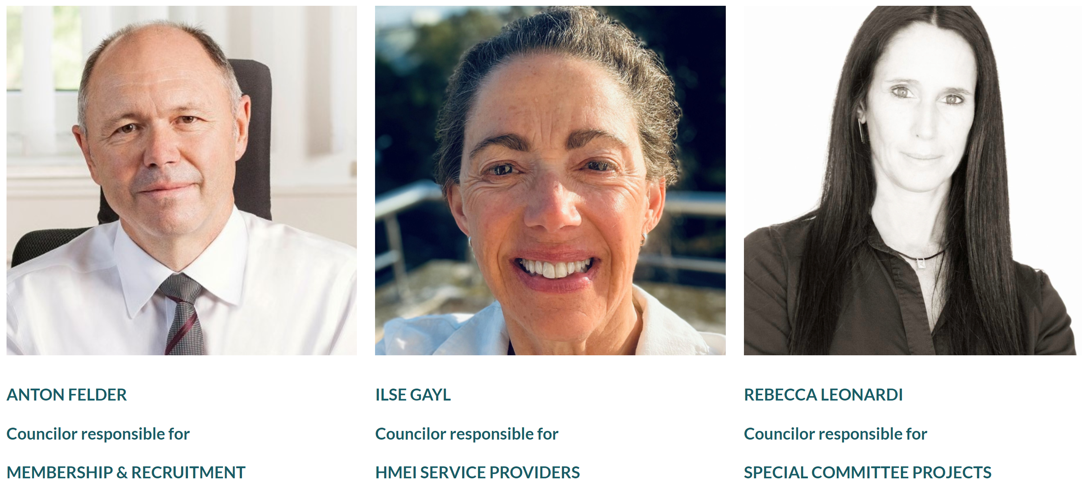
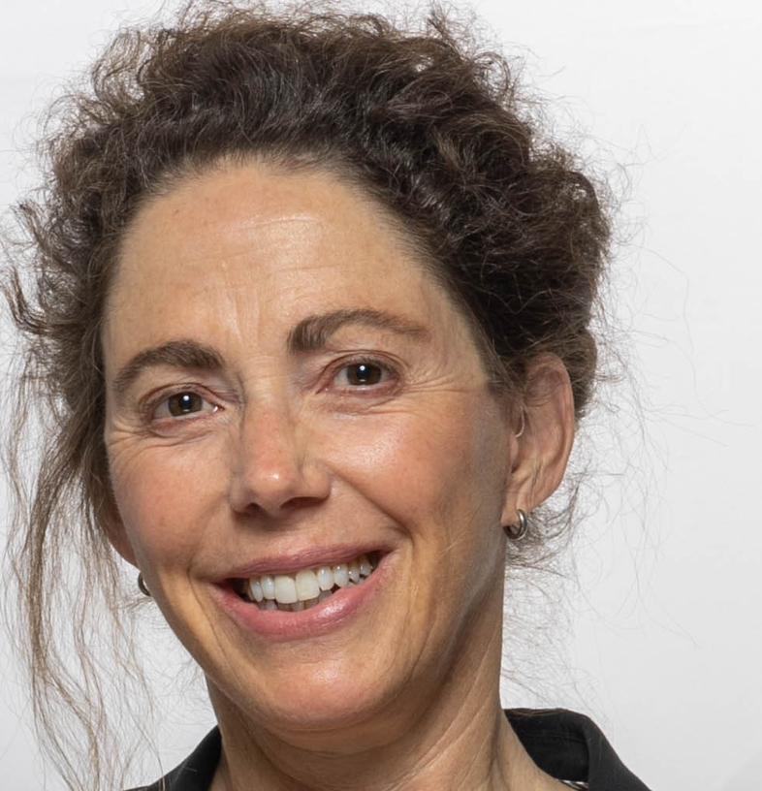
HMEI – Our Council
JOSHUA CAMPBELL CHAIR
Notes:
HYDROMETEOROLOGICAL AND ENVIRONMENTAL INDUSTRY
HMEI GENERAL ASSEMBLY
Twenty fourth Session (HMEI GA-24) GENEVA, Palexpo 5 October 2023
Agenda item X (Name), Doc. X

Slide 4
HMEI – Commitment
HMEI seeks to build trust as:
We Affirm and support the central role of NMHSs as the authoritative voice for public health and safety
We Share our technical expertise with, and learn from the WMO, WMO Members, and other international organizations to ensure policies are informed and implemented with the best science, innovation, and practices
We Engage with the WMO to align public, private, and academic initiatives that will empower WMO Members to achieve their objectives
2024 © HMEI
Notes:
HYDROMETEOROLOGICAL AND ENVIRONMENTAL INDUSTRY
HMEI GENERAL ASSEMBLY
Twenty fourth Session (HMEI GA-24) GENEVA, Palexpo 5 October 2023
Agenda item X (Name), Doc. X

Slide 5
Challenge 1 Changing Climate
Disaster Risk Management
Developing resilience
Forecast Accuracy
AWS Network 75%
Satellite 75%
Combined >95%

Slide 6
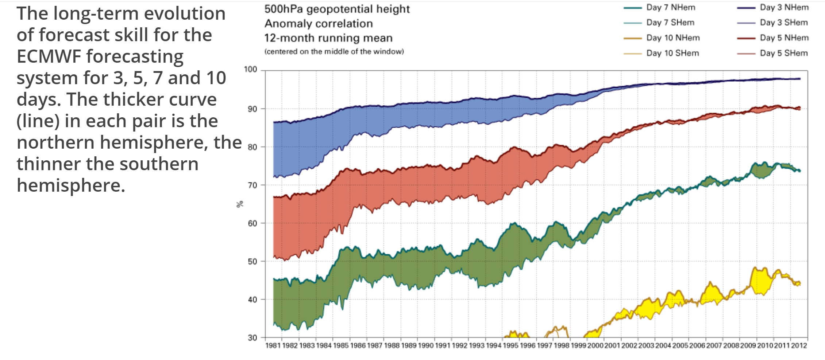
Percent
30 50 70 90
Forecast Improvements 1981 to 2012
3 day
5 day
7 day
10 day
1981 2012
Notes:
Improvements in data collection, more stations, better satellite and ocean data
Goal is to improve 7 and 10 day forecasts – so what is stopping us

Slide 7
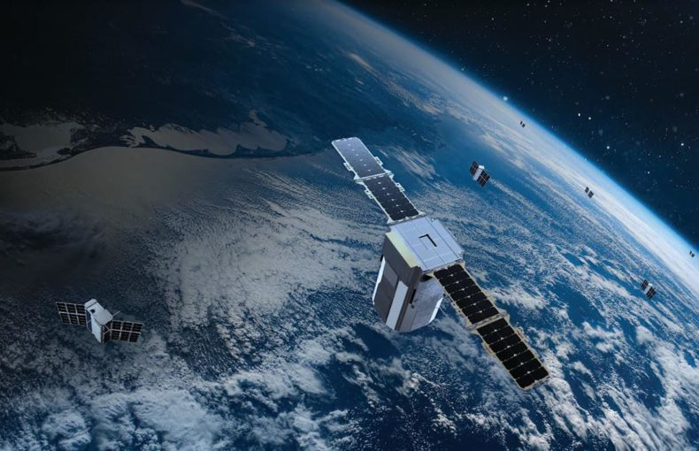
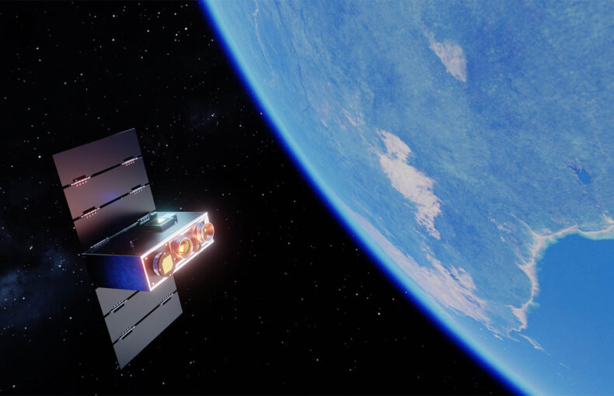
Challenge 2 Lack of Data Globally
Data Sharing
Data Holes

Slide 8
Important Initiatives – Unified Data Sharing Policy
Encourages Free and Open Exchange of Data amongst member nations
Unified Data Policy
SOFF
WMO
HMEI
GBON
Together, we forge policy and public-private relationships to advance our shared objectives
The Standards
How LDCs can fund network establishment and sustainable operations through data sharing
2024 © HMEI
Notes:
HYDROMETEOROLOGICAL AND ENVIRONMENTAL INDUSTRY
HMEI GENERAL ASSEMBLY
Twenty fourth Session (HMEI GA-24) GENEVA, Palexpo 5 October 2023
Agenda item X (Name), Doc. X

Slide 9
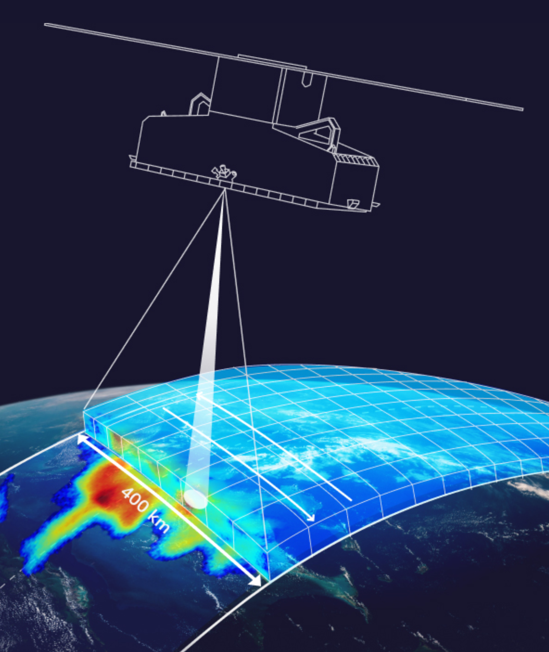
Important Initiatives – Unified Data Sahring Policy
Encourages Free and Open Exchange of Data amongst member nations
Unified Data Policy
Resolution 1 (Cg-Ext(2021))
Annex 3 – Guidelines on the application of the data policy in public-private engagement
2024 © HMEI
Notes:
HYDROMETEOROLOGICAL AND ENVIRONMENTAL INDUSTRY
HMEI GENERAL ASSEMBLY
Twenty fourth Session (HMEI GA-24) GENEVA, Palexpo 5 October 2023
Agenda item X (Name), Doc. X

Slide 10
Business Models
Traditional
Hybrid
Full Service
Public Owned
Public Owned
Private Owned
Public Operated
Private Operated
Private Operated
2024 © HMEI
Notes:
HYDROMETEOROLOGICAL AND ENVIRONMENTAL INDUSTRY
HMEI GENERAL ASSEMBLY
Twenty fourth Session (HMEI GA-24) GENEVA, Palexpo 5 October 2023
Agenda item X (Name), Doc. X

Slide 11
Business Models
Full Service
Private Owned
Private Operated
2024 © HMEI
Notes:
HYDROMETEOROLOGICAL AND ENVIRONMENTAL INDUSTRY
HMEI GENERAL ASSEMBLY
Twenty fourth Session (HMEI GA-24) GENEVA, Palexpo 5 October 2023
Agenda item X (Name), Doc. X

Slide 12
Business Models
Performance Acknowledged
Justifies Ongoing Budget or Modifications to the same
Budget Established
Report on Delivery
Public
Value Created
Value Delivered
Private
Investment Made
Payment Received
Revenue covers original investment and profit allows for new investment
Tax to help fund Public Services
2024 © HMEI
Notes:
HYDROMETEOROLOGICAL AND ENVIRONMENTAL INDUSTRY
HMEI GENERAL ASSEMBLY
Twenty fourth Session (HMEI GA-24) GENEVA, Palexpo 5 October 2023
Agenda item X (Name), Doc. X

Slide 13
The Focus
Budget Established
Report on Delivery
Public
Value Created
Value Delivered
Private
Investment Made
Payment Received
2024 © HMEI
Notes:
HYDROMETEOROLOGICAL AND ENVIRONMENTAL INDUSTRY
HMEI GENERAL ASSEMBLY
Twenty fourth Session (HMEI GA-24) GENEVA, Palexpo 5 October 2023
Agenda item X (Name), Doc. X

Slide 14
Desired Outcome
What can we can do, working together, to leverage the value we independently and jointly create, to the benefit of protecting lives and livelihoods of WMO Member Nations Citizens?
Public
Value Created
Value Delivered
Private
2024 © HMEI
Notes:
HYDROMETEOROLOGICAL AND ENVIRONMENTAL INDUSTRY
HMEI GENERAL ASSEMBLY
Twenty fourth Session (HMEI GA-24) GENEVA, Palexpo 5 October 2023
Agenda item X (Name), Doc. X

Slide 15
Thank You
HMEI Council
Joshua Campbell Ashish Raval
Chair Vice Chair
e: joshua@campbellsci.com e: ashish.raval@synopticdata.com
t: +1 435-227-9739 m: +1 703-737-3808
HMEI Secretariat
Dr. Alexander Karpov Ms. Corine Perreman
Executive Secretary Administrator
e: akarpov@hmei.org e: cperreman@hmei.org
t: +41 22 730 8334
2024 © HMEI
Notes:
HYDROMETEOROLOGICAL AND ENVIRONMENTAL INDUSTRY
HMEI GENERAL ASSEMBLY
Twenty fourth Session (HMEI GA-24) GENEVA, Palexpo 5 October 2023
Agenda item X (Name), Doc. X

