Slide 1
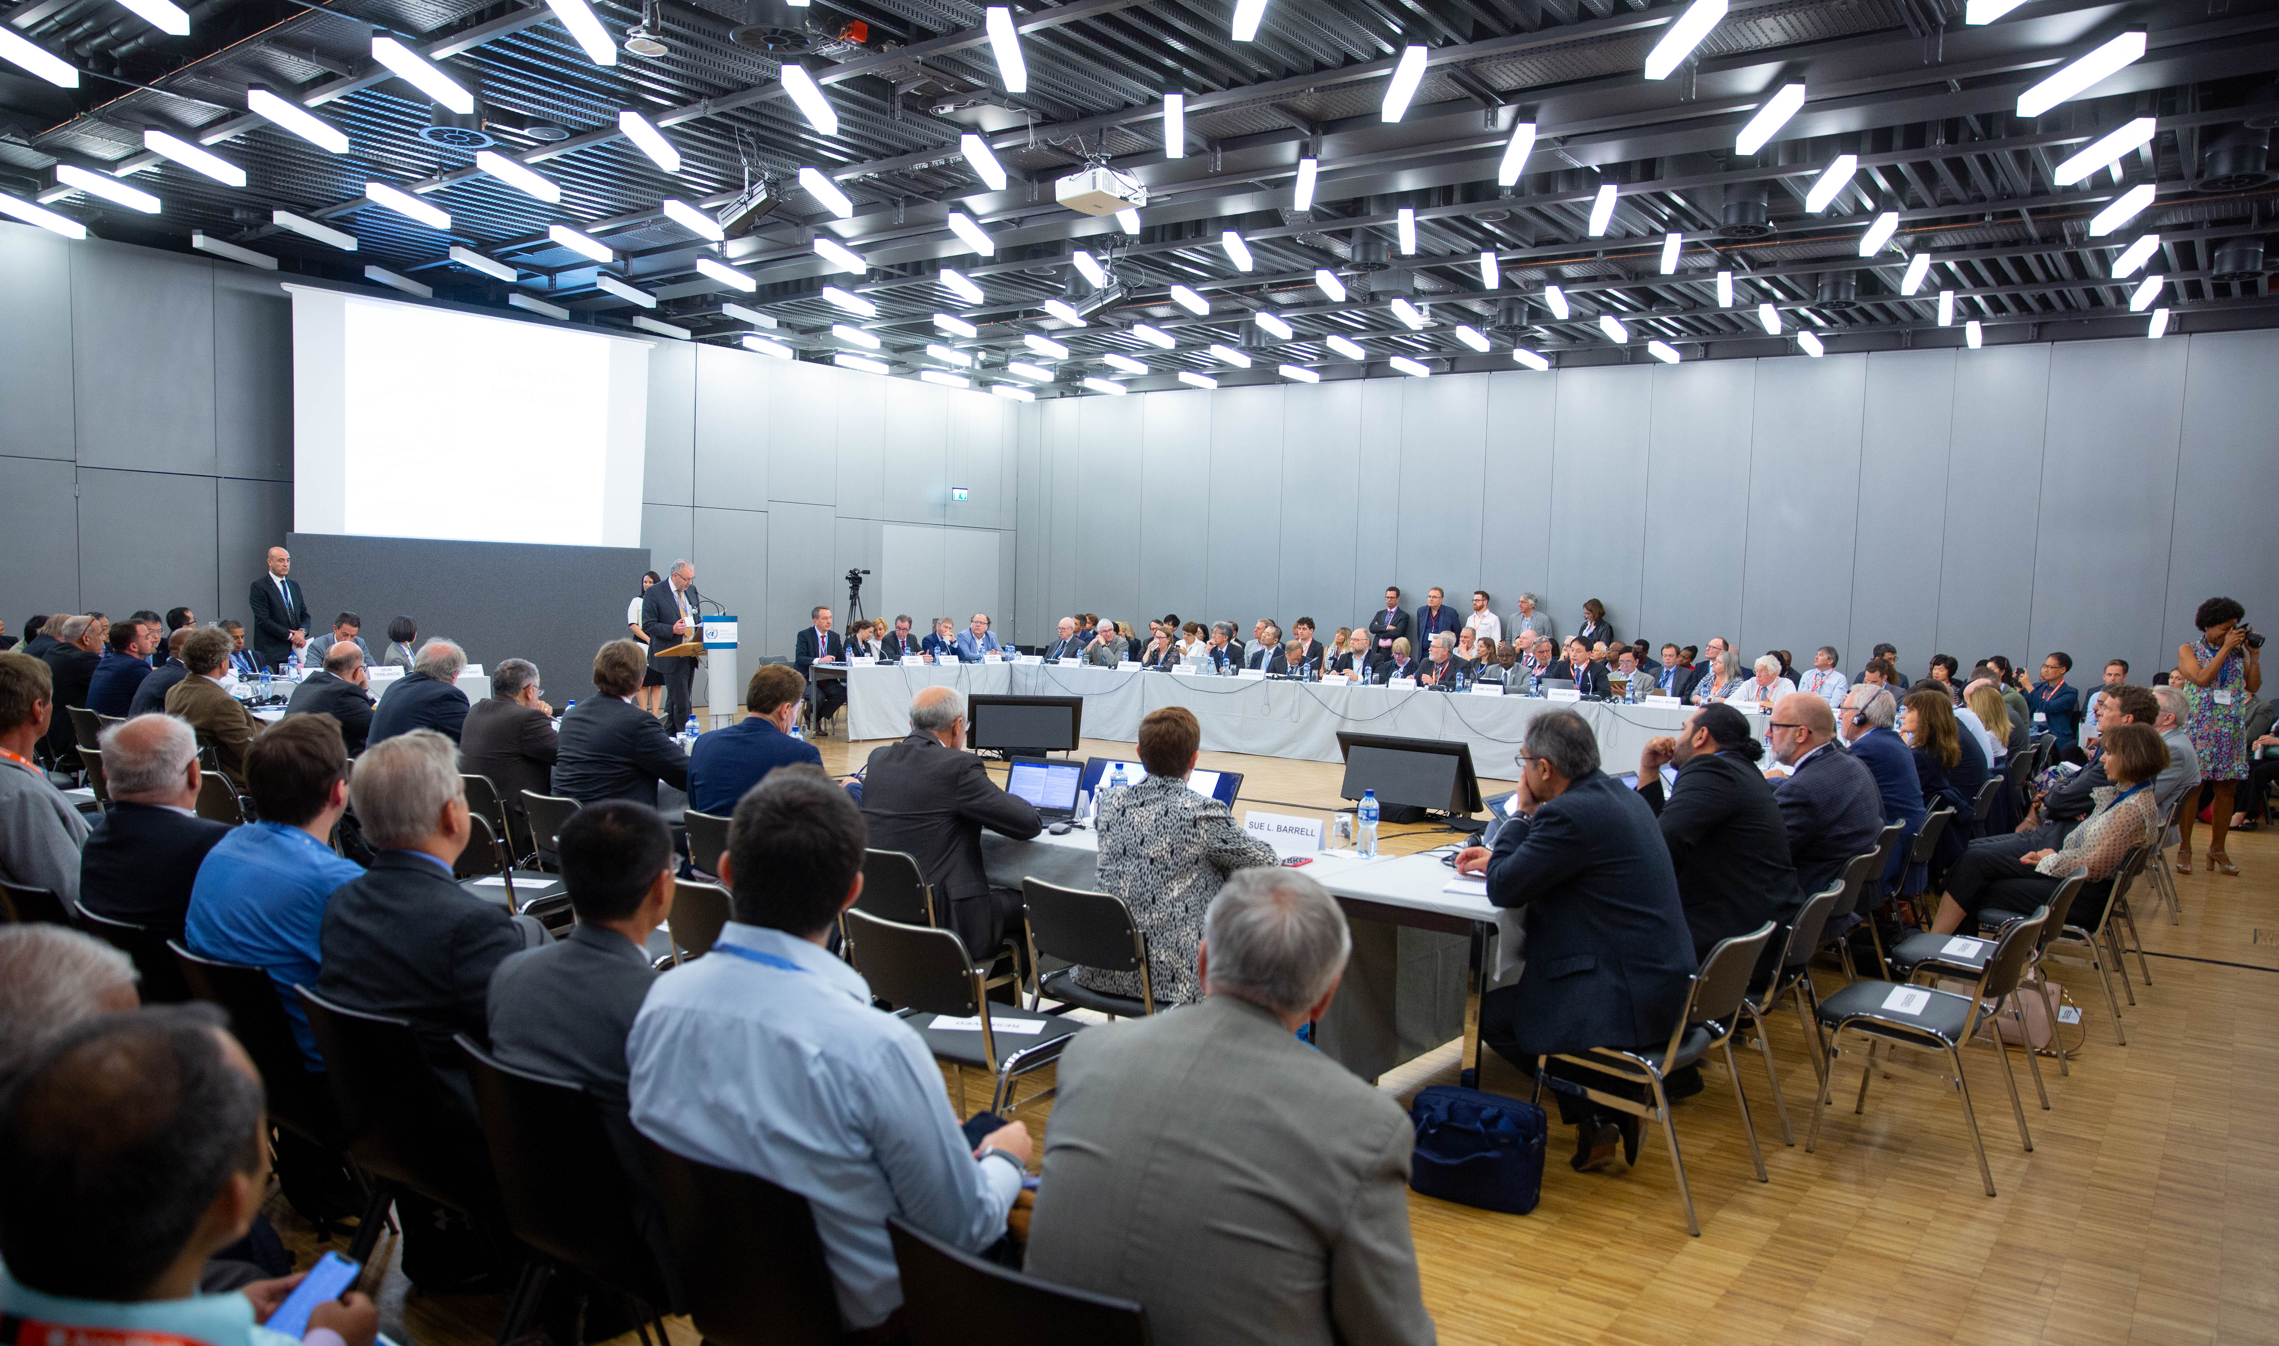
KEY MESSAGES
Theme:
Launch of the first OCP White Paper on Future of Weather and Climate Forecasting (vision 2030+)
The 2021-2030 decade: Exciting times ahead in Earth System modelling with significant improvements of the forecasts of all time scales “from minutes to seasons”
These improvements will be a major contribution to the common goal of building stronger resilience at all levels – from planetary to local
The OCP White Paper #1 “Future of Weather and Climate Forecasting” is offered as a tool to researchers, practitioners, planners and decision-makers – its key messages and recommendations could fit to various national or business scenarios

Slide 2
KEY MESSAGES
Theme:
Launch of the first OCP White Paper on Future of Weather and Climate Forecasting (vision 2030+)
Technology and research
Major technological developments in HPC, Cloud, AI/ML
More observations from satellites, private companies, IoT
Accelerated R-2-O and innovation
Aligned strategy for weather and climate models development
Partnerships are essential – a common view of all speakers
They should be strategic, built around a common goal
Motivational differences should not be an obstacle
Build more collaborative opportunities
Engage with users – co-design

Slide 3
KEY MESSAGES
Theme:
Launch of the first OCP White Paper on Future of Weather and Climate Forecasting (vision 2030+)
Investments
Advocate for sustainable and enhanced public investments in the backbone
Account for the NEWP advancements (current and expected) in the development assistance financing to raise effectiveness and sustainability
Leverage through PPE investments in all elements of the NEWP systems (OBS, HPC, …)
Evolving roles (link to the Day 2 topic)
Rethink “Who Does What” to optimize and develop best scenarios for each stakeholder
Consider the needed resources vs. existing resources, e.g., NMHSs and smaller stakeholders to focus on the best use of the ample amount of high-res global ensemble data
Open the door for more collaborative opportunities through PPE and other forms of engagement among the sectors

Slide 4
KEY MESSAGES
Theme:
Launch of the first OCP White Paper on Future of Weather and Climate Forecasting (vision 2030+)
No one left behind
Help less developed countries to maximize the benefits including through PPE
Enhance data sharing to get better products from the NEWP systems
Build capacity in downscaling ever improving NEWP products to significantly improve the services provided at national and local levels
Better engage scientists from developing countries in the NEWP development
WMO role
Continue to lead the international cooperation and promote multisector engagement through the OCP
Plan and develop further the GDPFS (supported by the GBON, WIGOS and WIS) as a backbone used by all stakeholders
Provide the needed guidance and methodology for quality assurance in the multi-stakeholder service delivery environment

