Slide 1
High-Level Regional Forum of the Open Consultative Platform
Regional Association IV
(North America, Central America, and the Caribbean)
HMEI Overview & Good Practices
Kingston, Jamaica – 8 February 2023
Jay Wilson
HMEI Councillor for WMO Commissions Collaboration
Director, Business Development & Sustainability, OTT Hydromet

Slide 2

HMEI – Association of Hydromet Industry
Who We Are | Our Core Values | EWS Gaps | Our Value Proposition | Contact Info
not-for-profit organization representing the interests of our 130+ members who are developers, manufacturers, and service providers
strive to advance technologies, standards, operational uses and sustainability of equipment, software, systems, and services supporting the weather, water and climate value chain
share the goals of development partners to improve human resilience and economic prosperity
seek to provide fit for purpose & sustainable solutions - software, communication, analytical services and equipment to our customers – in an ethical and collaborative way that fosters transparency and openness

Slide 3
HMEI – Association of Hydromet Industry
Who We Are | Our Core Values | EWS Gaps | Our Value Proposition | Contact Info
share our technical expertise¹ with WMO and other international organizations to ensure policies are informed by the best science and practice
affirm and support the central role of met services as the single authoritative voice for weather alerts - public health and safety
support all aspects of the global weather enterprise and seek to bolster the government and academic organizations at its core
believe private sector engagement is an effective strategy to improve the quality and sustainability of hydromet services and can help close budgetary, technical and human resource gaps in national public institutions
¹ Publications with WMO & World Bank - Generic Automatic Weather Station (AWS) Tender Specifications; Charting a Course for Sustainable Hydrological and Meteorological Observation Networks in Developing Countries
Notes:
HMEI members affirm and support the central role of met services as the single authoritative voice for weather alerts, especially when it pertains to public health and safety

Slide 4

Who We Are | Our Core Values | EWS Gaps | Our Value Proposition | Contact Info
PPE Good Practice
A Public Benefit Corporation committed to providing expanded access to environmental data to enhance public safety, improve the productivity of government agencies and commercial entities, and assist in research and educational initiatives to advance the understanding of Earth systems
PROJECT: National Mesonet Program (NMP)
48 Partners: Private companies, State mesonets, Academic research organizations
Data type: aircraft data, boundary layer observations, nationwide surface data
Data use: NWP, short-term forecast modifications, situational awareness, post-event analysis
BENEFITS
Cost efficient: data costs less than if the federal government builds own observing capability
Fill gaps in federal observing capabilities
Structured data rights
Data prices driven by market demand
Incentivize commercial providers to field systems and provide data where gaps exist (e.g., where greatest forecast error originates in global NWP)
… a model for effective Public-Private Partnership as it integrates state, local, and private sector assets
at a fraction of the cost of deploying and sustaining additional federal assets

Slide 5

Who We Are | Our Core Values | EWS Gaps | Our Value Proposition | Contact Info
PPE Good Practice
A global weather risk solutions company that provides weather and natural peril risk mitigation products and services to individuals, organizations, cities, and nations world-wide, that have the greatest potential of falling victim to climate-related disasters
GOALS:
Create an alternative source of renewable energy
Export 70% solar energy and 30% in-country use
Reach 3.3 Million household through off-grid connections by 2025
ACTIVITIES:
Build the-state-of-the art PV panel factory
Supply soIar photovoltaic panels and solar lanterns for household levels, schools, health centers and for irrigation in rural areas where electricity is not available
BENEFITS
Generate revenue (local and foreign currency for the institution)
Bring about technology transfer in the country in the field of solar photovoltaic
Create job opportunities and entrepreneurs in the field
Build compound where staff and their families can live and eat

Slide 6
Who We Are | Our Core Values | EWS Gaps | Our Value Proposition | Contact Info
Potential Activities with HMEI Members
Co-development of innovative tools / solutions / end-user services
Knowledge sharing sessions (exchange of good practices and challenges & share new solutions and technologies)
Collaborate with development partners to pilot a PPP - potentially through SOFF to ensure GBON compliance
Support implementation and operation of systems and services, & data management at country level
Internships / Fellowships at HMEI Member Companies
Co-develop sales and marketing schemes with revenue sharing for cost recovery to sustain the observation system and services

Slide 7
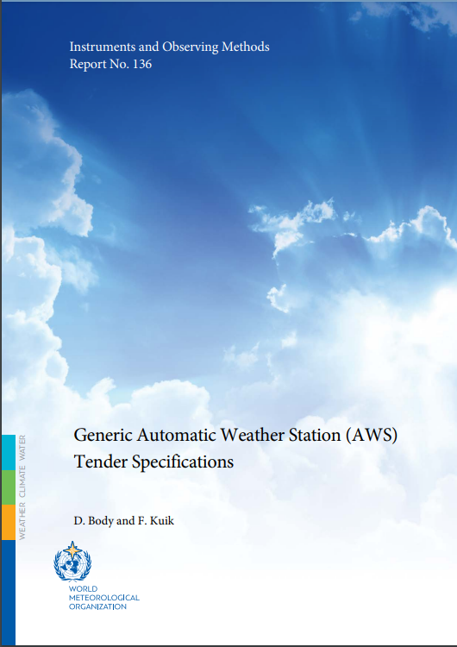
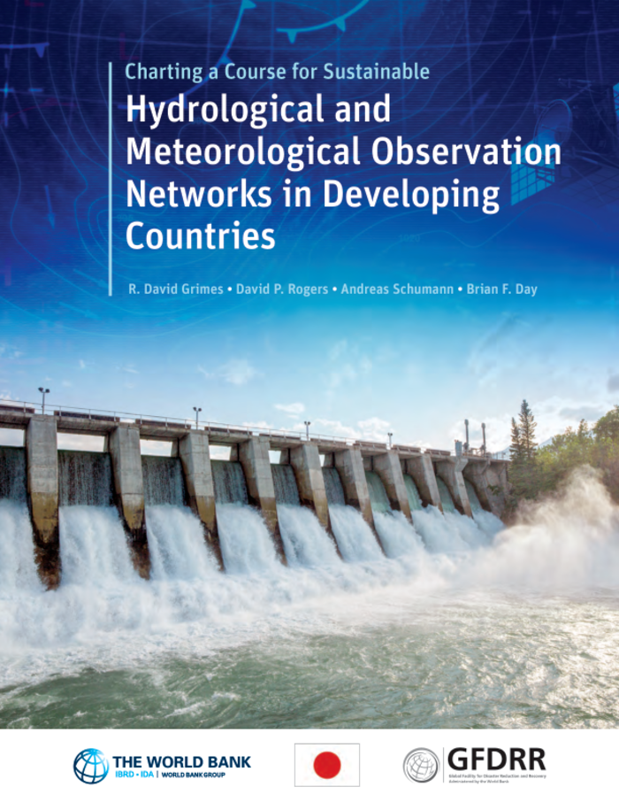
Who We Are | Our Core Values | EWS Gaps | Our Value Proposition | Contact Info
HMEI Councillor for WMO Commissions Collaboration
Ms. Jay Wilson
e: josephine.wilson@otthydromet.com
m: +41 79 617 9919
HMEI Secretariat
Dr. Alexander Karpov Ms. Corine Perreman
Executive Secretary Administrator
e: akarpov@hmei.org e: cperreman@hmei.org
t: +41 22 730 8334
Publications
Generic Automatic Weather Station (AWS) Tender Specifications
IOM-136
Charting a Course for Sustainable Hydrological and Meteorological Observation Networks in Developing Countries
Link to doc

