Slide 1
GCF’s Investments in
Climate Information and Early Warning Systems
Joseph D. Intsiful (PhD)
Senior Climate Information and Early Warning Systems Specialist
Green Climate Fund
February 2023
Notes:
Excellencies, distinguished invited guests, ladies and gentlemen.
My name is Hong-Thuy Paterson, the Chief Financial Officer / Chief Operating Officer of the Green Climate Fund or GCF.
I bring you warm greetings.
My presentation will focus on GCF’s Investments in Climate Information and Early Warning Systems.

Slide 2





GCF overview
First Board meeting
First projects approved
209 projects approved, USD 11.4b committed
2010
2012
2014
2015
2019
2023
Established by 194 countries
(UNFCCC COP16)
USD 10b+ pledges Mobilised
USD 9.8b new pledges
An operating entity of the UNFCCC fostering a paradigm shift to low-emission and climate-resilient development pathways in developing countries
Notes:
The GCF Journey (Overview):
Established in 2010 by 194 countries during UNFCCC COP16
GCF is an operating entity of the UNFCCC fostering a paradigm shift to low-emission and climate-resilient development pathways in developing countries.
First Board meeting was held in 2012
USD 10b+ pledges Mobilised in 2014
First projects approved in 2015
USD 9.8b new pledges in 2019
200 projects approved, USD 10.8b committed in 2022

Slide 3
Challenges provide opportunity for GCF’s Impact
Growing demand far exceeds supply – EW4A,NDCs, NAPs, National Plans
Climate information and early warning services have market potential for unlocking private sector investments and participation
Growing commitment across global, continental and national scales – Paris Agreement, Sendai Framework, UNSG Call for Action
Unique opportunity to enhance coherence and complementarity of investments
Leveraging private sector finance, public budgets and public-private partnerships

Slide 4
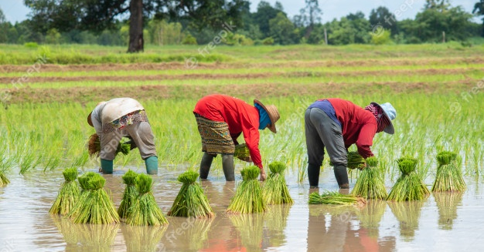
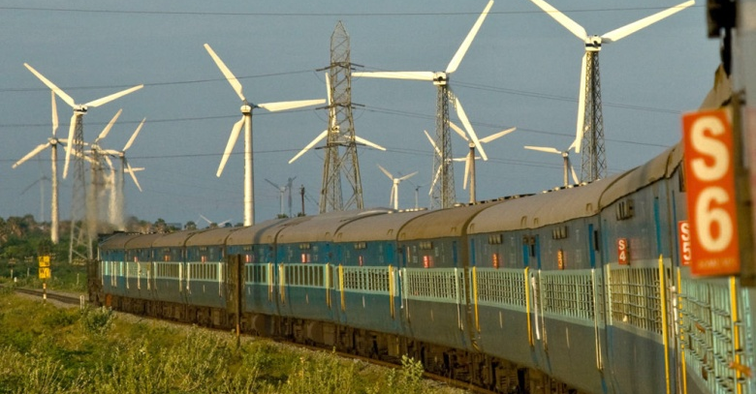
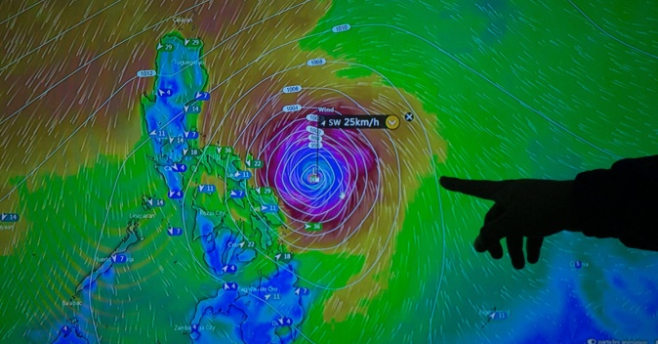
Opportunity for GCF’s Impact (cont)
Growing demand for GCF to support CIEWS
  USD 650 mil in CIEWS and active pipeline of USD 1.5 bil
  Asia Pacific 47.84%, Africa 42.21%; Latin America & Caribbean USD 7.87%, Eastern Europe 2%.
  21 % for modernising hydromet (generation of CIEWS)
  79% for sector applications (use of CIEWS)
Paradigm shift achieved through:
  systematic investment in CIEWS value chain
  incentivising use of CIEWS for investments and analytics
  supporting long term planning and preparedness
  promoting low emission and climate resilient development
Without GCF support, the majority of developing countries will not be able to establish fit-for-purpose CIEWS

Slide 5
Framework for Paradigm-Shifting Pathways
  PATHWAY 2
  Impact-Based Multi-Hazard Early Warning Systems and Early Action (short to medium term risks)
  DESIRED TRANSFORMATION
  Investments for both adaptation and mitigation
  Reliable CIS and Impact-Based MHEWS supporting well-informed, science-based decision-making
PATHWAY 1
Climate Information Services
Modernisation of hydromet services
Regional hydromet programs
Creation of relevant, science-based information
  PATHWAY 3
  CIEWS for infrastructure design and resilience financing

Slide 6
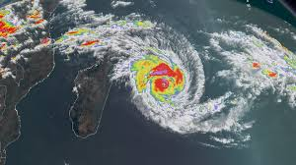
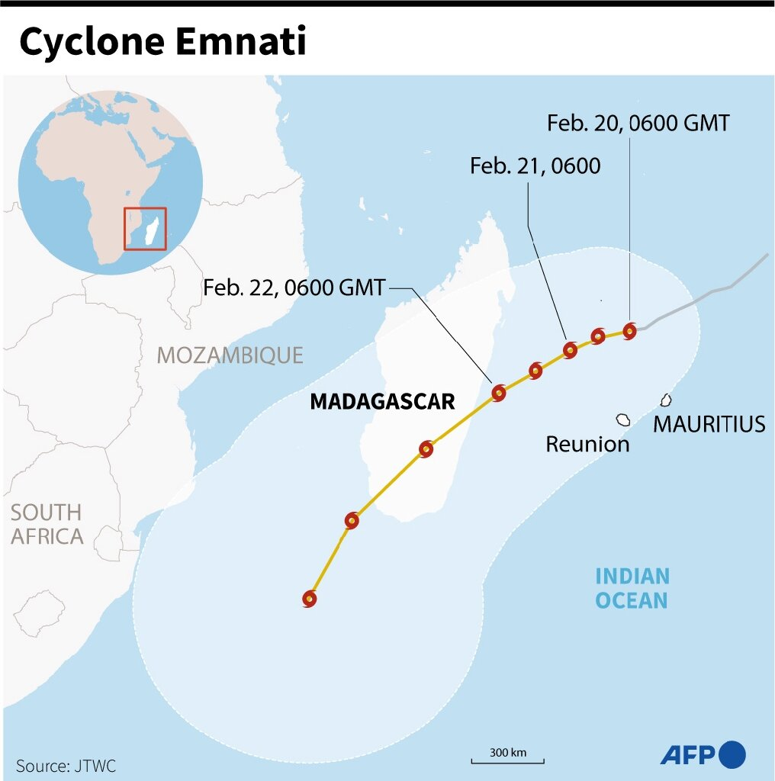
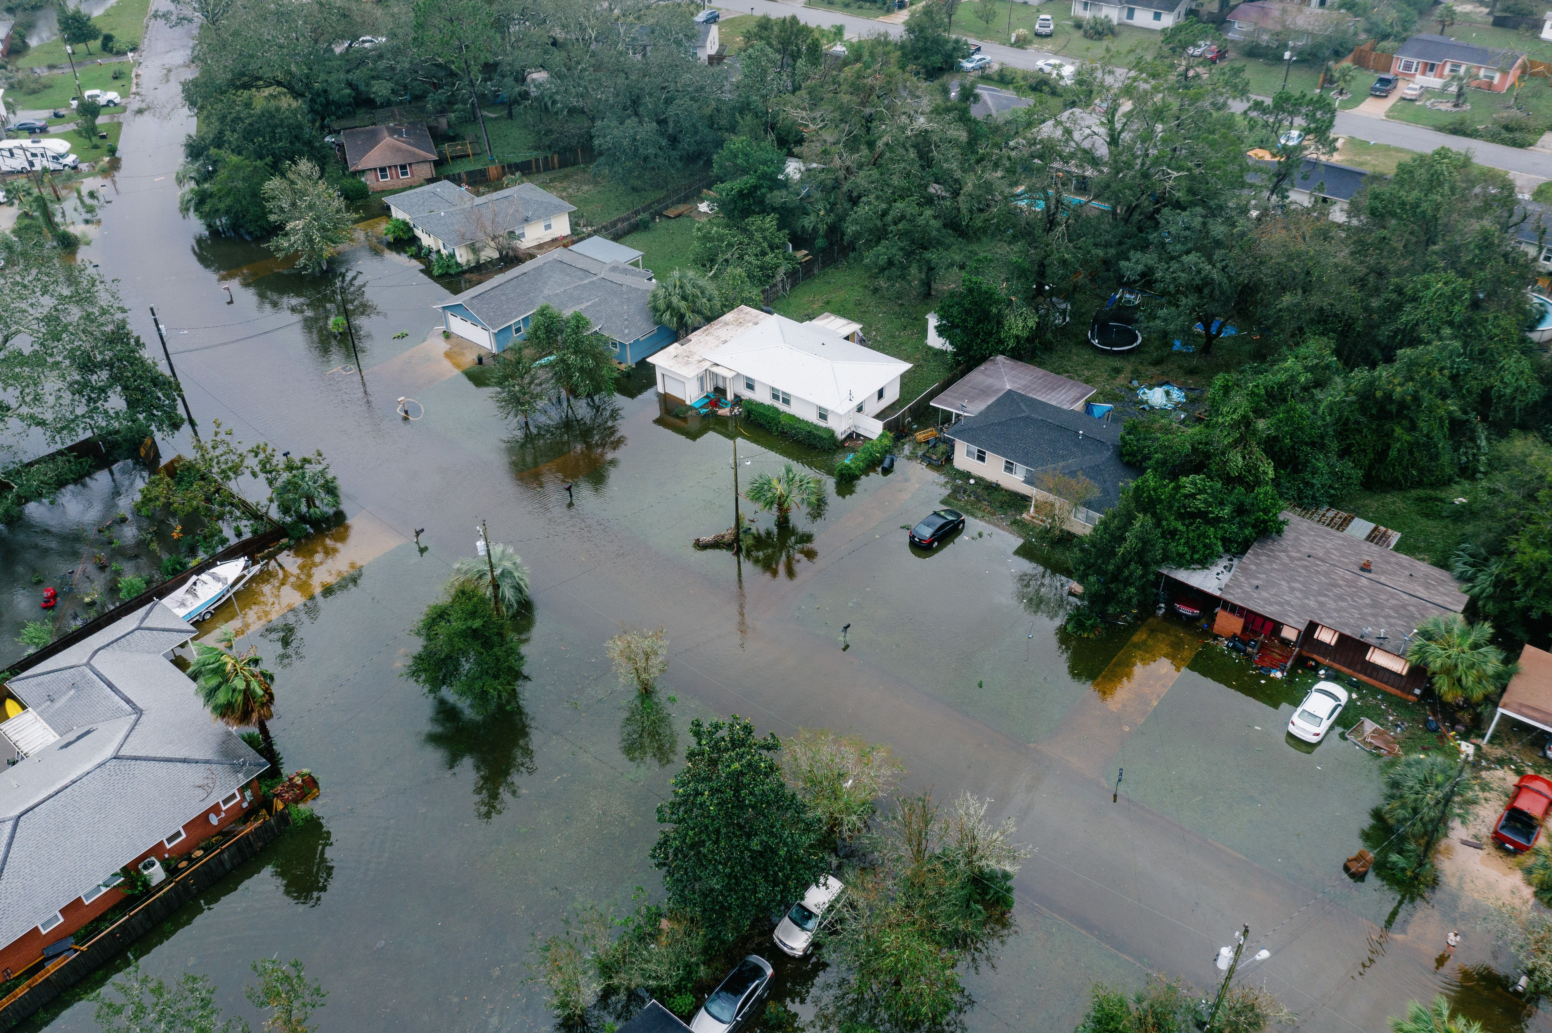
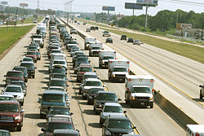
Application of the three paradigm-shifting pathways in tropical cyclone and storm intervention
Weather and climate extremes
Weather translation to hazards
impact and disaster risk estimation
Risk reduction scenarios
Climate data, analysis and forecasts
Extraction of weather information to predict hazards
Placing into situational context: disaster risk, hazard, exposure and vulnerability
Mitigation and prevention, preparedness, response and recovery strategies
Tropical cyclone track, scale and intensity
Storm surge, flooding, inundated areas and strong wind
Affected population and infrastructure, disruption of services, damages due to wind and water
Implementation of evacuation and recovery plans
Climate services (pathway 1)
Multi-hazard early warning systems (pathway 2)
Disaster risk reduction (pathway 3)

Slide 7





How we work
A RANGE OF FINANCING INSTRUMENTS
Grants, Equity, Guarantees & Loans
leverage blended finance
Piloting support for new financial structures
SAP, PPF, EDA, PAP
COUNTRY-DRIVEN
A RANGE OF FINANCING INSTRUMENTS
RISK-TAKING, PATIENT CAPITAL
COUNTRY-DRIVEN
Readiness programme supports country planning
GCF programming is aligned with country priorities
RISK-TAKING, PATIENT CAPITAL
accept higher risks to support early-stage project development & innovations to catalyse climate finance
AN OPEN, PARTNERSHIP ORGANISATION
BALANCED ALLOCATION
AN OPEN, PARTNERSHIP ORGANISATION
over 200 Accredited Entities and delivery partners
BALANCED ALLOCATION
targeting 50:50 allocation between mitigation & adaptation
Notes:
GCF has several unique features that allow it to be the main global fund for climate finance.

Slide 8
GCF Performance Metrics

Slide 10


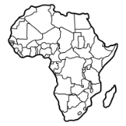

GCF investments in CIEWS
To date, GCF funding committed to 56 CIEWS projects amounts to USD 650 million
The distribution varies across regions and country groupings. Asia Pacific 47.84%, Africa 42.21%; Latin America & Caribbean USD 7.87%, Eastern Europe 2%.
International entities continue to dominate the CIEWS portfolio, receiving about 92.13% of total GCF resources.
100 % of CIEWS projects are for public sector
Notes:
To date 56 approved projects worth at least USD648M. This consist of Asia Pacific 47.84%, Africa 42.21%; Latin America & Caribbean USD 7.87%, Eastern Europe 2%.
More attention has focused on Africa, LDCS and SIDS. GCF adopts a demand-driven approach and anticipate increasing demand for Latin America and the Caribbean in the short to medium term.
A strategy to increase direct access entities participation in CIEWS has been developed and would be validated during the GPC in mid September, 2022.
Although 100 % of CIEWS projects are for the public sector with a focus on public goods and services, emerging CIEWS market (e.g. agriculture, aviation, logistics and infrastructure) in the developing world is creating opportunities for private sector participation.

Slide 11
Investment Framework for Early Warning for All
GCF works with over 120 Accredited Entities and delivery partners who channel funds to projects
Disaster risk knowledge, observations and forecasting, preparedness & DRR planning, communication of early warnings, use of information for planning
Every developing country will be protected by basic early warning systems, including all SIDS, LDCs and African States
E4All Platform
Observation and Forecasting
Disaster risk knowledge
Preparedness
Communica-tion of Early Warning
Climate Information in Planning & Decision Making
Enabling environment, policies, frameworks
Pipeline development and maturation
Innovative approaches development
Investments with
GBON/SOFF/CREWS
Implementation, coordination, and knowledge management

Slide 12
GCF Approved Projects

Slide 13







Structured approval process
Country
Programme
Proposal
Generation
FP Submission
by AE
FAA signing &
implementation
Board Approval
iTAP Review
Due Diligence
Project approval process requires country-driven approach

Slide 14



GCF-CREWS CIEWS Fast-track Scaling-up Framework
Common Accredited Entities/Delivery Partners
Common Countries
Secretariat Level
GCF
AEs
CREWS AEs/DP
GCF
Countries
CREWS
Countries
GCF
CREWS
Joint projects
Sequenced projects
Joint Research/Community of Practice
Implementation arrangements for sequencing/co-designing/co-financing projects with SAP support through common accredited entities
Collaboration at the country level where common countries are targeted for support through GCF country programming and CREWS country programming (country diagnostics) for joint programming/project design
Institutional collaboration on knowledge brokering through frontier research in climate science and policy and its application to low-emission climate-resilient development.

Slide 15


Barriers to Fit-for-Purpose CIEWS
Lack of enabling environment for institutional effectiveness
Limited governmental finances and budgets allocated to NMHS & NDMA.
Lack of coverage and scale for effective service delivery in terms of quantity and quality of hard infrastructure and inadequate soft infrastructure for ensuring delivery and uptake of information.
The complexities of forecasting
Market barriers to creating enabling conditions
Uncoordinated interventions limit the effectiveness of existing support to developing countries.

Slide 16
CIEWS Sectoral Guide
Transformational planning & programming
Catalyzing climate Innovation
Mobilization of finance at scale
Coalitions and knowledge to scale up success
Paradigm-
shifting pathways
Climate Information Services
Support establishment of National Framework for Climate Services to strengthen generation and uptake of climate services
Mainstream CIS in policies and plans across all priority sectors
Enhance CIS for projects across the 8 result areas, NAPs, NDCs and national development plans
National and regional optimisation of investments in hydromet
Operationalise GFCS at scale
Enhance hydromet service provision from basic to full, optimising infrastructure through regionalisation and gap-filling.
New public-private partnership business delivery models
E-infrastructure to reduce cost and enhance efficiency
Create enabling environment for growth in hydromet services
Optimise GCF financial instruments to match needs of beneficiaries
Innovative financing solutions (including blended finance)
Enhance resource mobilise from SOFF, GEF, AF
Ring-fence national climate funds and other funding sources for hydromet services
Scale up government budgetary allocation for hydromet services
Knowledge platforms for sharing best practices in modernisation of climate services
Institutional collaborative platforms to enhance knowledge in CIS, digital technologies and business delivery models
Identify best practices and lessons learned to strengthen political, policy and governance capacity in hydromet services
Impact-Based Multi-Hazard Early Warning Systems and
Early Action
Integrate IB-MHEWS in planning, policy and decision making at all levels
Enhance mechanisms for strengthening capacity at all stages of IB-MHEWS value chain
Community engagement in designing and implementing forecast-based action at all levels
Project pipeline development
Make fit-for-purpose IB-MHEWS widely available by strengthening capacity
Enhance community-based MHEWS through capacity building of communities, and institutions
Pilot disaster communication systems using digital technologies
Enhance mechanisms for delivering and scaling up FbA
Innovative financing solutions (including blended finance)
Scale FbA through dedicated funds, insurance and market-based mechanisms, standard resource allocation processes
Embed FbA in financing and delivery systems at scale, working with private sector and informal non-banking institutions
Institutional collaborative platforms for climate-informed surveillance systems, assessments, and policies
Community knowledge platforms to integrate indigenous knowledge
Knowledge brokering, knowledge management, evaluation and learning, impact evaluation and feedback in IB-MHEWS and FbA
Evidence base for FbA
CIEWS for Infrastructure Design and Resilience Financing
Strengthen the use of digital technologies for climate investment and financial decisions
Enhance the use of climate analytics for managing financial risks in public sector markets.
Enhancing the use of climate analytics for infrastructure design
Project pipeline development
Promote CIEWS for infrastructure design and implementation
Promote digital technologies and enabling environment for climate investment and financial decisions
Establish market place for digital technology in climate finance
Enhancing the use of climate analytics for managing financial risks
Scale up uptake investments in CIEWS for infrastructure design
Scale up financing of climate analytics and digital technologies
Digital technology startup funding through crowd-sourcing
Climate analytics startup funding for managing investment and financial risks in private sector through crowd-sourcing
Establish knowledge platforms for sharing best practices in digital technologies and climate analytics for climate finance and investments
Establish Innovation hub for climate analytics and digital technologies in climate finance
Matrix of actions across the drivers of paradigm shift (menu of sub-project activities)

Slide 17
GCF CIEWS Pipeline
The CIEWS pipeline consists of 27 CN/FPs, requesting for USD 809.15 million in GCF financing and USD 1,107.2 million in co-financing
Promoting programmatic approaches to enhance efficiency and effectiveness
The pipeline will benefit 225.48 million people directly, and 271.75 million people indirectly
Geographically, the pipeline is distributed as follows:
  48.2% in Africa
  29.6% in Asia-Pacific
  11.1% in Eastern Europe
  11.1% in LAC

