Slide 1
Public-Private Engagement (PPE)
PPE Office, WMO Secretariat

Slide 2
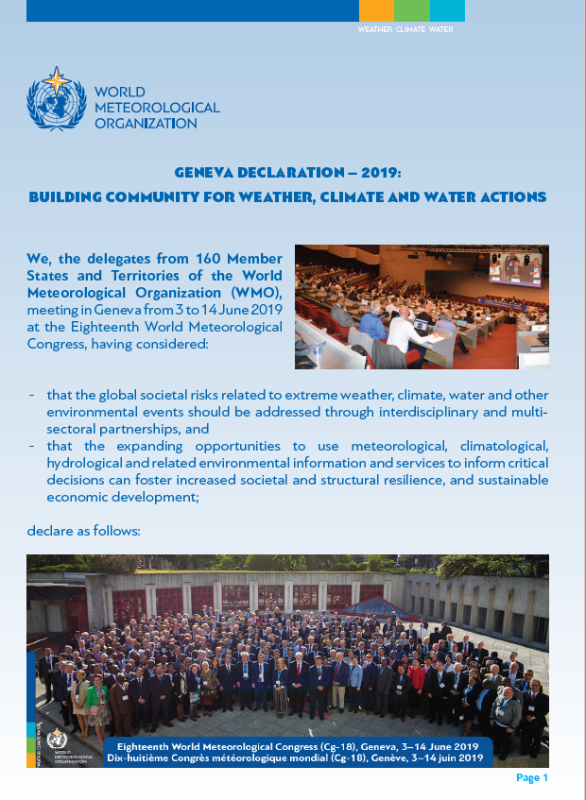
“We WELCOME
- The opportunities for all stakeholders and the broader user community that will result from a closer collaboration among public, private and academic sectors;
- The engagement of all sectors in addressing the societal needs through weather, climate, water and other environmental information and services;”
Geneva Declaration – 2019

Slide 3
Terminology – Public-Private Engagement
Public–Private Engagement (PPE):
Collaboration between NMHSs (and/or other public agents) and private sector entities to produce and deliver weather, climate, hydrological, marine and related environmental information and services while respecting the public interest and the mandates of NMHSs and keeping in mind budgetary constraints. (WMO Guidelines for Public-private Engagement (2021 edition))

Slide 4
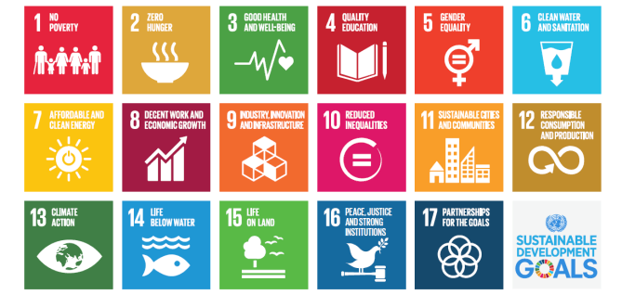
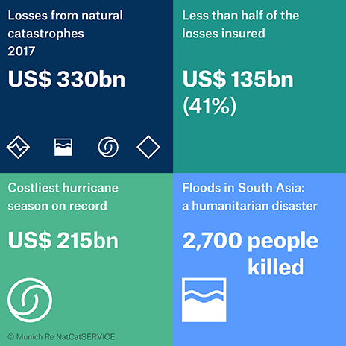
Drivers for Public-Private-Academic Engagement (1/2)
Growing needs
Agenda 2030 / Sustainable Development Goals (SDG)
Calling for engagement of non-state actors
Sendai Framework for Disaster Risk Reduction 2015-2030
“…There is a need for the public and private sectors and civil society
organizations, as well as academia and scientific and research institutions, to work more closely together and to create opportunities for collaboration …”
Paris Agreement
Public-Private sector participation is recognized as a key for integrated, holistic and balanced non-market approaches to assist in the implementation.

Slide 5
Drivers for Public-Private-Academic Engagement (2/2)
Changing environments and technologies
Changing environment, increasing risks
Rapidly changing technologies
New business models & opportunities
Progress in Science
Public budget constraints
Growing demands for information and services

Slide 6
Why Public-Private Engagement (PPE)?
In short, this is because PPE will/can be beneficial to every stakeholder, collaboratively providing solutions to materialize further better services to all users, meeting various needs more effectively/efficiently and sustainably.

Slide 7
A Variety of Modalities for PPE
There are a number of ongoing practices in many countries in a variety of modalities that fits in each NMHS’s/country’s context.
worth individuals.
Modalities for PPE: Tailored Services
Public Service
A Value Chain
Modalities for PPE: End-to-End
DBO Design-Build-Operate
Modalities for PPE: IaaS Infrastructure as a Service
DaaS Data as a Service
OaaS Operation as a Service
Crowdsourcing
Diversity of modalities and clear interdependence between stakeholders

Slide 8
Innovative Practices in Different Modalities Evidence is better than debate…
Examples related to Public-Private Engagement Opportunities
Crowdsourcing (use of non-standard data)
Data sharing (exchange of standardized data)
Collaboration (in supercomputing incl. NWP model development)
Procurement of services from the private sector (IaaS and OaaS)
Open data (business model change)
Revenue-sharing with the private sector
Licensing the private sector
worth individuals.
worth individuals.

Slide 9
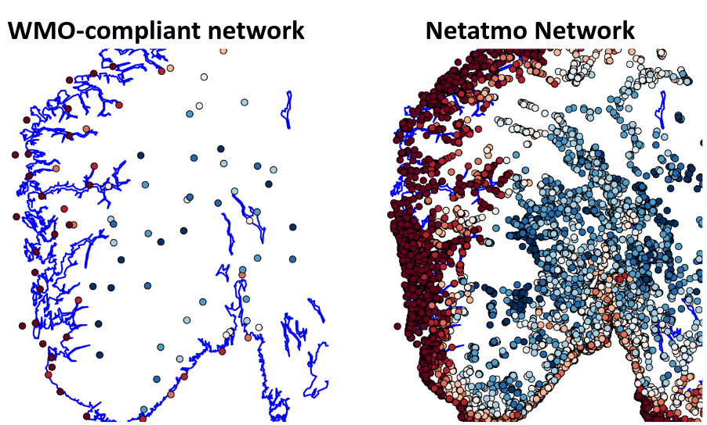
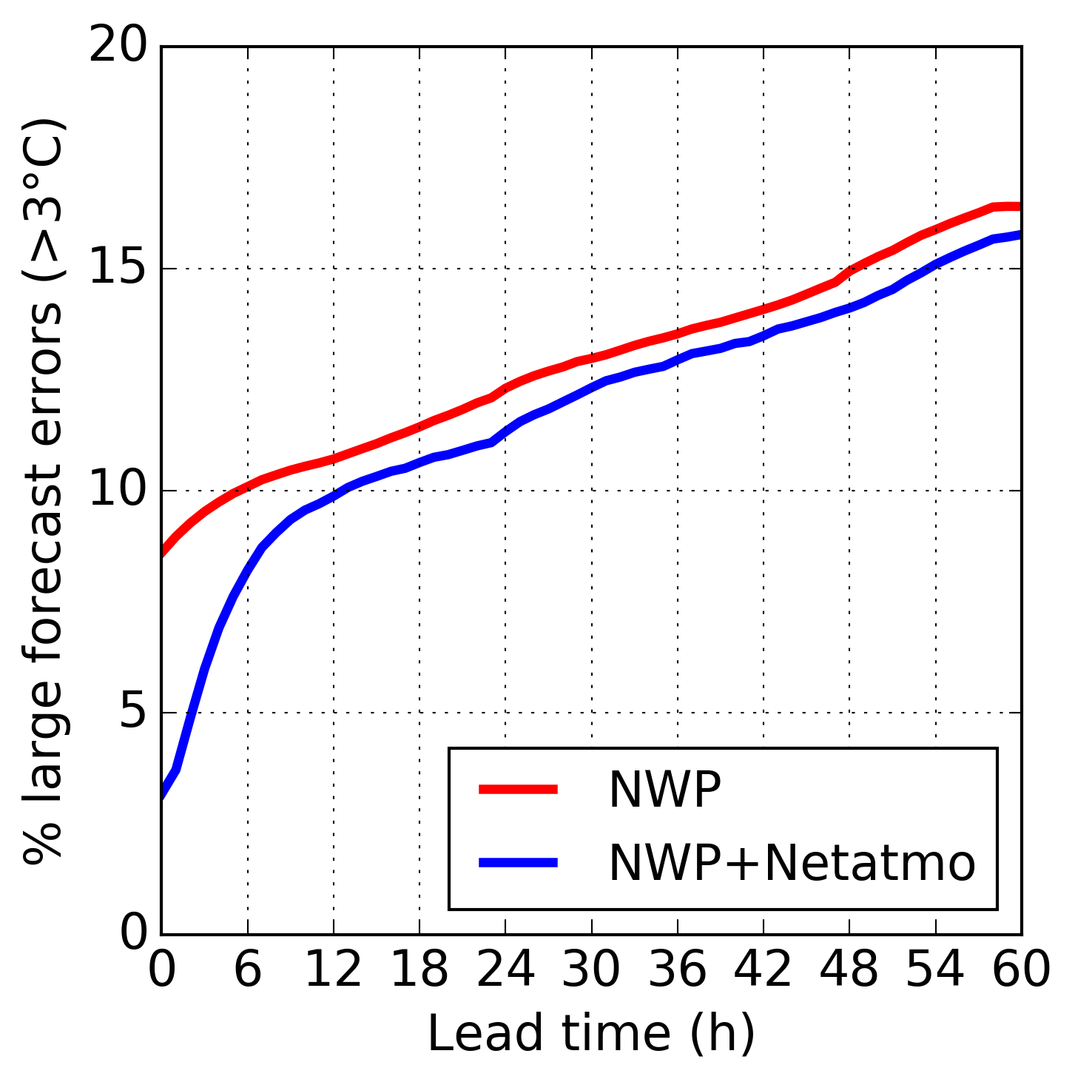
Examples of precedents and practices
Crowdsourcing (use of non-standard data)
MET Norway (Norwegian NMHS) integrates private sector observations from Netatmo’s Network in operational weather forecasting (link).
Details in PPE Resources in the WMO PPE website

Slide 10
Examples of precedents and practices
Technology innovation
ECMWF and ATOS launched a Center of Excellence in Weather & Climate Modelling to support ECMWF’s medium to long-range weather prediction and global climate modelling by improving access to AI and quantum computing technologies (link 1, 2, 3, 4 & 5)
UK Met Office’s partnership with Microsoft to harness next generation of supercomputing capability and data technologies to deliver innovation for weather and climate forecasting (link 1 & 2)
From the WMO Data Conference Preparatory Workshop on Theme 2: "Business models and data policy issues“ (Oct 2020)
From a WMO OCP Innovation Webinar (Oct 2021)
Supercomputing leap in weather and climate forecasting - Met Office

Slide 11
Challenges…
The private sector’s evolution in capability and ongoing Digital Transformation (DX) provide opportunities to Members, while in some/many Members there seems to remain deep-rooted fear to the private sector. How can we dispel deep-seated fears?
To go forward in PPE, it is necessary to break through existing barriers such as:
Lack of mutual trust
Lack of understanding in opportunities and risks of PPE
Lack of legislative/ institutional framework
Insufficient Gov funding (affects data sharing)
Dialogues through the Open Consultative Platform & Regional Fora
Capacity Development through sharing good practices and training
Relevant assistance to Members to ensure regulator/promoter’s roles
Learning from business models; advocates needed

Slide 12
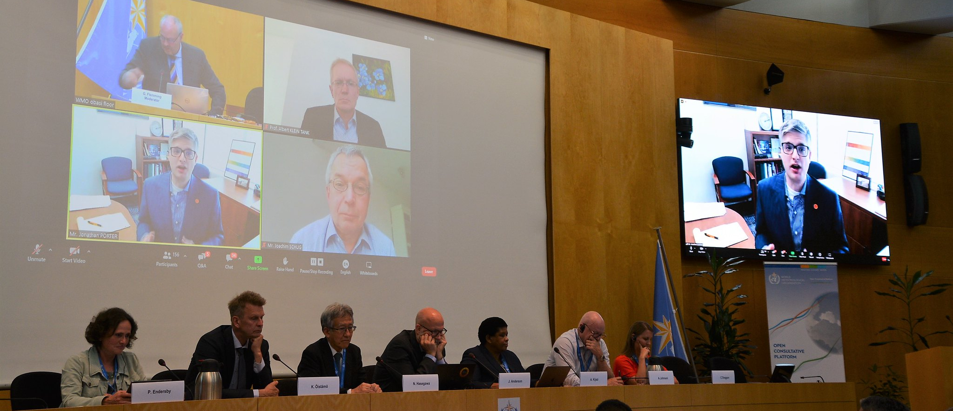
WMO’s Open Consultative Platform (OCP) “PARTNERSHIP AND INNOVATION FOR THE NEXT GENERATION OF WEATHER AND CLIMATE INTELLIGENCE”
OCP-HL-1 (High-Level Round Table), June 2019
The Open Consultative Platform (OCP), established on the occasions of the 18th World Meteorological Congress in 2019, serves as an open, constructive and participatory framework for addressing the grand challenges of the global weather enterprise.
In the spirit of collaboration, mutual respect, and trust, the Platform enables all stakeholders to stay abreast of issues and opportunities, both institutional and technological, to motivate collaborative, win-win approaches and to nurture innovation.
WMO plays a central global role in facilitating the cooperation of Member States and Territories and their weather enterprise stakeholders.
OCP-HL-3 on Evolving Roles and Responsibilities – Future of NMSs, June 2022

Slide 13
THANK YOU
https://public.wmo.int/ppe

