Slide 1
Enabling Strategies & Legislation
Jean Sébastien Cases, VP Sales & Marketing
Singapore, April 18th, 2023
MFI’s views

Slide 2
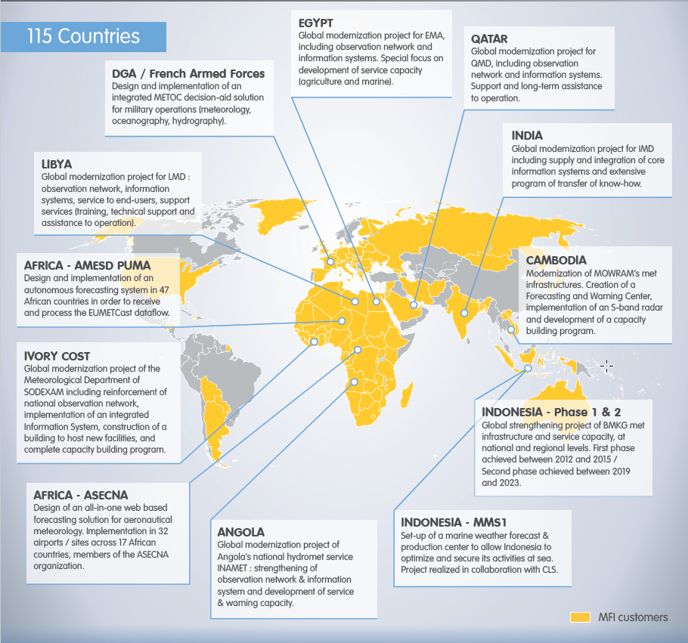

What we’ve been doing at MFI… for the past 20 years
GLOBAL INTEGRATED STRENGTHENING PROJECTS FOR NMHS
Characteristics of these projects ?
They integrate all steps of the meteorological value chain
They are designed to be fully implemented within an average duration of 3 years
They are effective with visible outcomes from the first year of implementation

Slide 3
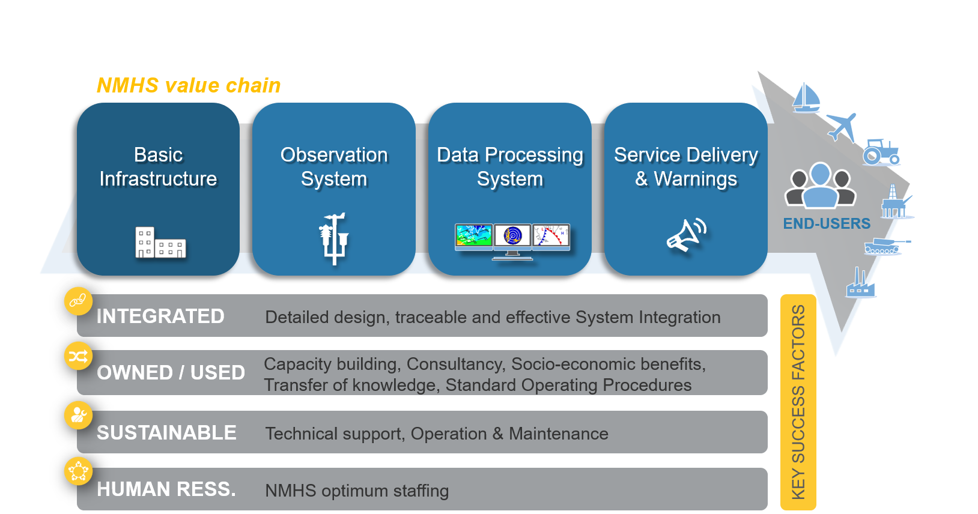
What is our strategy for successful projects ? 1/3
Principle 1: Design integrated projects embracing the whole met value chain

Slide 4
What is our strategy for successful projects ? 2/3
Principle 2: Set-up PPE mechanism to bring together Public and Private sectors
PUBLIC SECTOR
PRIVATE SECTOR
NMHS
RSMC
Suppliers
Integrator
JOINT WORK
GPC
Operational design
R & D
Tech support
Local partners
Specifies
Designs
Hosts
Builds
Operates
(science & expertise)
Operates
(admin & tech.level)

Slide 5
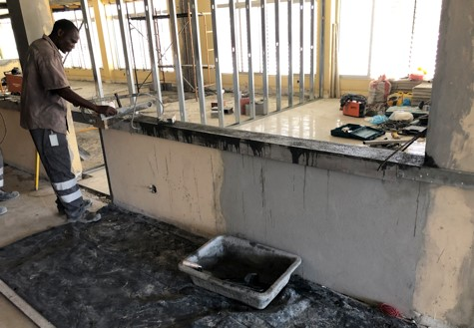
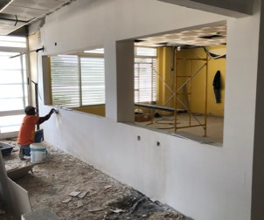
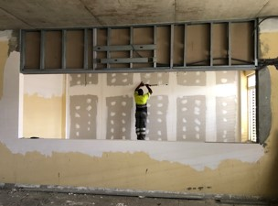
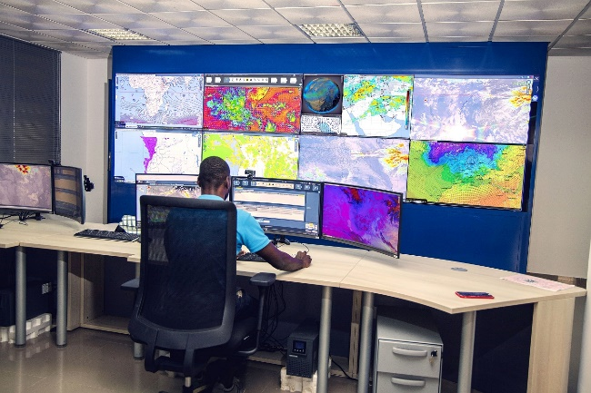
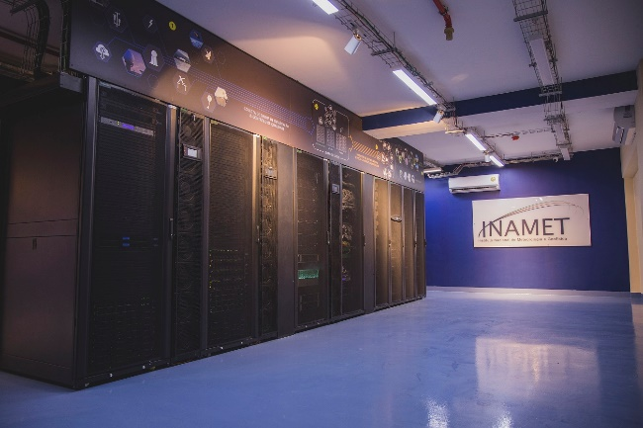

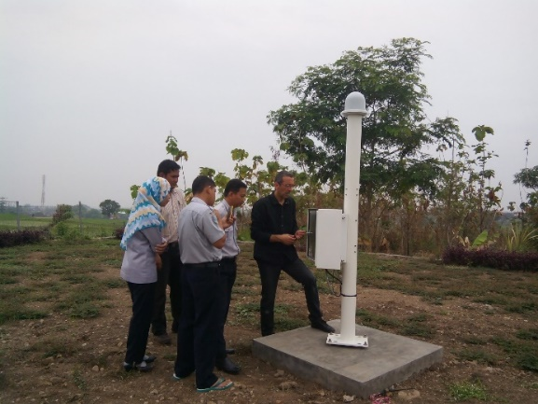
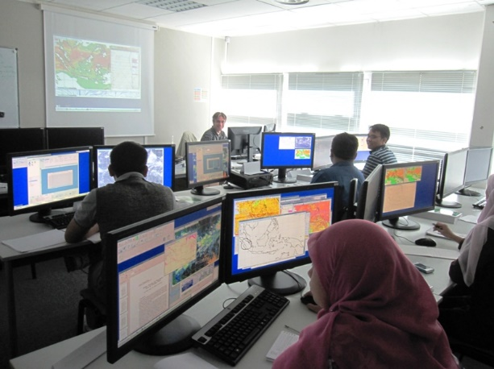
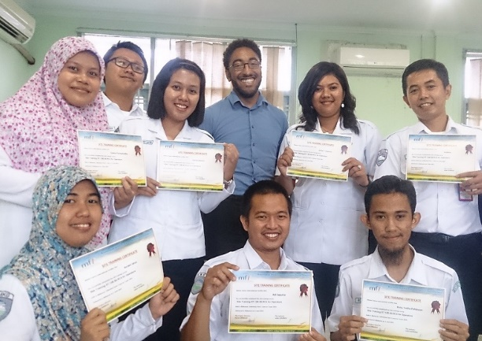
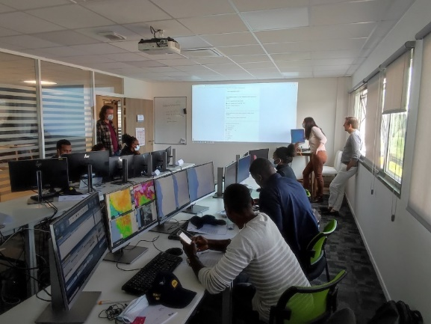
What is our strategy for successful projects ? 3/3
Principle 3: Adopt a DBO model – Design, Build, Operate
“DB” means the one in charge of the design is the one implementing the solution:
= “One-stop-shop spirit” >> KEY TO RESPONSIVENESS & EFFICIENCY
“O” means the projects provides assistance and service beyond its completion:
= Tech support, maintenance of equipment, IT administration, …>> KEY TO SUSTAINABILITY

Slide 6
What are currently the issues to be addressed ?
Financing… Needs to be more suited !
Compliant with DBO model
Including running costs for minimum of 2 years
Procurement… Needs to be more flexible !
Simplify procurement for more efficiency
Cost evaluation including OPEX costs & contingencies
Avoid “out of the blue” consultancy vs teamwork
Clear tax rules
Legal framework… Needs to be formalized !
NMHS weather warning entity by law
Share of work between NMHS and DMO/CS by law
Share of work between National and local authorities by law

Slide 7
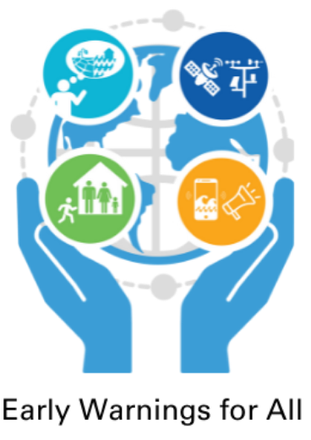
Then the ideal strategy for taking up the EW4A challenge !
Provides funding to Private & Public sector involved
Scenario 1
Fully implemented and hosted in beneficiary country
Private sector - System integrator
- Suppliers
Public sector - GPC - Main NMHSs
- RSMCs
Financing solution
- Based on existing (GCF, SOFF, CREWS)
UN EWS consortium No. x
Designs technical solution & delivers / operates in main NMHSs
Hosts, implements & supports the solution → all benefi-ciaries
Scenario 2
Back office hosted in major regional NMHS
Front office in beneficiary country
Beneficiaries (all eligible countries in resp. area) NMHSs + stakeholders

Slide 8
Thanks for your attention!

