Slide 1

PPE – Collaboration on Special
Observations
James Sun
© 2002-2023 ZOGLAB Microsystem Co., Ltd

Slide 2
１. Private company role in the PPE
value chain
Topics
２. NMHS needs and supplies
３. Case examples of collaboration on
special observations
４. Summary

Slide 3
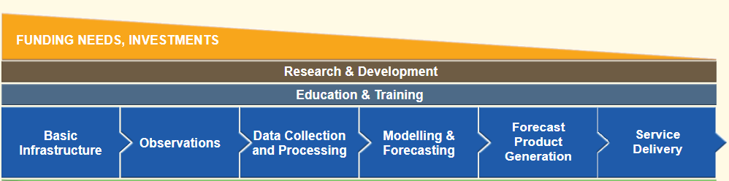
Private Company’s Role in Basic Infrastructure
Roles of the Private Sector | Characteristics of the Private Sector
- Manufacturing and supply of equipment Development of innovative techniques | - Quick response to market needs - Ability to innovate - Ability to develop fit-for-purpose, customized products and solutions

Slide 4

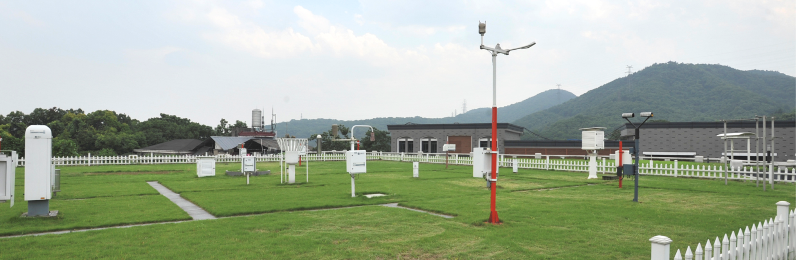
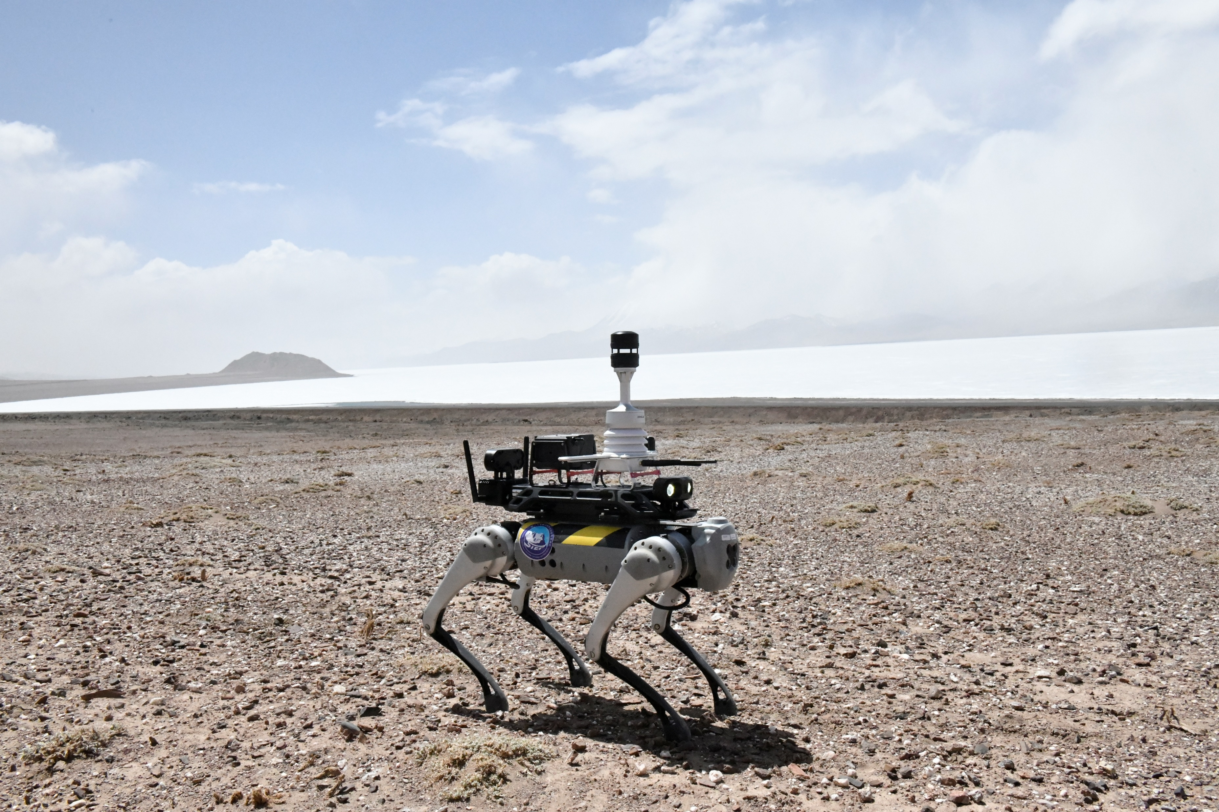
NMHS Needs and Supplies
Needs of NMHS | Supplies
Main Observation and Forecasting | Ground: AWS, ground radar, and other remote sensing equipment High altitude: radio sounders, balloons, planes and rockets Spaced based: satellites
Special Observations Special projects Special environments Special methods | Atmospheric composition, climate changes High mountain, desert, ocean, extreme weather, polar regions UAV, Robotic dogs, etc. “ Special equipment are developed to provide accurate weather data onsite and in real time.”

Slide 5
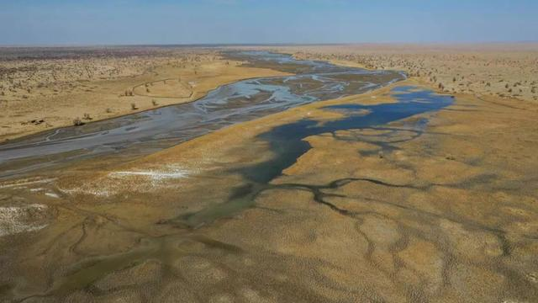
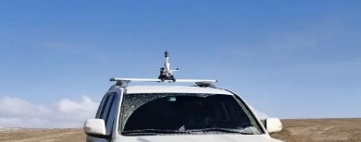
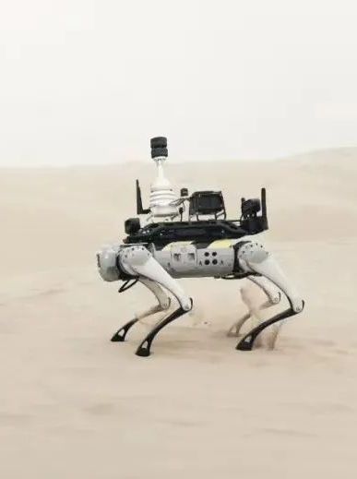
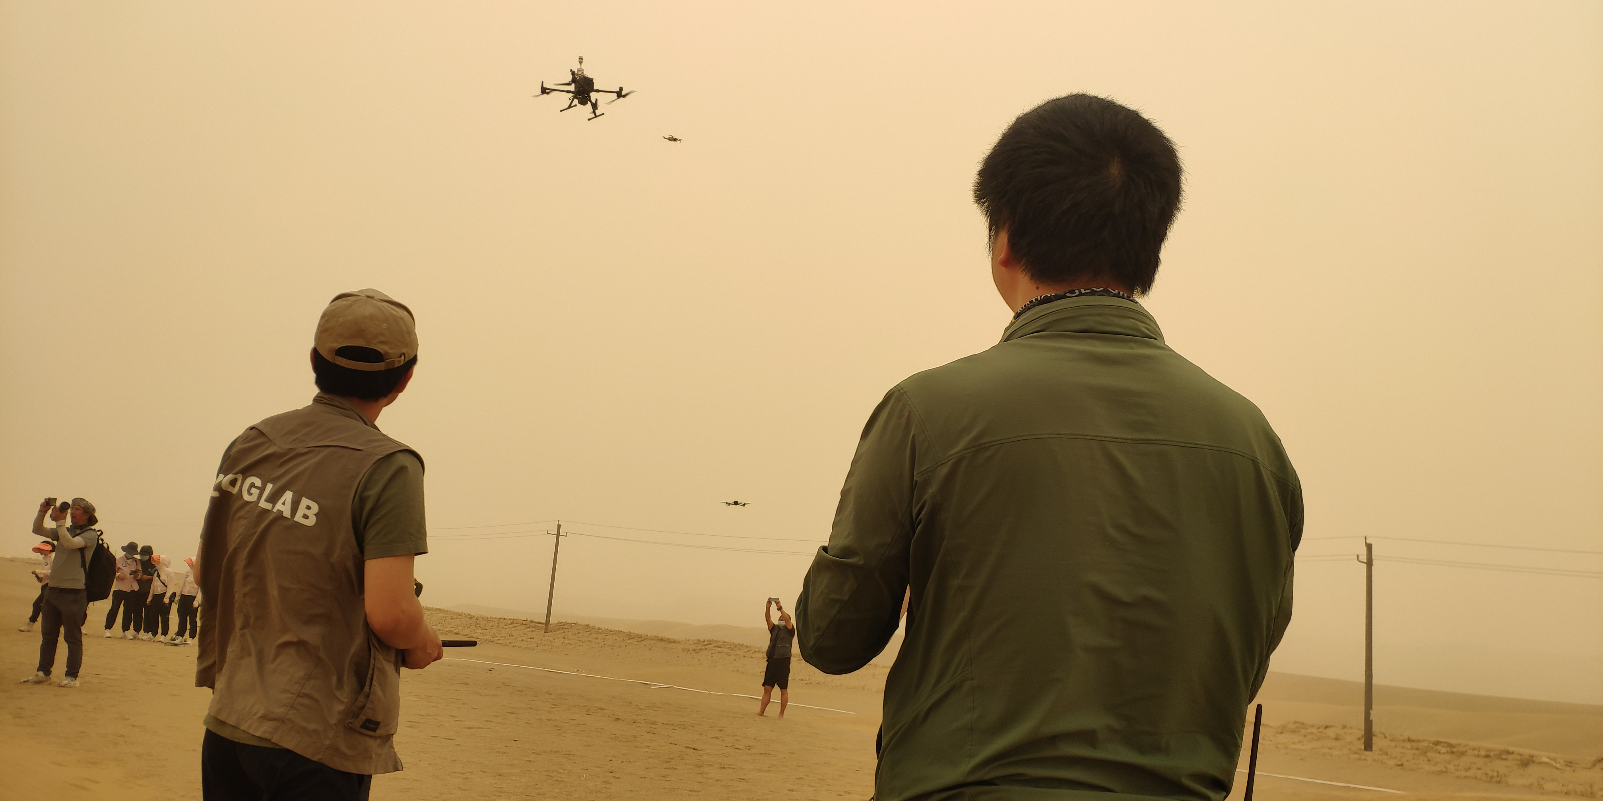
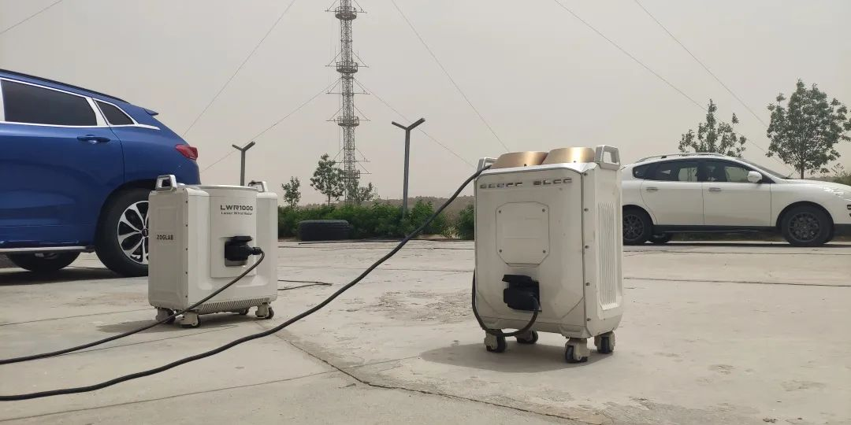
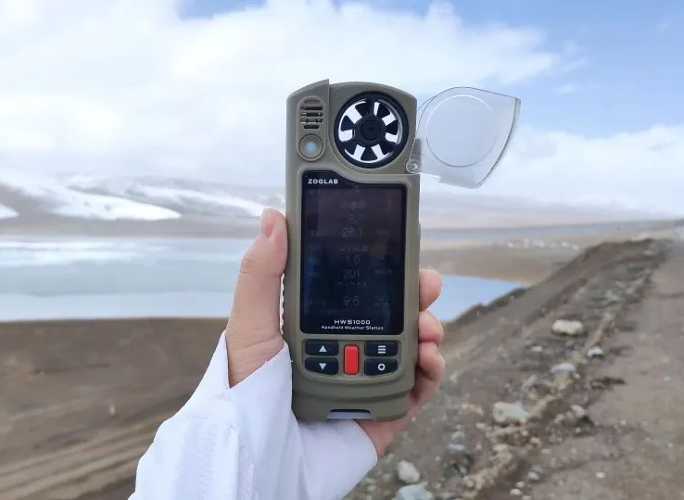
Case Example 1: Climate Research in Taklamakan Desert
and Northern Tibet Plateau
In 2020-2022, China Meteorological Administration (CMA) and Nanjing University of Information Technology (NUIT), collaborated with ZOGLAB in a long term climate research of dust aerosol transport in the Taklamakan desert and cloud and precipitation on the northern slope of the plateau and its water vapor channels. ZOGLAB provided a comprehensive observation solution that included 1) mobile AWS, 2) air-borne UAV, 3) lidar, 4)ceilometer, and 5) handheld weather meter.

Slide 6
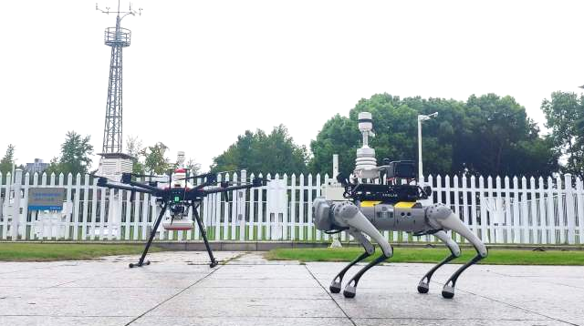
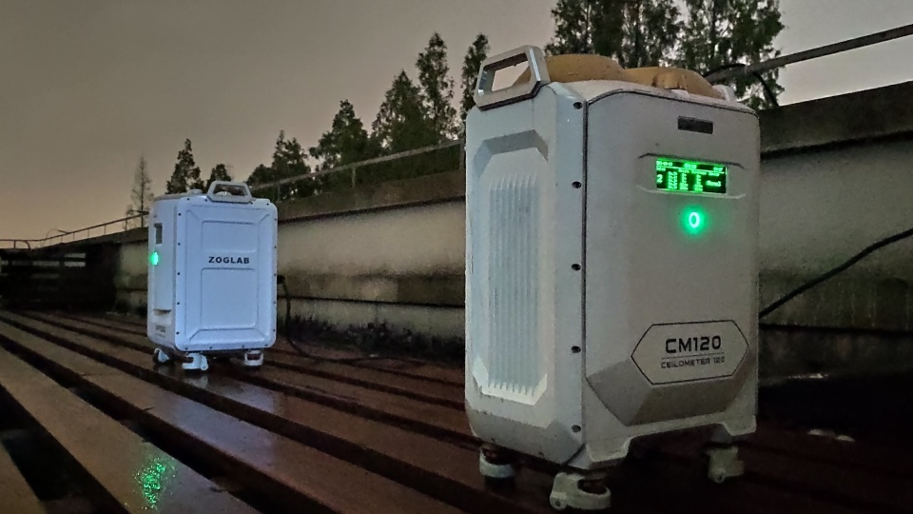
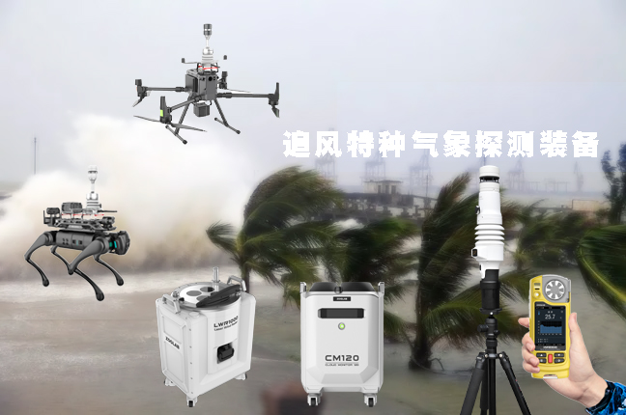
Case Example 2: Typhoon Study in the Coastal Urban City
Asia-Pacific Typhoon Collaborative Research Center, under CMA, collaborated with ZOGLAB on typhoon studies on September 3-5, 2022 and September 14-15, 2022 in an effort to analyze the typhoon coastal wind fields, as well as to study of the interaction between typhoons and urban super high buildings. ZOGLAB provided the mobile observation equipment including 1) handheld weather stations, 2) drones, 3)robotic dogs, 4) ceilometer, and 5) wind lidar. These equipment were used to collect wind speed, direction, and cloud data on the spot and in real time.

Slide 7
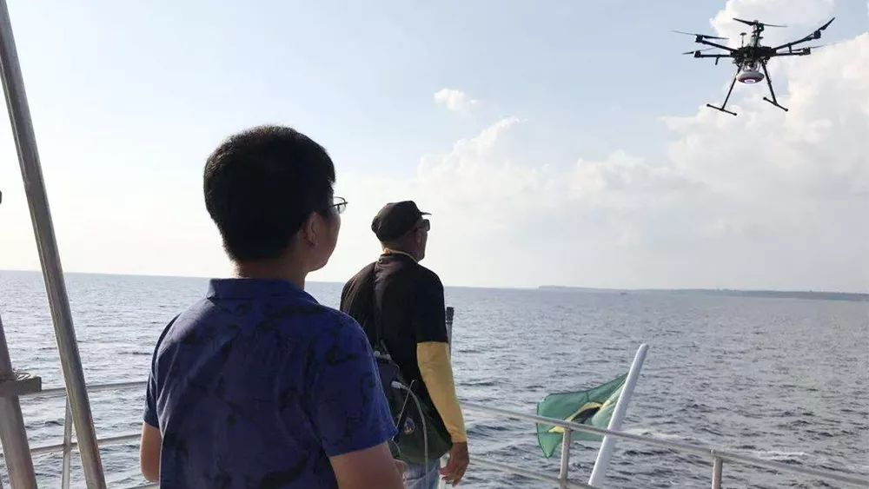
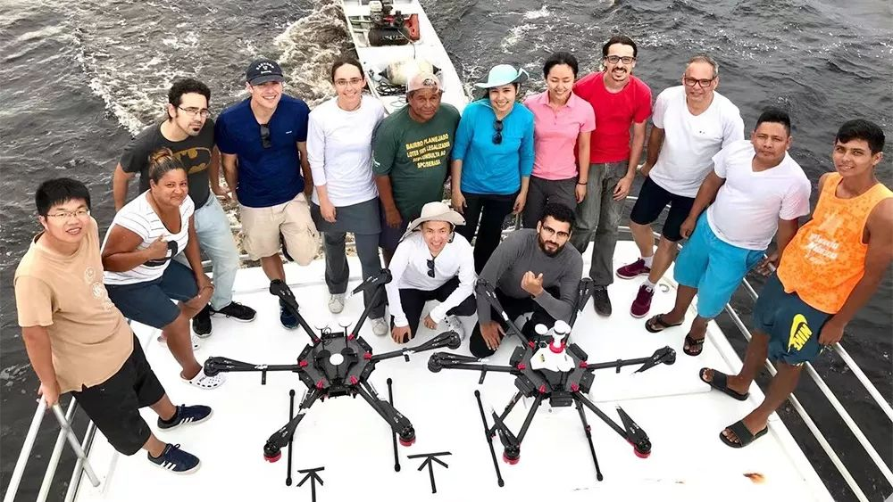
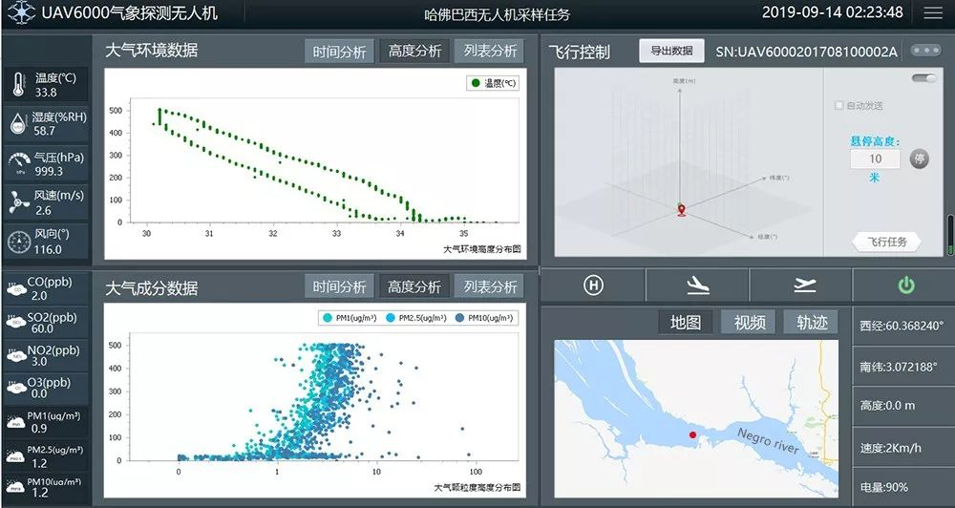
Case Example 3: Wind Observation and Air Composition Analysis in the Amazon
无人机执飞亚马孙河流域
科考团队合影
无人机采样中
Harvard University, Amazon State University, and ZOGLAB collaborated to carry out air composition research in the Amazon River basin in Brazil. The special equipment used included meteorological drones and a wind lidar, providing data to study the VOC gas diffusion model, the chemical composition related to particles in the original atmospheric environment, and the impact of human activities on the tropical forest.

Slide 8
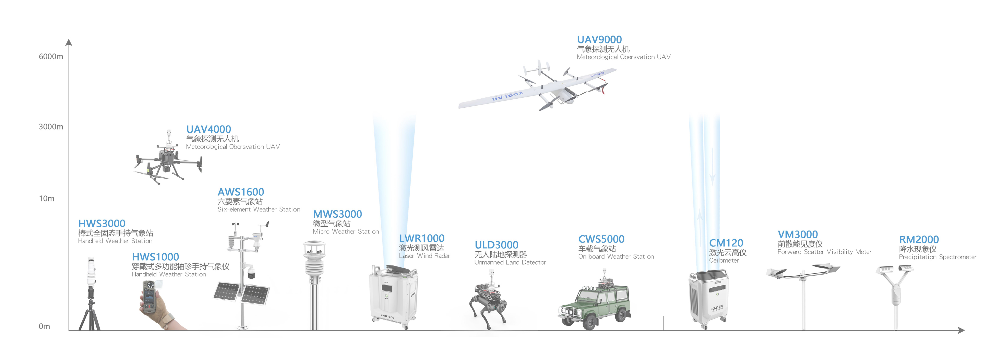
Collaboration between the public and private sectors is important and necessary in developing the weather enterprise
Special observations need special equipment
The private sector can use its advantages to provide innovative, fit-for purpose, and cost effective products and solutions to the public sector
Summary

