Slide 1
Legislation & Strategy: Meteorological Service Act in Japan
OBAYASHI Masanori, Director-General, Japan Meteorological Agency
Regional Forum for RA II/V, 18 April 2023, Singapore

Slide 2
Meteorological Service Act in Japan
Enacted in 1952, amended more than 30 times.
Based on the premise that the collaboration across the sectors is essential (the government alone can’t do everything!).
Key Features
Director-General of JMA: Responsible for sound developments of meteorological services as a whole, incl. those by the private sector.
Advisory Committee:
Composed of external experts from the public, private, and academic sectors.
Makes recommendations on high-level JMA policies.
Single Authoritative Voice: Anyone other than JMA shall not issue warnings.
Source: Modernization of Meteorological Services in Japan

Slide 3
Roles of JMA and Private Weather Service Companies in Japan
JMA :
Responsible for fundamental public services with a focus on warnings for DRR. (Single Authoritative Voice)
Not provides commercial services. (Avoiding competition and conflicts of interest)
Licensed weather companies:
Provide their customers with customized services and also JMA warnings.
Assign certified weather forecasters.
JMA’s data/products:
Provided on a free and unrestricted basis.
The Japan Meteorological Business Support Center (JMBSC) as the gateway.
Japan Meteorological Agency
JMA Warnings,
Public Weather Forecast, etc.
Japan Meteorological Business Support Center
Observation data,
NWP data,
JMA Warnings,
etc.
Free and unrestricted
Data handling fee: actual expenses
Private weather service companies
・Licensing of Forecast Services
・Certified Weather Forecasters
JMA Warnings,
Customized Services
Mass media, Internet, etc.
Customers
JMA Warnings,
Value-added Services, etc.
Public

Slide 4
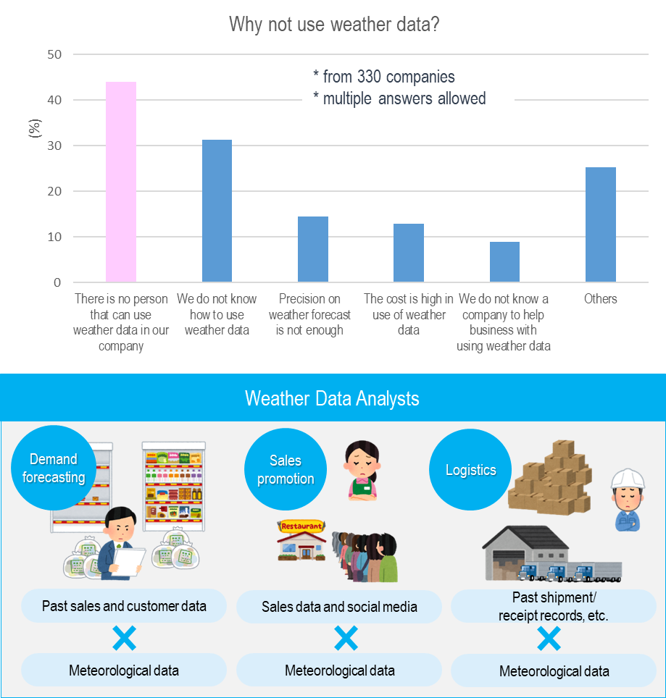
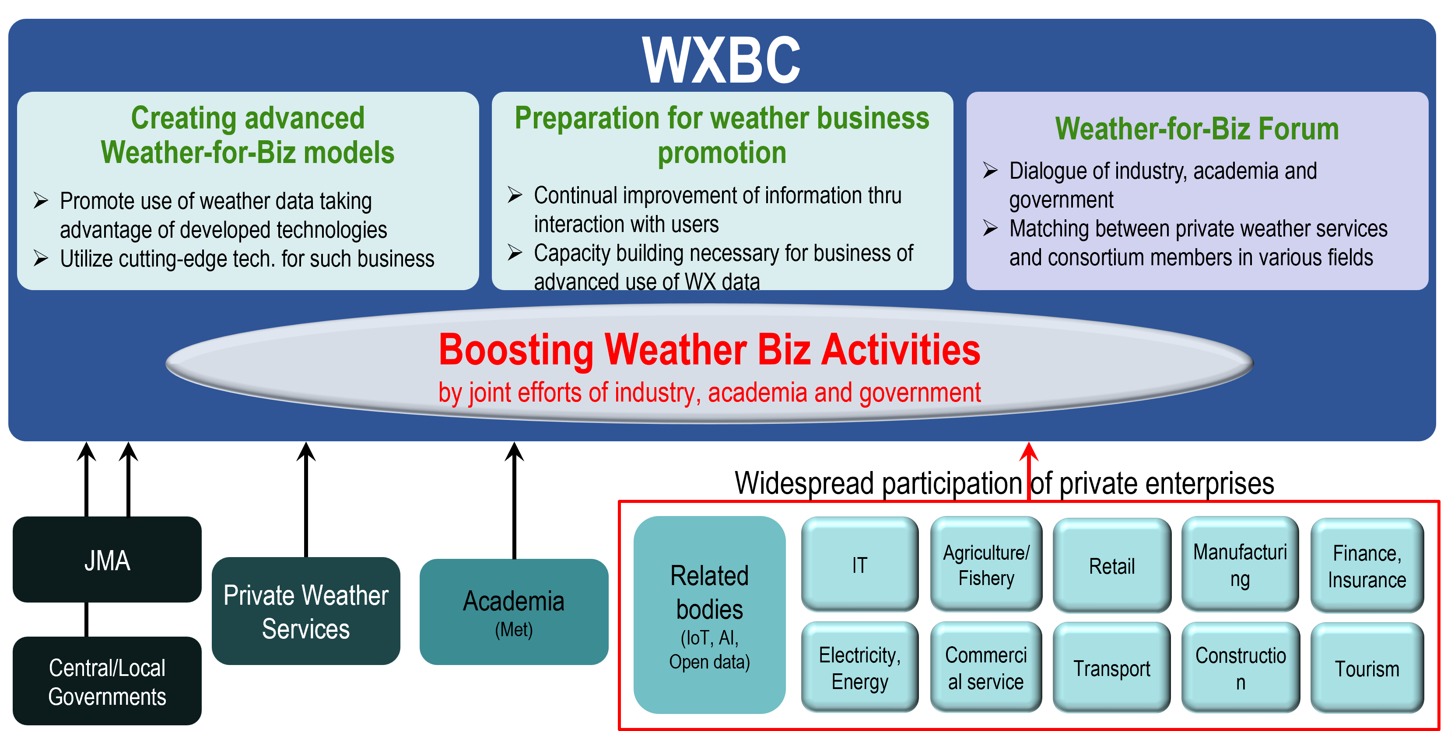
Weather Business Consortium (WXBC)
An undertaking for developments of the entire meteorological services.
Established in 2017, consists of more than 1,200 enterprises including private weather service companies.
Mission: - Creation of new business models utilizing weather data. - Facilitation of weather data utilization in business sectors. - Capacity development for weather data handling.

Slide 5
Vision for Meteorological Services in 2030 ( Advisory Committee Recommendation in 2018)
Contribution to a Safe, Resilient, and Vibrant Society
Timely and proper DRR responses/actions for extreme events
Accurate meteorological services will be provided, understood, and utilized by local residents, foreign visitors, and businesses, enabling them to respond and act properly in case of disasters.
Vibrant individual life
Improved quality of life and comfort for each individual through access to personalized meteorological services for various aspects of each person's life
Innovation in economic activities
Meteorological information and data are utilized to create a variety of services and improve productivity in various industrial fields.
Priority Areas
1. Advancing Research and Development for Obs. & Forecasting
2. Promoting Use of Meteorological Data & Information
3. Supporting and Promoting Disaster Preparedness & Response
Advancing operational techniques, including satellite and earth system modeling, to provide services supporting decision making at various time-scales( from nowcasting to decades)
Establishing an environment for easy acquisition and utilization of meteorological data and information
Improving user understanding of and capacity to use meteorological data and information
Advancing comprehensive decision support services for DRR stakeholders (hotline, JETT, training )
Fundamental Cross-cutting Policies
PDCA
Reinforcement of Governance
Technical Infrastructure
Public-Private-Academic Partnership
International Cooperation
Science and Technology
Efficient and effective R&D structure
Basic Obs. Network
Public-private-academia dialogue platform
User-focused
Strategic R& D Planning
Super computing
Human resource exchange and development
Social Needs
HR developments for R&D and DRR
Data distribution infrastructure
Promotion of joint projects
public-private partnership management
Data sharing using Cloud technology

Slide 6
Key Takeaways
JMA DG’s legal responsibility for developments of the entire meteorological services has now become more important than ever. JMA is promoting partnership across the whole value cycle of meteorological services, facilitating dialogues among stakeholders in the public, private, and academic sectors.
The Advisory Committee’s high-level policy recommendations are indispensable for DG to improve meteorological services responding to rapidly changing environment.
The legal basis for the Single Authoritative Voice empowers JMA to provide effective warning services without any confusion.
High quality, sustainable public infrastructures ,and free, unrestricted data provision are fundamental for the growth of private meteorological services. This requires that the government fully funds its NMHS for public services.
The Meteorological Service Act forms the basis for developments of meteorological services in Japan.

