Slide 1
Collaboration between NMHSs and with the public and academic sector in high performing computing infrastructure
Roar Skålin, Director General, MET Norway RA VI Regional Forum of the Open Consultative Platform, 03.11.2023

Slide 2
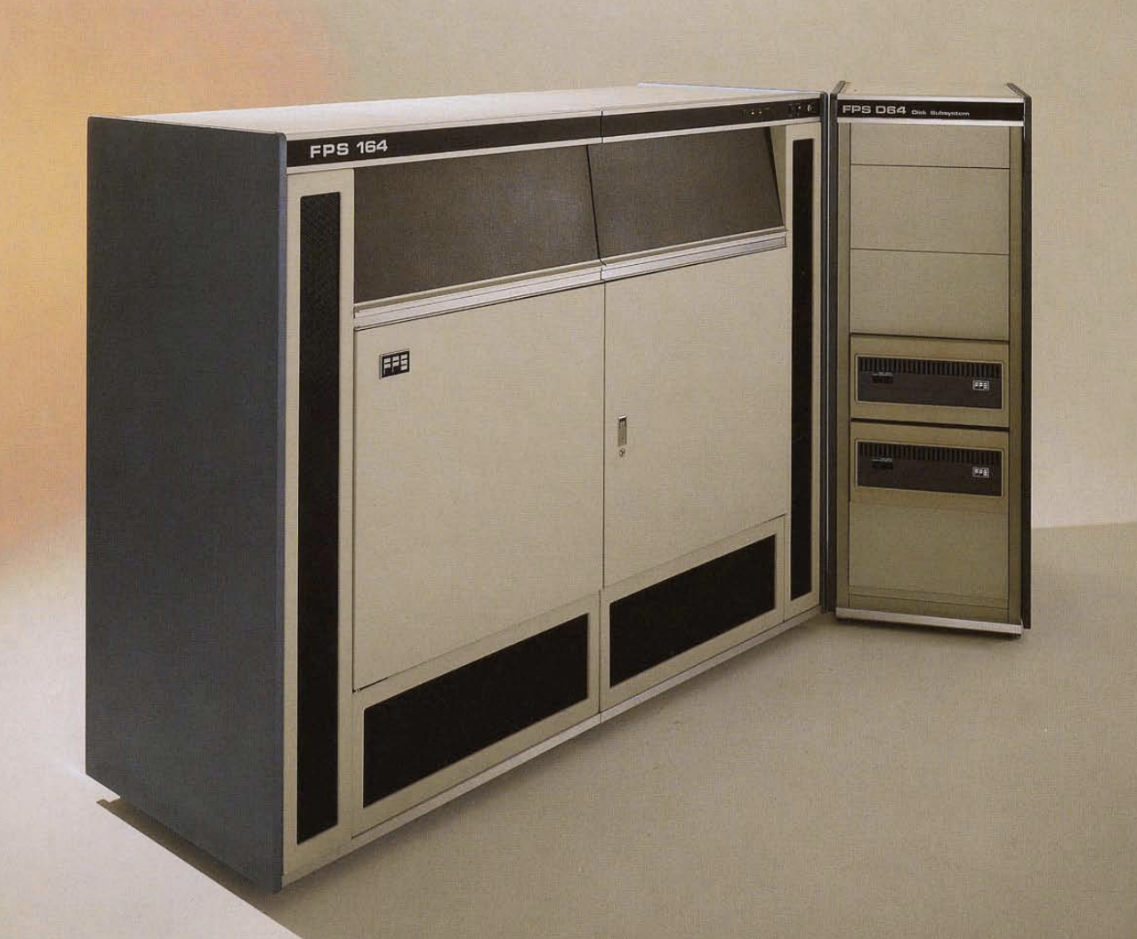
The last HPC operated by MET Norway….
Floating Point Systems FPS-164 Scientific Computer
1982 - 1987
We have powerful clusters in-house and operate them ourselves, but the main HPCs are located outside MET Norway and operated by partners

Slide 3
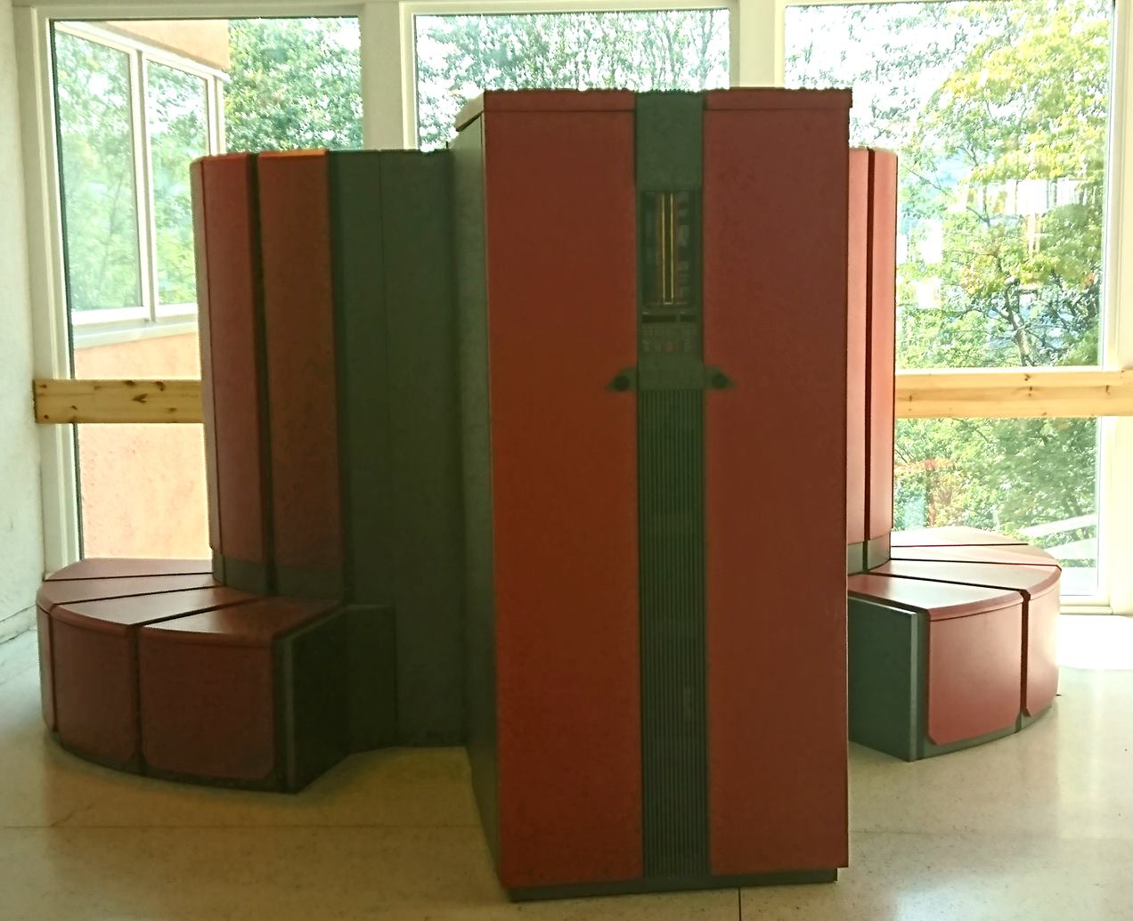
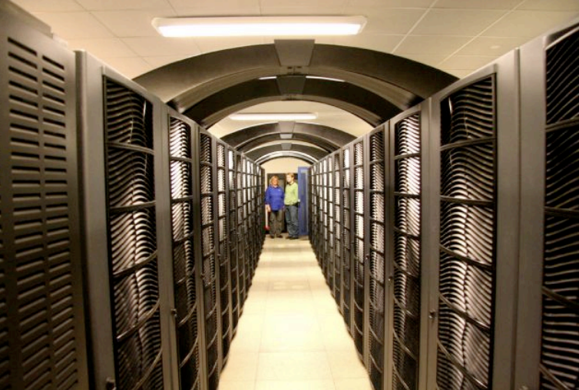
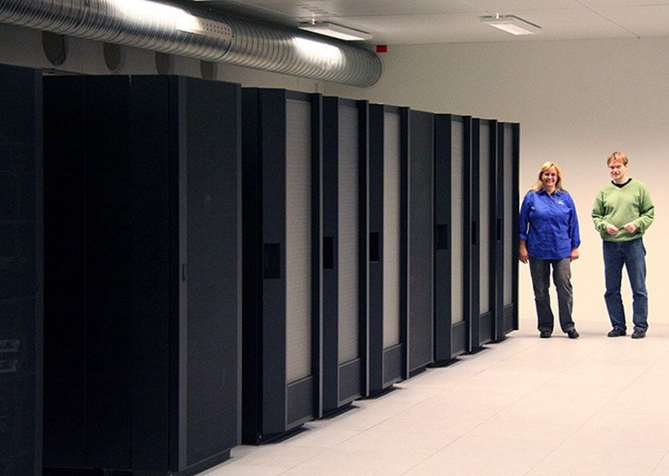
1987 - 2018
Cray X-MP
Cray Y-MP
Cray T3E
SGI Origin 3000
IBM Power P5+
SGI Altix ICE X
The two first operated by SINTEF (research institute)
The four last operated by the Norwegian University of Science and Technology

Slide 4
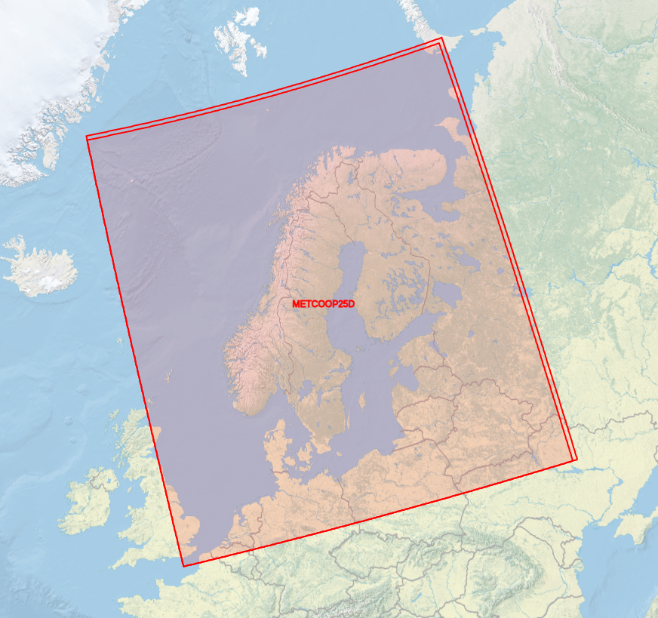
From 2014: MetCoOp
MetCoOp is a cooperation on operational NWP between the national meteorological institutes of Estonia (ESTEA), Finland (FMI), Norway (MET) and Sweden (SMHI)
It was established in 2011 (Norway and Sweden), and went operational in 2014. Finland joined 2016 and Estonia 2018
The common model used is Harmonie AROME. The main product is an ensemble of forecasts (started from different initial conditions and using different lateral boundary conditions), with 30 members (over a 6 hour period)

Slide 5
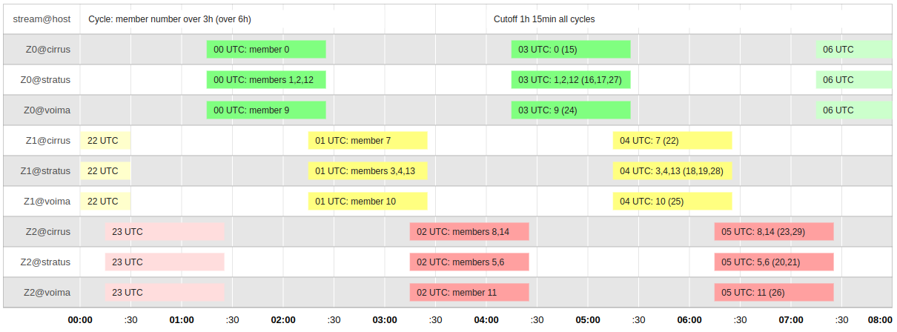
MEPS production schedule

Slide 6
HPC systems used in MetCoOp operations
Cirrus (SMHI, Norrköping). 256 compute nodes, 8192 cores, 96 GiB ram/node, Intel OmniPath 100 Gb/s interconnect.
Stratus (NSC, Linköping). 520 compute nodes, 16640 cores, 96 GiB ram/node, Intel OmniPath 100 Gb/s interconnect.
Voima (FMI, Helsinki). Cray XC40, 172 compute nodes, 128 GB ram/node. Cray Aries/Dragonfly interconnect.
Teho (FMI, Helsinki). Cray XC40, 172 compute nodes. 128 GB ram/node. Cray Aries/Dragonfly interconnect.
Cirrus and Stratus are operated by National Supercomputing Centre at Linköping University, Sweden

Slide 7
35 years with external HPCs - lessons learned
Research institutes and universities have delivered professional services
Excellent understanding of 24/7 operations
Risk management
Highly qualified personnel
Legal and economical issues have required some clarification
Public procurement
State aid
Value added tax
Difficult to recruit HPC experts - collaboration reduces the problem
Need for high performance network (for external datacenters this is required anyway)

Slide 8
Prerequisites for a successful collaboration with academia
Mutual understanding of the societal missions and legal framework for both parties
“Science for Service”
Create ownership among all participants
Building trust over time
Involvement of academia in R&D also when the collaboration is on infrastructure

Slide 9
Eight years of NMHS cooperation on NWP - lessons learned
Common HPCs is not the goal - it is a means to produce world class very short-range and short-range NWP for the geographical areas of interest
Sharing competence and resources gives additional value for all
We have been able to exploit the value of different cultures - “best of both worlds”
On my “top two” list of successful collaborations
Why do the countries in RA VI want to run NWP models on so many overlapping domains?
We are on the way to extending the collaboration - United Weather Center (UWC) with 10 (soon 11) NMHSs

