Slide 1
MOJI WEATHER
CASE INTRODUCTION:
PPE ON WEATHER SERVICES IN CHINA
PPE: Public-Private Engagement
2023.04
YaoHai Huang
Senior Vice President
MOJI
Notes:
Thank you Ms. Qu, Secretary general
Good morning, everyone. I’m Huang from Moji, which is a commercial weather company in China.
It’s my great honor to give a short talk on this WMO PPE Forum.
In my talk, I would like to show 4 cases related to the mutually beneficial collaboration between public and private meteorological entities in China.
Those collaborations cover the public weather services, meteorological technologies, observation data and high impact weather detection.

Slide 2
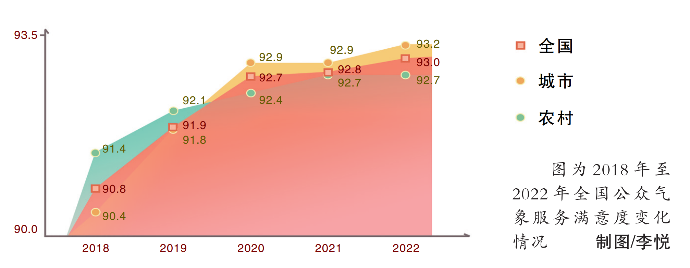
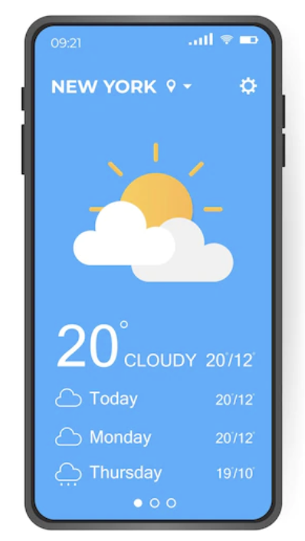
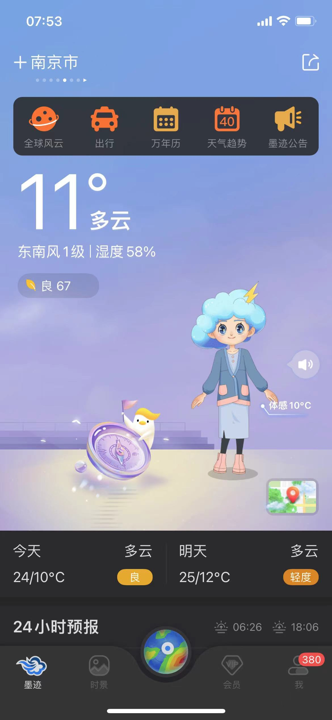
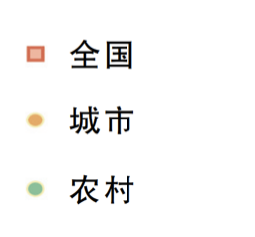
MOJI WEATHER
Weather apps are becoming the most popular way for the public to access weather service.
Distribution of public channels to access weather information.
National Public Meteorological Service Satisfaction Scores (2018~2022)
National
Urban
Rural
From Chinese Meteorological Administration Survey
From Chinese Meteorological Administration Survey
Notes:
The first case is about ”Public Meteorological Services”.
One important function of weather services are to meet the daily needs of the common people.
Weather apps are becoming the most popular way for the public to access weather service.
- Since weather information is an important decision making factor, most of the needs come from the outdoor activity arrangement, such as travel, sports，driving, working safety and business activities.
- According to a survey by Chinese Meteorological Administration (CMA), over 70% people are obtaining weather information from weather apps. Half of them check the weather information more than one time a day.
In China, most of weather apps are provided by the commercial companies. They purchase weather data, such as weather forecasts and warning information, from governmental meteorological departments, and create additional functions to meet the various needs of the common people.
With both efforts of the governmental meteorological departments and the commercial weather companies, the satisfaction score of public meteorological services are increasing in recent years.

Slide 3
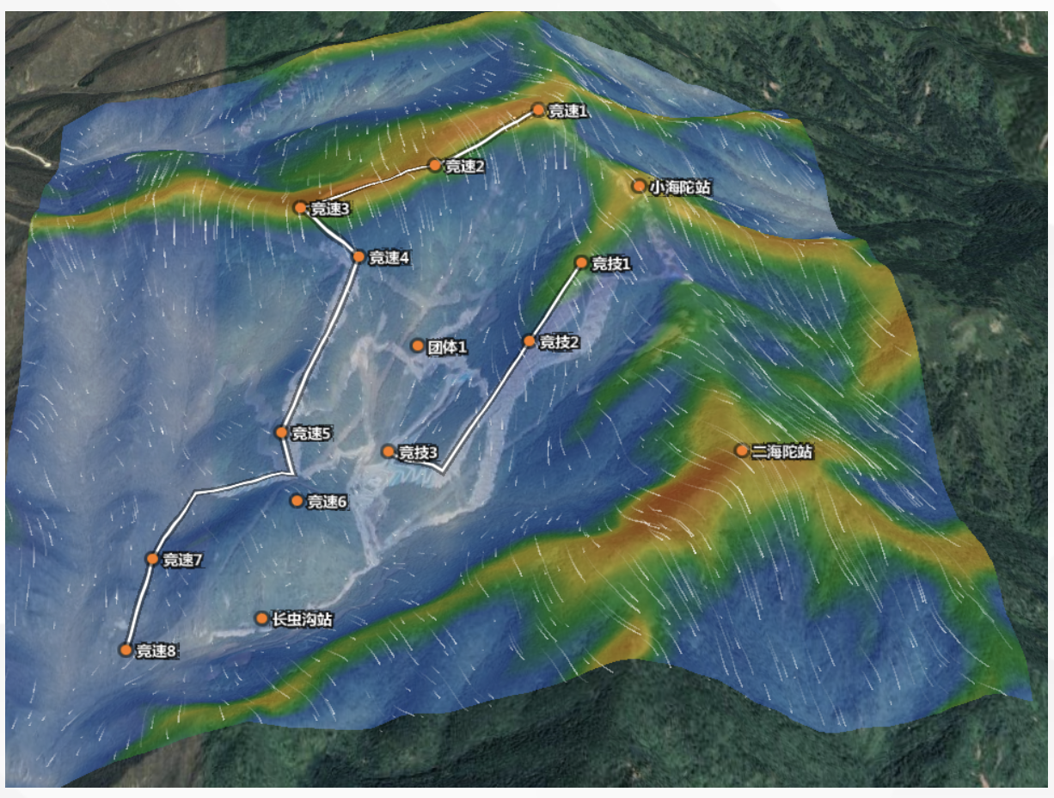
MOJI WEATHER
Commercial weather services play an active role in national and regional public events
High resolution numerical model
AI based model output statistics
Observation
National meteorological administration.
Commercial weather company
2022 Beijing Winter Olympic Games weather services
Notes:
In previous case, I show the collaboration for the public service, in this case, I will show another example of collaboration of weather service for important event.
In the 2022 Winter Olympics, weather service plays an importance role in the activity support.
The game was held in the high altitude mountain areas which had more forecasting challenge than the plain area.
So not only the national administration, but also commercial weather company worked together for improving the weather forecasting technologies for the mountain areas.
In one forecasting system, national meteorological administration was in charge of the observation, high resolution numerical model. And based on the result of numerical model, the commercial weather company further improved the accuracy in the model output statistics stage by using AI technologies.
With such collaboration, that forecasting system provided higher accuracy for the game supporting.
And also the "Science and Technology Winter Olympics" project in China also has been included in the WMO's High Impact Weather Forecast Demonstration Project and will continue to generate benefits for the future.
At such kind of event weather supporting, commercial companies can also contribute to the technologies development and system establish by utilizing their advantages.

Slide 4
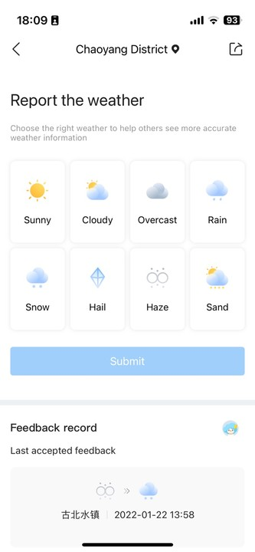
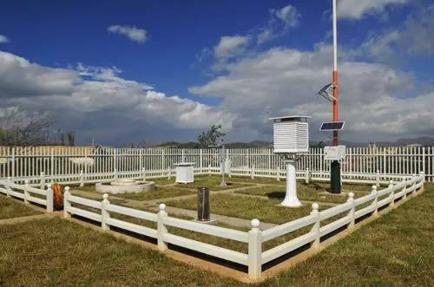

MOJI WEATHER
Commercial weather services add social weather feedback data to official observations.
User weather
feedback data
weather observation stations
weather application feedback
Notes:
Next I will show a case of observation data collaboration.
As we know the observation is the foundation of the meteorological industry.
At present, the observations, such as by the weather observation stations and meteorological satellite, are mainly provided through the professional observation network of national meteorological departments.
However, there are also problem of insufficient network density and difficulty in capturing small-scale weather systems.
With the the popular of mobiles, social weather observation, for example user feedback about weather status, could help to increase the observation data density.
For example, in the nowcasting task, even we have the radar observation and numerical model, forecast errors still happened.
When mobile users found those errors, some of them will send the correction weather status in order to help to other people.
With many of such user feedback data, some forecasting algorithm have been developed, either for changing incorrect forecast immediately online, or for training the forecasting model offline in future.
With such user feedback data and algorithm, in some cases, the accuracy of nowcasting could be improved more than 3%.

Slide 5
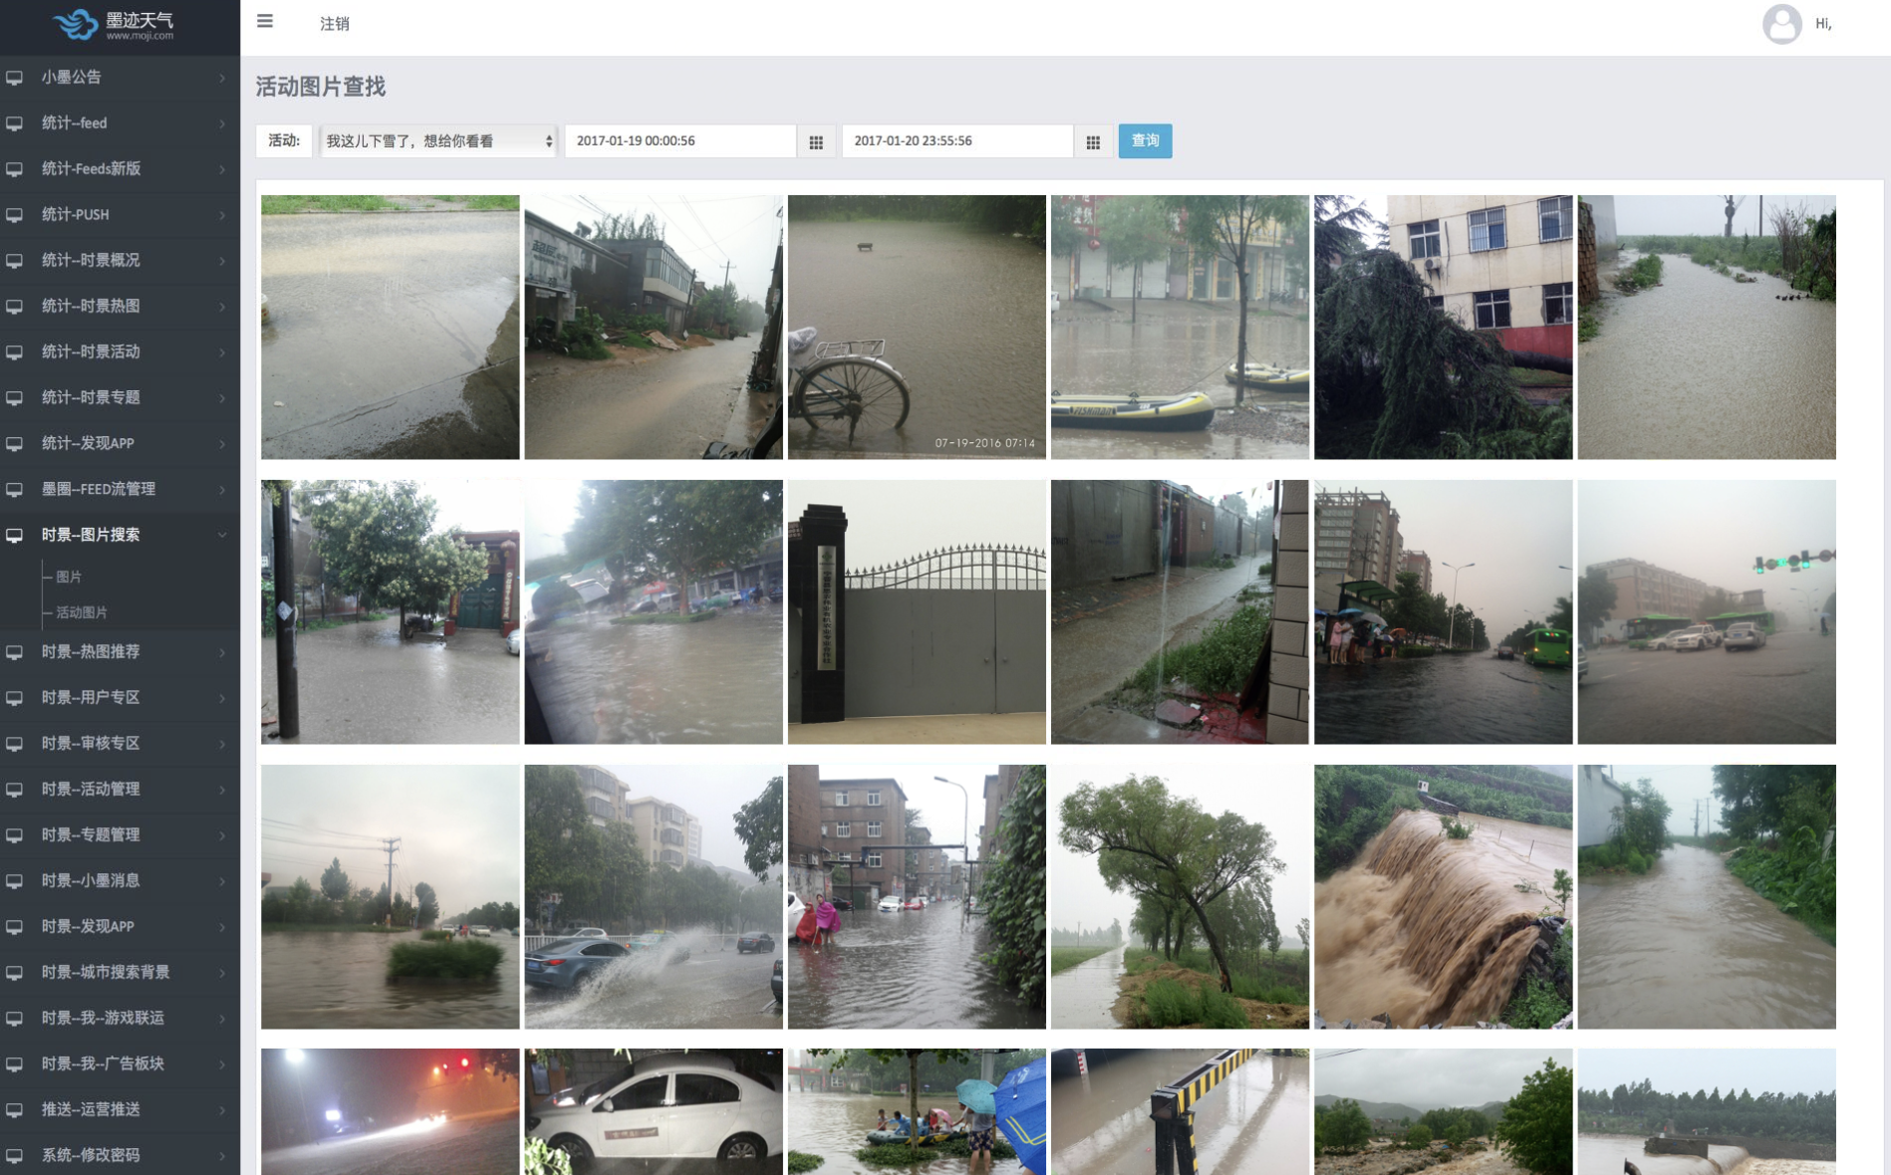
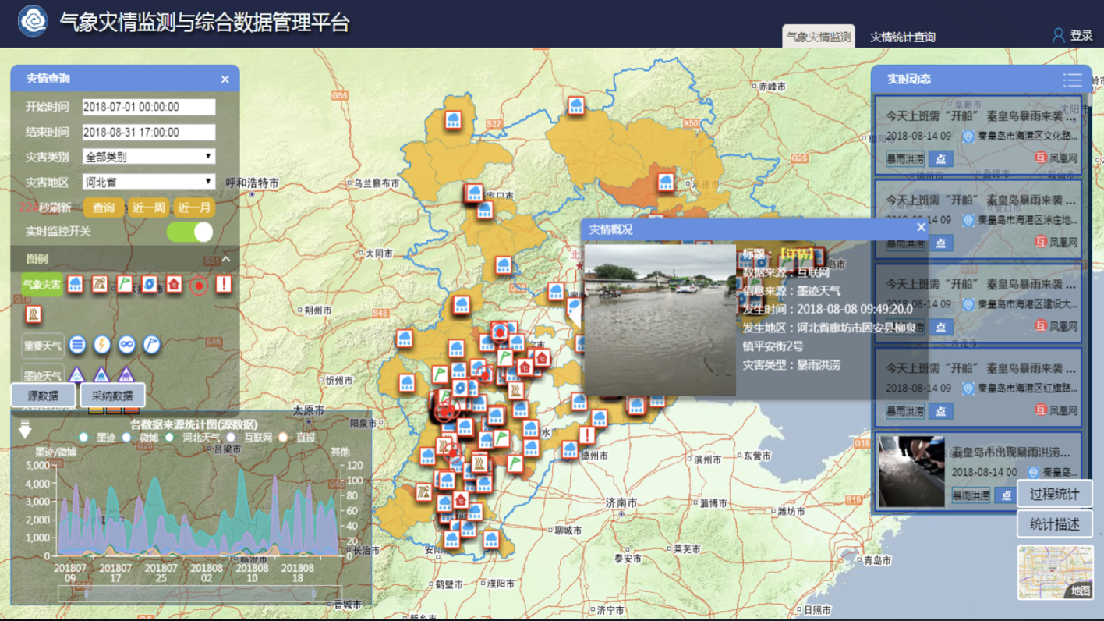


MOJI WEATHER
AI recognition for high impact weather detection.
Numerous in-site photos uploaded by users
Improve high-impact weather events observation 4 times than normal
Notes:
The last case is about collaborations in the high impact weather detection.
Some high impact weather, such as hail, happens in various local areas. The impact levels are also quite different.
One way of observation the impact level is using surveillance cameras. Since the limitation of number, the many cases cannot be observed.
While some weather apps providing functions of sharing photos of local weather and disaster status. By utilizing those photos, more high impact weather events could detected with exact place, time and levels.
For example, Moji Weather collaborates with the Hebei Provincial Meteorological Bureau in China to collect live photos and automatically classify them by AI image recognition technology.
The types of events includes: typhoon, rainstorm, flood, thunderstorm, gale, hail and other disasters
In one year in Hebei Province, and the number of detected high impact weather events by using mobile photos are 4 times larger compared with the conventional ways.
And the same them, since the photo are taken by people, the events naturally have much more relevance to the human activity.
That’s all for my 4 cases:the public weather services, meteorological technologies, observation data and high impact weather detection.
And I hope it could help you to understand some of status of PPE in China.
Thank you.

