Slide 1


How to Serve as a Bridge for
Public-Private Engagement (PPE)
QU YA
CMSA secretary-general
quya@chinamsa.org
Notes:
Thank you, Mr morator, and good noon, everyone. I am quya, the secretary-general of CMSA.
First of all, I would like to thank for PPE for giving me this opportunity to share with you the practices of CMSA. I ‘d like to begain with How to Serve as a Bridge for Public-Private Engagement

Slide 2

CMSA
China Meteorological Service Association
the only national, sector-oriented, non-profit organization in China for the meteorological industry
The Helper of
the Enterprise
The Assistant of
the Government
The Promoter of the Industry
680+ members
60% private sectors
17 Specialized Committees
Notes:
Firstly, I’ll give a brief introduction of China Meteorological Service Association. We were established in 2015, which is the only national, sector-oriented, non-profit organization in China for the meteorological industry.
We have nearly 700 members across the country , and about 60% are from private sectors.
The17 Specialized Committees are meteorological industries or high wheather impacted industries . Such as meteorological equipments, tourism, agriculture, finance and insurance. etc.
Basically, the core mission of CMSA is to be the assistant of the government, the helper of the enterprise and the promoter of the industry.

Slide 3
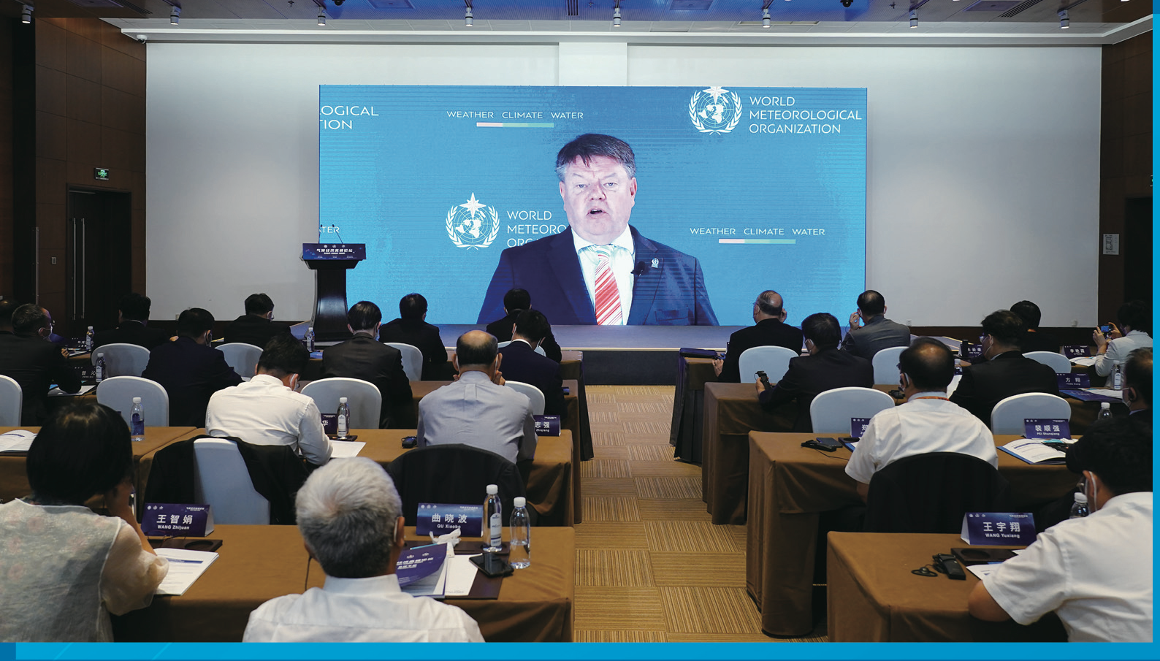
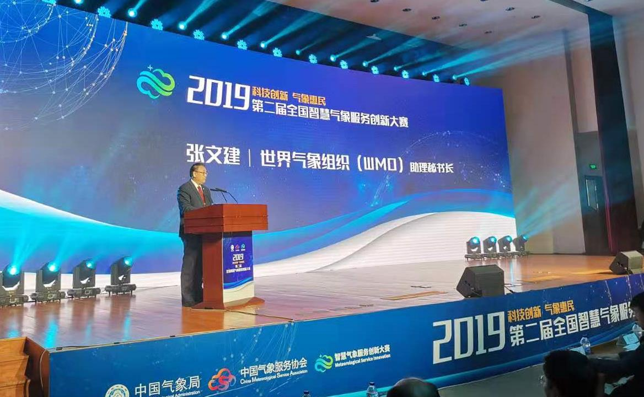
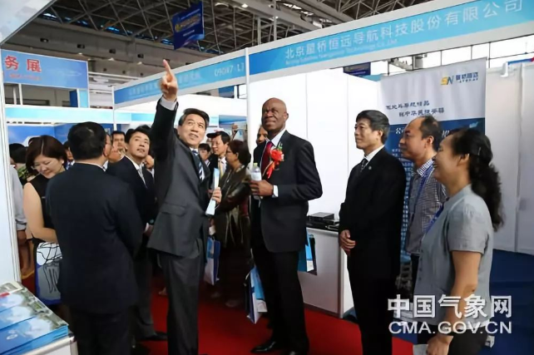
Practice Cases
in China
Ⅰ. Serve as a platform for public-private exchange in the field of meteorology
the China International Fair For Trade In Services (CIFTIS)
Meteorology and Global Trade Services Exhibition
Climate Economy Summit
the China-ASEAN Meteorological Equipment and Services Exhibition
Annual Conference of CMSA
Notes:
The second part of my presentation are practice cases of CMSA.
Firstly, we Serve as a platform for public-private exchange in the field of meteorology. Each year we hold a serious of exhibitions and conference. such as the CIFTIS and the China-ASEAN Exhibition,which are two of the three highest level exhibitions in China.
Last year, on the Climate Economy Summit of CIFITIS ,We were honored to have Mr. TALAS、Dr zhang wenjian, Mr Tasuya give presentations.
Annual conferences of CMSA also plays a important role to promote understanding between the public and private sectors. It can usually gather more than 700 members to participate.

Slide 4
Practice Cases
in China
Ⅱ. Facilitate private enterprises in bidding for government sponsored projects
National meteorological "14th Five-Year plan"
The State Council issued the Outline for the high-quality Development of Meteorology(2022-2035)
01
Put forward: "improve diversified investment mechanism", "increase openness and cooperation", "encourage social resources to participate in meteorological service supply"
CASES IN
CHINA
02
“Actively guide social forces to promote high-quality meteorological development."
03
CMSA led a joint effort to bid for the emergency rescue command system which provides decision support to the Ministry of Emergency Management
Notes:
Secondly, we Facilitated private enterprises in bidding for government sponsored projects.
In fact, in meteorological department, CMA have invited CMSA’s Enterprises members participated in the formulation of policies and regulations.
And we also led a joint effort to bid for the emergency rescue command system which provides decision support to the Ministry of Emergency Management.

Slide 5
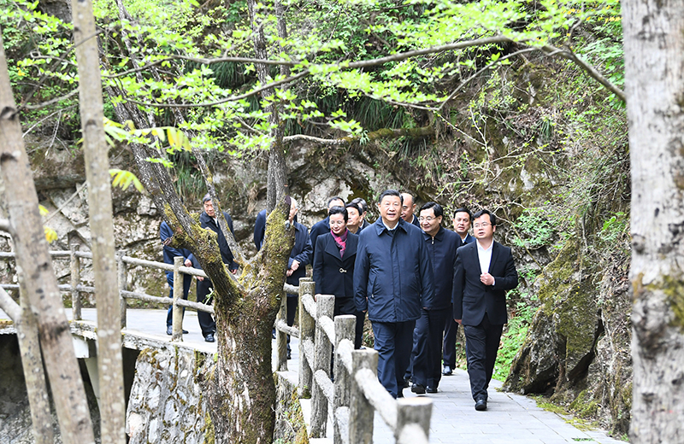
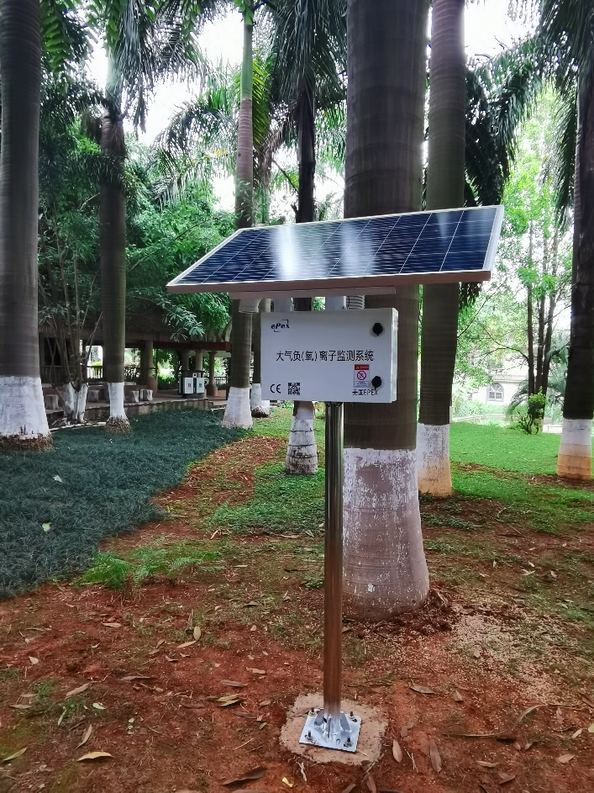
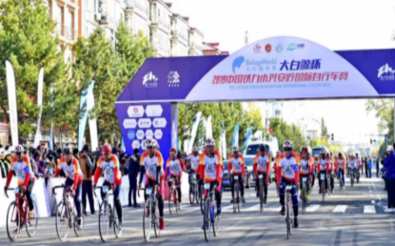
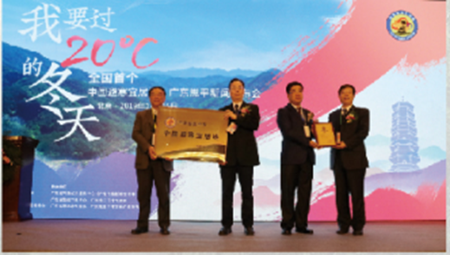
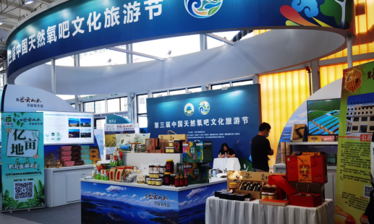
Bring the meteorological sector and local governments together under the national strategy of green and low carbon development
Designate China's natural oxygen park as a green industry cluster, unleashing the potential of meteorology for economic development
Notes:
The Chinese governments at all levels attach great importance to green and low carbon development.
With the guidance of CMA, CMSA designate China's natural oxygen park as a green industry cluster, unleashing the potential of meteorology for economic development, which creates the opportunities for the enterprises to participate in governments ‘ socio-economic development. especially in the fields of clean energy sustainable utilization, environment-friendly tourism.

Slide 6
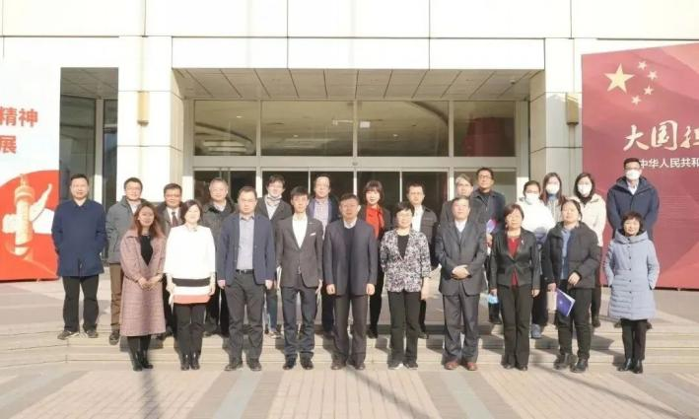
Ⅲ. Facilitate public-private cooperation in meteorological research and development
INNOVATION PLATFORM
drive market-oriented technology innovation with the joint efforts of governments, industries and the academics
enhance the capacity of innovation in meteorological science and technology
promote the application of technologies
a meteorological innovation platform
Notes:
Thirdly, in 2022 CMSA led the establishment of a meteorological science and technology innovation platform with a fund of more than 20 million. To drive market-oriented technology innovation with the joint efforts of governments, industries and the academics

Slide 7
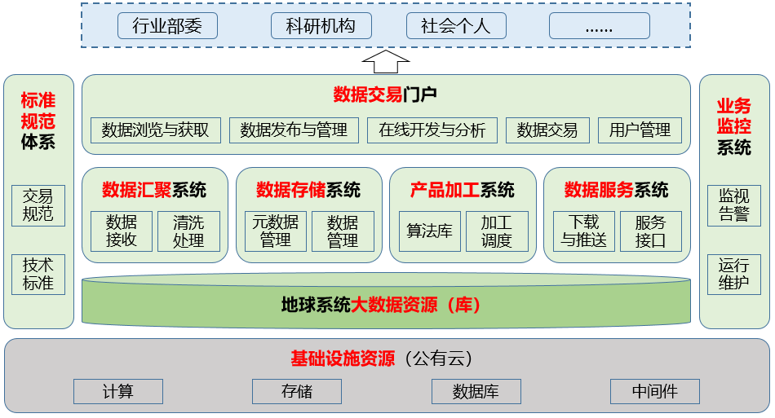
Professional Committee on Earth System Social Observations
Ⅳ. Partnership for the sharing of meteorological data
Scientific
research institution
Trading platform for social observation data
Industry ministries
Social individual
Standard specification system
Data trading portal
Business Monitoring System
Data browsing and acquisition
Data release and management
Online development and analysis
Data trading
user
management
The data circulation and transaction among the members of the Committee
one-stop data registration, management, trading, and service.
Based on the public cloud
Trading norms
Data convergence system
data storage system
Product processing system
Data service system
Surveillance Warning
Technical Standards
data
acceptance
Cleaning treatment
Metadata processing
data management
algorithms library
Processing scheduling
Download and push
Service interface
Operation and maintenance
Infrastructure Resources (Public Cloud)
Count
Storage
Data Base
Middleware
System architecture of the trading platform for Earth system social observation data
Notes:
The fourth, we also led the Partnership for the sharing of meteorological data. The Earth System Social Observation Committee was established in 2022 for the sharing and trading of social observation data between members, and the platform is currently under construction.

Slide 8
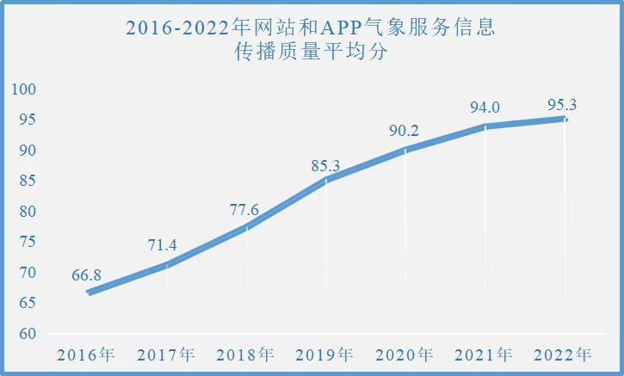
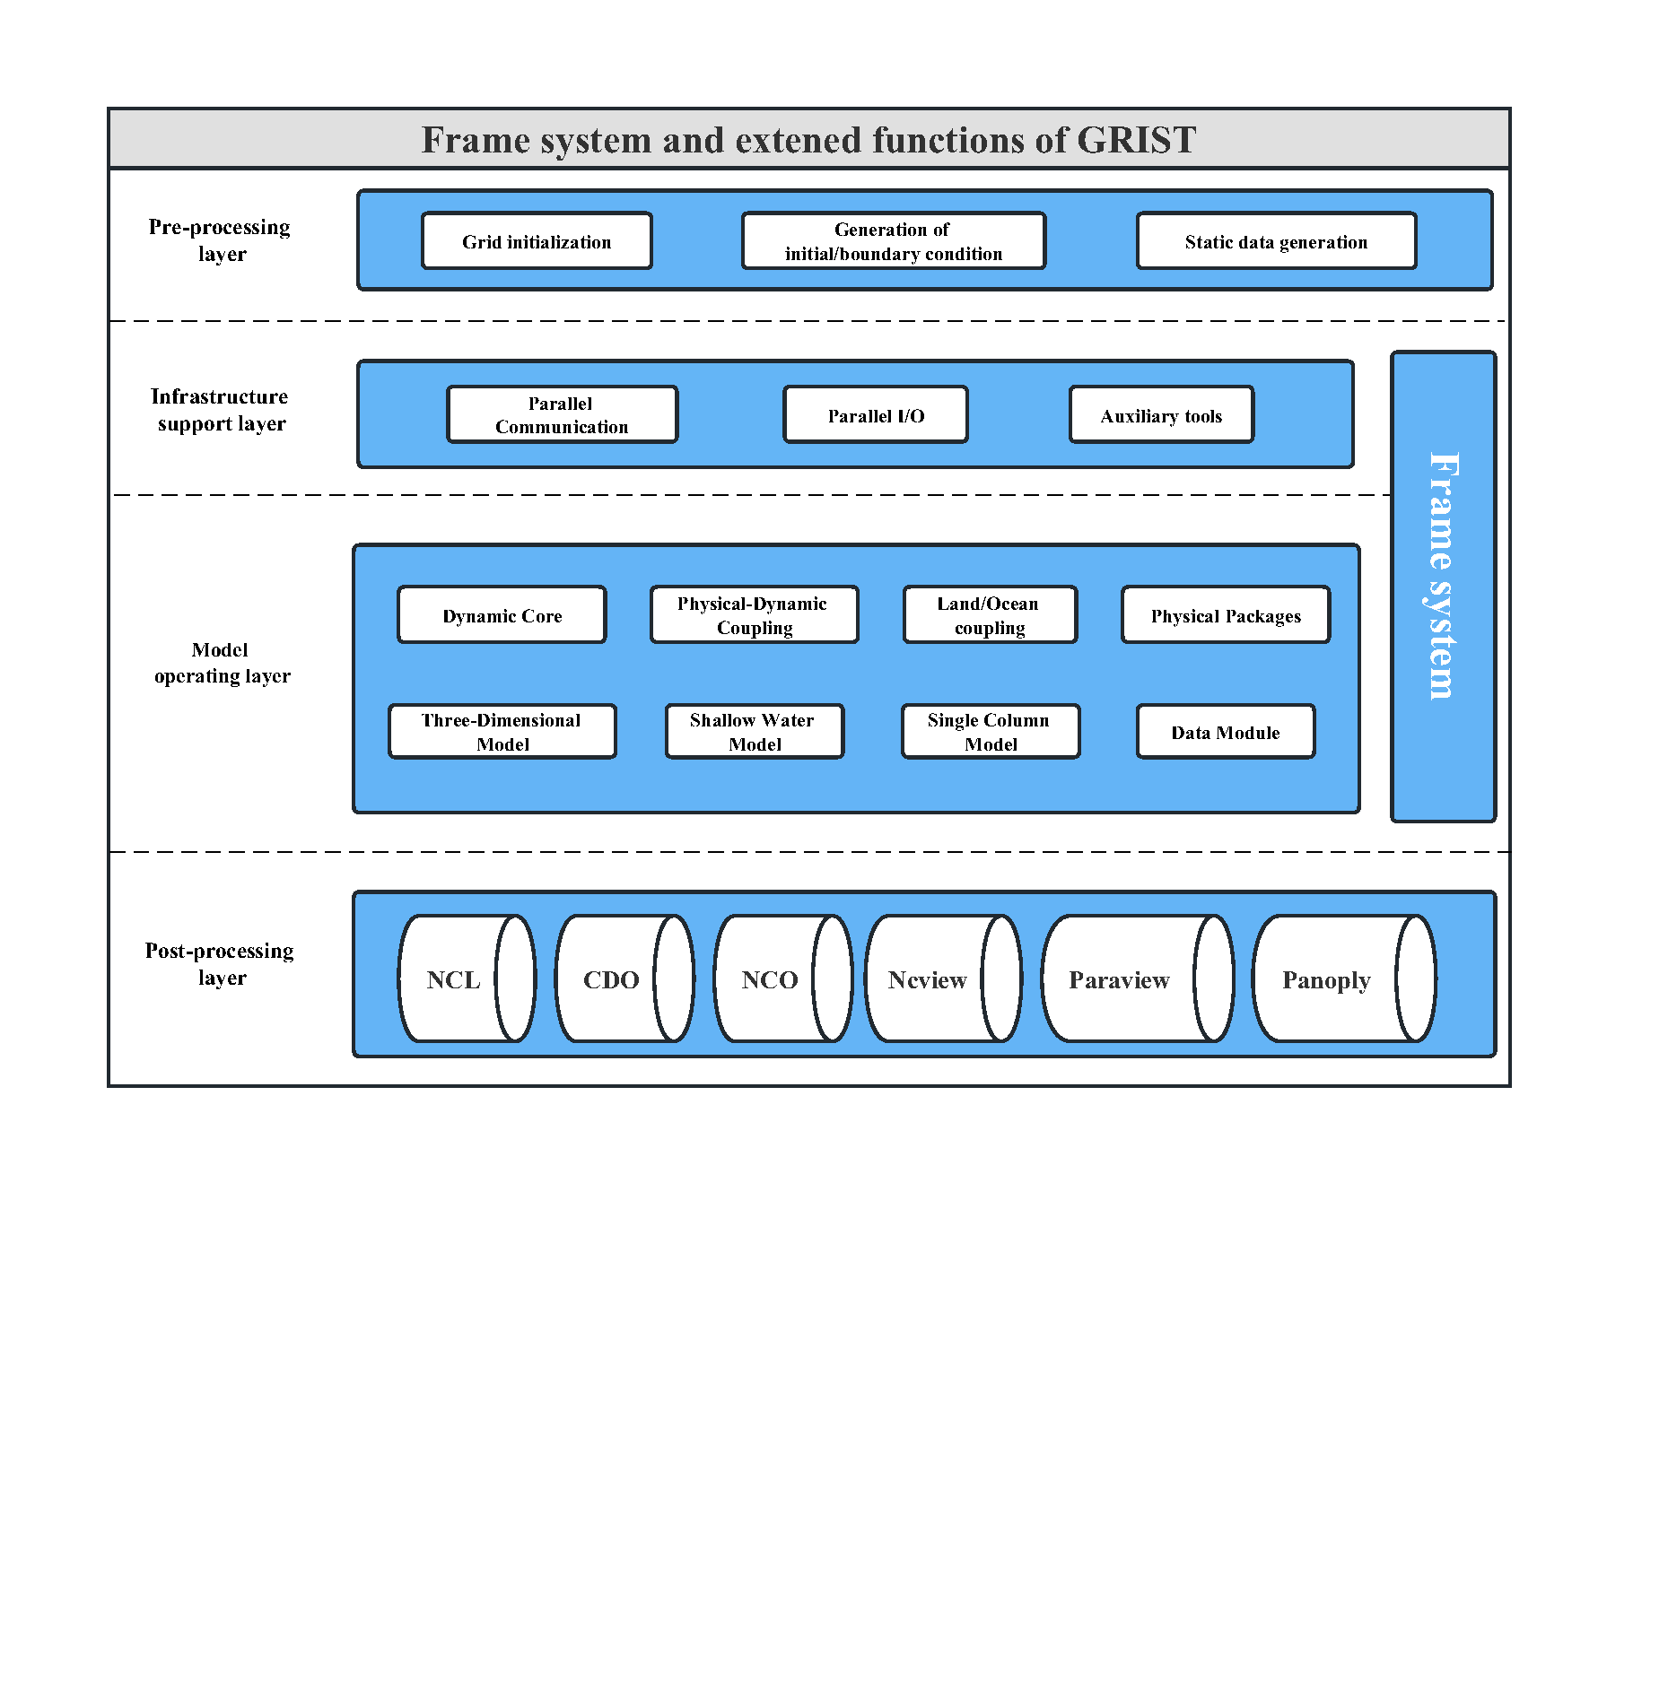
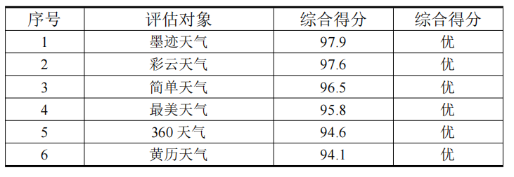
PIESAT
MOJI Weather
Unified weather-climate model system
Quality Rating of assessed APP Weather Hazard Warning Signal Dissemination (2022 Part)
Global-to-Regional Integrated forecast SysTem (GRIST)
Notes:
Fortunately, we are not alone on our efforts. The two of CMSA members, MOJI weather and Piesat, are really early birds on public-private engagement. I’d like to spare more time for them.

Slide 9
Thanks for listening
Contact E-mail: cmsa@chinamsa.org Contact number:0086-10-58993503
China Meteorological Service Association
Notes:
Thank you for listening, under the guidance of WMO, We hope to further promote public-private partnerships in China.
We are looking forward to work closely for the progress of global meteorology with you.

