Slide 1
Public-Private Engagement in the Republic of Korea
Mr. Seungwan MA
Director
International Cooperation Division
Korea Meteorological Administration
18 April 2023
OCP Forum for RA II/V, Singapore

Slide 2
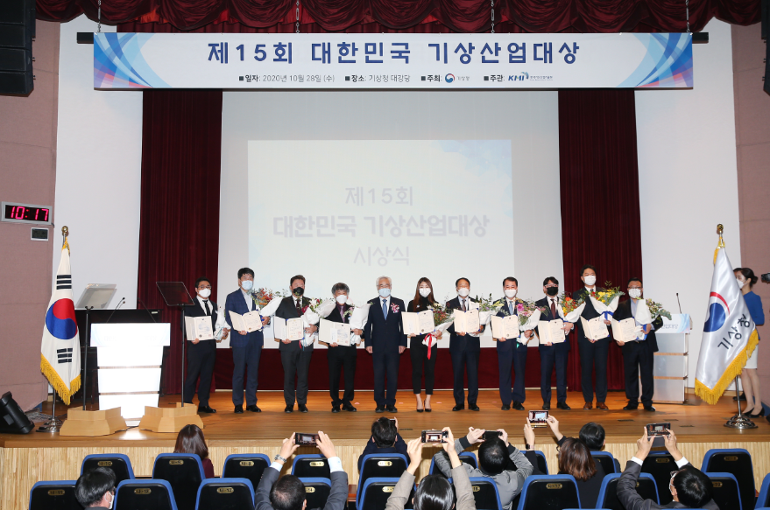
PPE Mechanism of the Republic of Korea
Conventional Mechanism: R&D Grants to Academia
Regular dialogues between KMA and private sector began in 2000
☞ Led to new national strategy for cross-sectoral collaboration
Enactment of the Weather Industry Promotion Act in 2009
☞ Led to new R&D funding mechanism for private industries
☞ Led to new start-up companies
☞ Certificate of excellent business, Met. Industry Awards etc.
Role of KMA in PPE
Regulator & Supporter

Slide 3
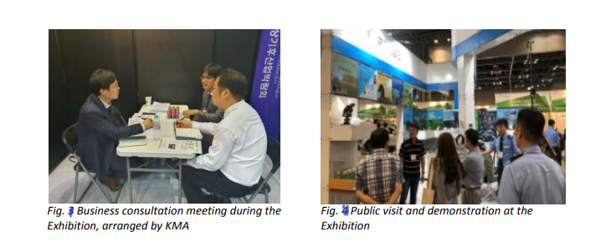
Open Data Policy & Big Data Forum
Emerging public needs for weather and climate data
☞ Legal frameworks to support domestic weather industry
Open Government Data Policy (Open API)
☞ Promote transparency, accountability, & added-value
Far more extensive data and information needed for private sector
☞ Weather and Climate Big Data Forum and Exhibition began (2014)

Slide 4
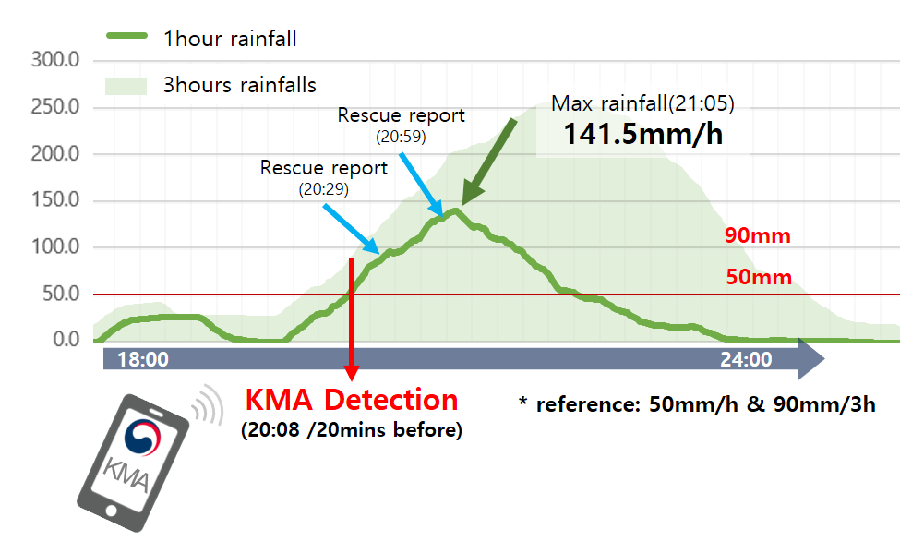
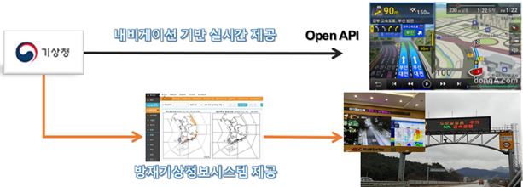
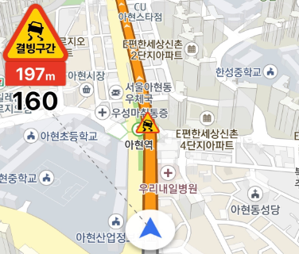
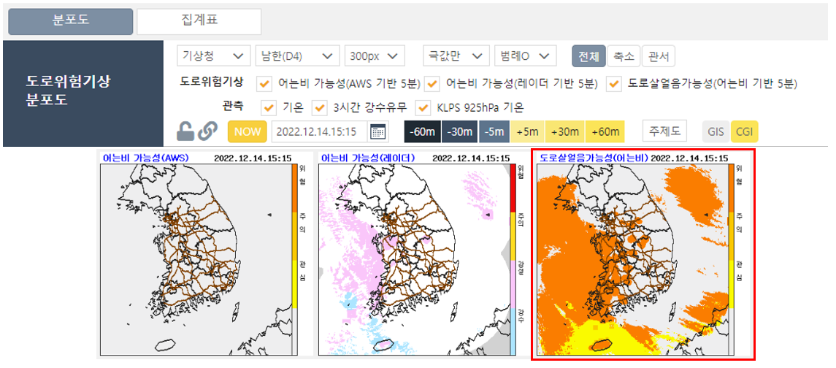
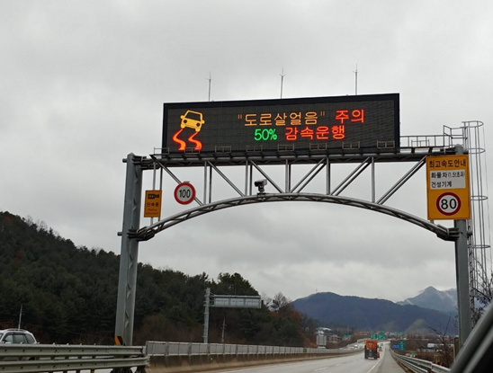
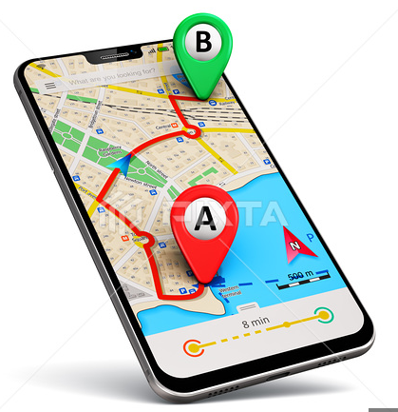
PPE to disseminate alert and warning info
Direct Cell Broadcasting
Emergency Alert Message
[KMA]
There is a heavy rain of more than 50mm per hour near ○○○-dong.
Please share information with your family and neighbors and pay attention to safety accidents.
※ Example
Black ice and fog information service on GPS-navigation
Real-time
GPS-navigation service
Black ice
Fog
Disaster Prevention
Information System
Met. Observation

Slide 5
Expectations towards OCP
Globally accepted references in weather and climate industry
to be developed via WMO OCP

Slide 6
Thank you
E-mail: wann567@korea.kr

