Slide 1
Practice and Reflection on
CMA Public-Private Engagement
Xiaoxiang ZHU
CMA Public Meteorological Service Centre
（ National Early Warning Centre ）
April 18, 2023
Notes:
Practice and reflection on CMA PPE

Slide 2

Outline
I. Principles and legal Basis
II. The concept of Public-Private Engagement development
III. CMA’s practice in PPE
IV. Way forward

Slide 3
I. Principles and Legal Basis
CMA encourages social forces to participate in the development of meteorological operations and services, aiming at value sharing and a win-win situation for both the public and private sectors.
  CMA public-private partnerships should, in general, support the accomplishment of the duties entrusted to us by the WMO Convention, encourage the sustainable growth of global meteorology and the shared development of national capabilities, and avoid eroding the foundation of our shared development.
  They should also support the maintenance of the authoritative voice of the WMO and national meteorological and hydrological services while also being able to encourage the participation of social forces in the development process.

Slide 4
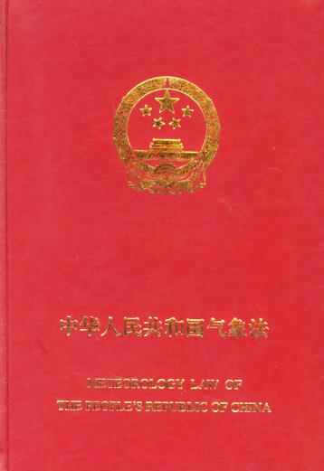
In actual practice, the CMA has adhered to the pertinent legal provisions of the Meteorological Law of the People's Republic of China and has organized the development of successful public-private partnerships in accordance with the pertinent elements of the Outline for Quality Meteorological Development (2022-2035) and the 14th Five-Year Plan for Meteorological Development.
China's Meteorological Legal System
212 local regulations & government regulations
31 departmental regulations
3 administrative regulations
1 law
Notes:
212部地方性法规和政府规章
31部部门规章
3部行政法规
1部法律

Slide 5
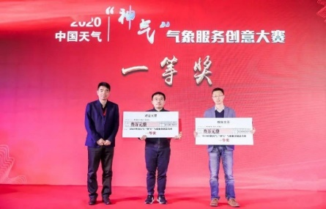

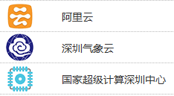


II. The Concept of PPE Development
Governments at all levels should establish partnerships with national meteorological departments to enhance their capabilities and fulfill their responsibilities, meanwhile private institutions should open up information and technology to governments.
Data Development
Product Display
Cloud
Support
Industrial Incubation
Capital Matching

Slide 6
III. CMA’s Practice in Public-Private Engagement
1. Openness and Data Sharing for Mutual Benefit
Measures for the Administration of Meteorological Information Services
Announce the "Catalogue of Open Sharing of Basic Meteorological Data" to the public
  Openness and data sharing has always been valued highly by the China Meteorological Administration (CMA).
  It released the Measures for the Administration of Meteorological Information Services in 2015 with the goal of regulating meteorological data sharing service activities and fostering meteorological data development and utilization. The decree was updated in 2020.
  A new version of the Catalogue of Open Sharing of Basic Meteorological Data was released in 2023
Together for mutual sharing and mutual benefit

Slide 7
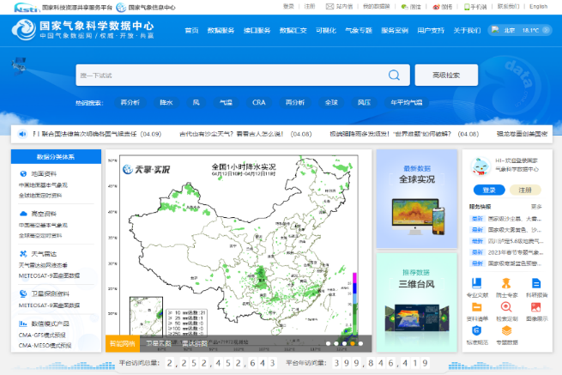
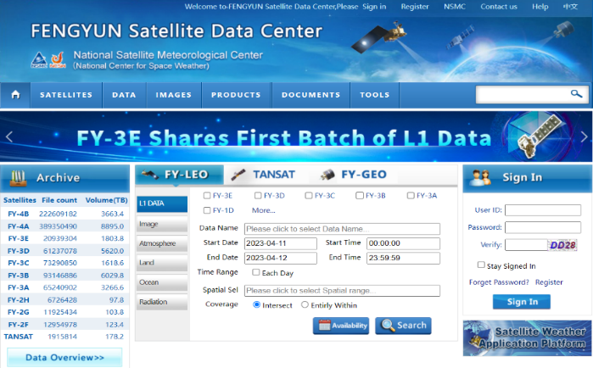
III. CMA’s Practice in Public-Private Engagement
1. Openness and Data Sharing for Mutual Benefit
Utilizing data from China Meteorological Data Sharing Network and FENGYUN Satellite Data Center. These service networks provide weather information to the public.
Meteorological information has actively supported national scientific and technical research, assisted in the cooperative growth of businesses, encouraged business efficiency, and sparked public innovation.
http://data.cma.cn/
http://data.nsmc.org.cn/
7 categories of 1350 basic meteorological materials and products
471,117 registered users, including 1885 registered enterprises
number of visits (2022):712,236,449
Total Archive：31.1 PB (incl. real time)
Freely registered users in 126 countries: 135758（by the end of 2022）

Slide 8
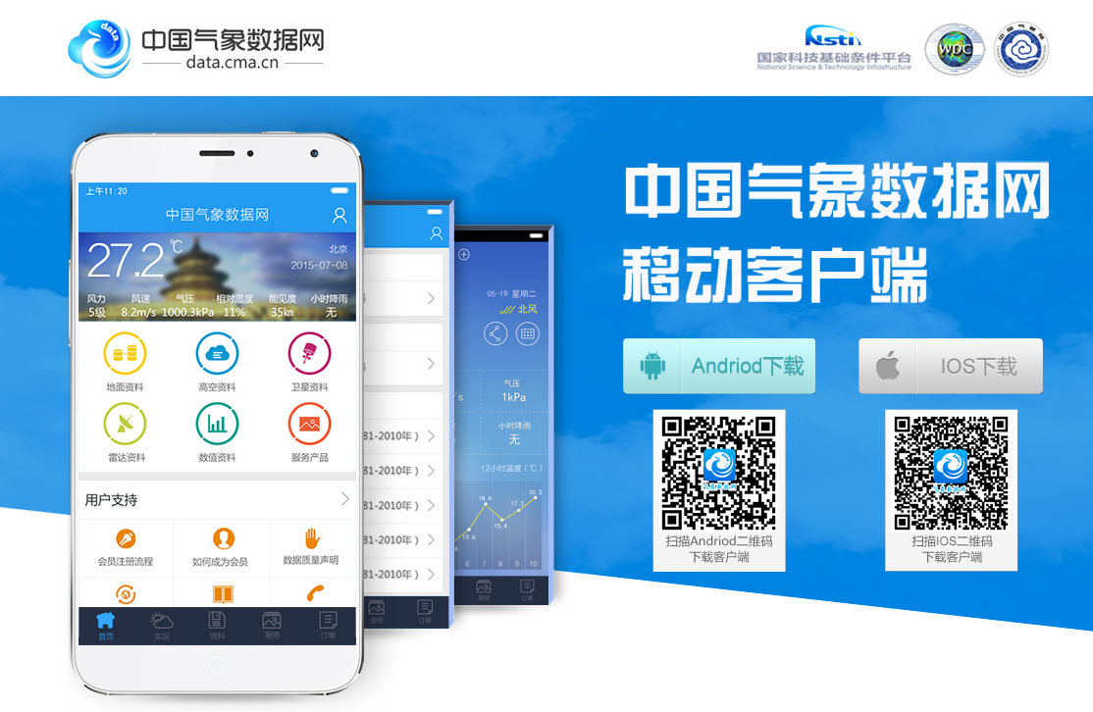
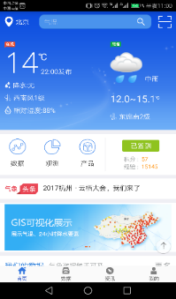
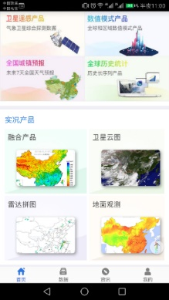
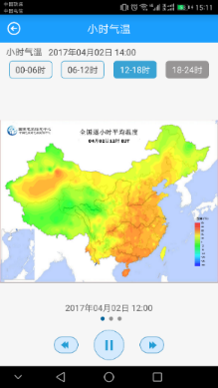
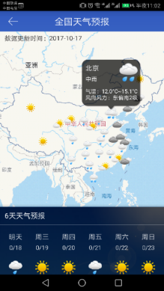
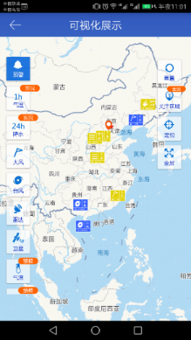
III. CMA’s Practice in Public-Private Engagement
1. Openness and Data Sharing for Mutual Benefit
CMDC-Primary Features (APP on MT)
Various data
Meteorological data and products
Weather forecasts
Data analysis
Customized services

Slide 9

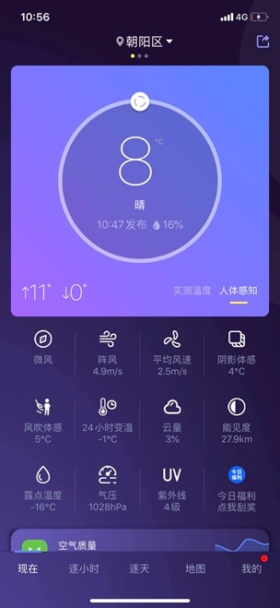
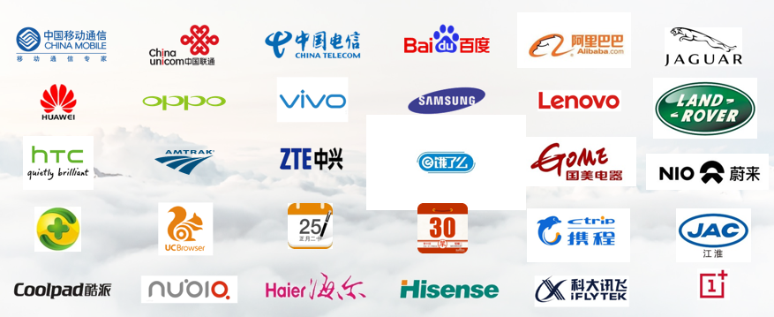
III. CMA’s Practice in Public-Private Engagement
2. Public meteorological service with the participation by
diversified parties
In September 2015, Huafeng Weather Media Group Co. , China's largest weather information media services company, and AccuWeather International LLC., a global commercial weather services company, jointly established Huafeng-Accu Weather Technology (Beijing) Co. Ltd. which is 65% owned by Huafeng Group and 35% owned by AccuWeather.
Huafeng-Accu began to operate, authorized by the China Meteorological Administration，the official "China Weather" mobile app and web-based public meteorological services, providing public weather services of 3 million cities to 250 million users worldwide.
Revenue over the past 3 years has reached 226 million yuan.

Slide 10










2. Public meteorological service with the participation by
diversified parties
Public-private Partnerships in Early Warning
To enable warning information distribution to be effective and efficient, CMA NEWC establishes a multi-dimensional dissemination network.
Kuaishou
Renminhao
Baidu
Sina Weibo
Alibaba
Toutiao
Tencent
Xiaomi
TikTok
Wechat
Multilevel Application
National
Provincial
Municipal
county-level
Warning Dissemination and
Communication Matrix
Accurate
Targeted
Multi-form Products
Text
Image
Voice
Short video

Slide 11
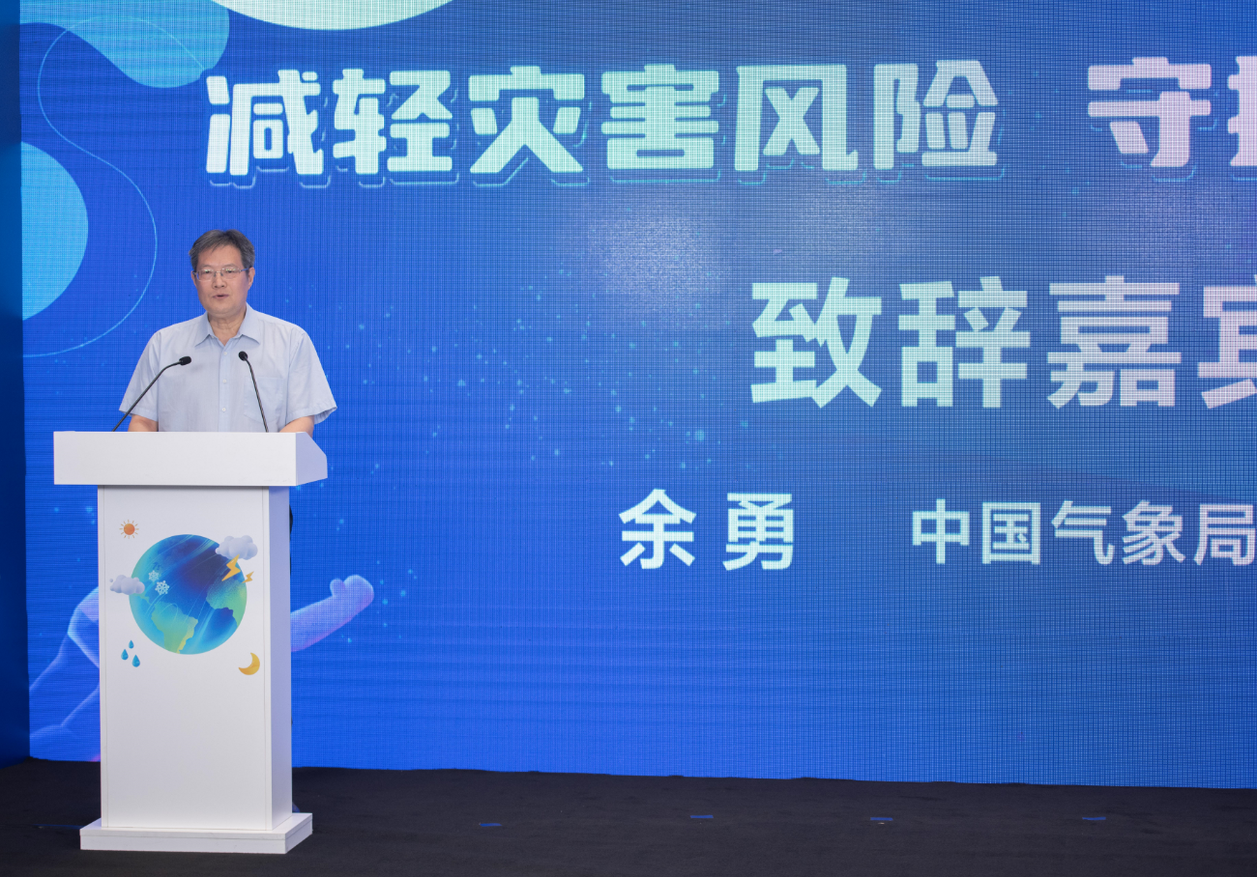
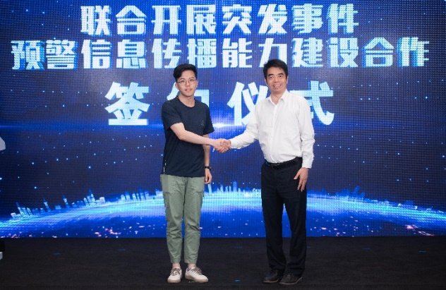
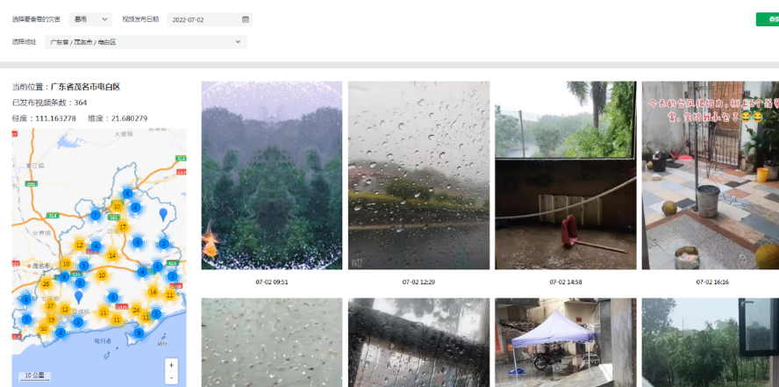
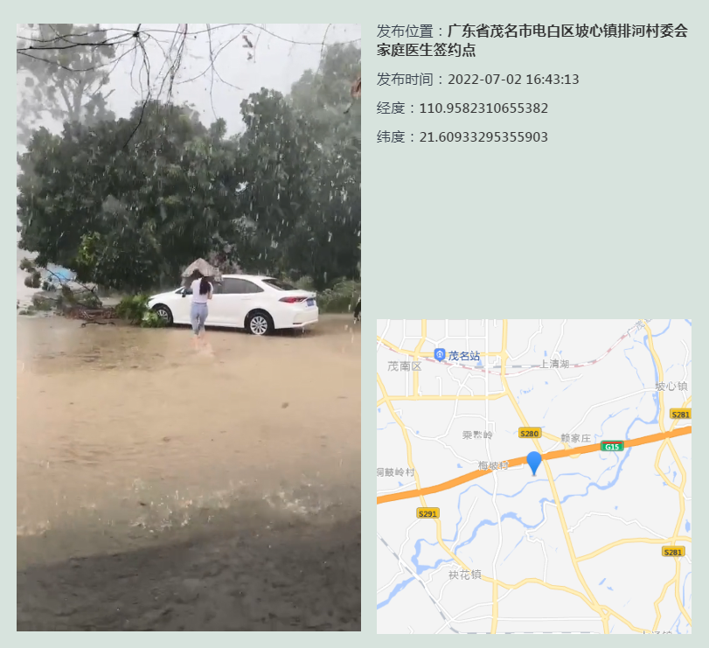
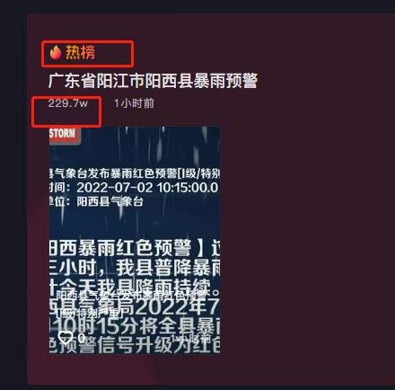
2. Public meteorological service with the participation by
diversified parties
An online disaster emergency information platform has been built jointly with TikTok. Users in the affected areas can receive early warnings immediately. Through this platform we can collect disaster-related videos from users and then apply them to related meteorological services.

Slide 12
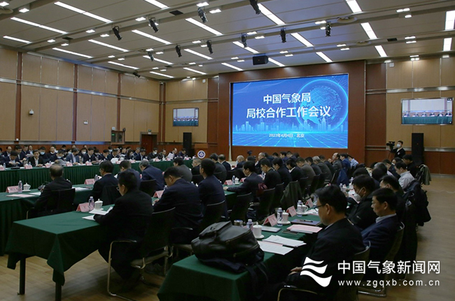
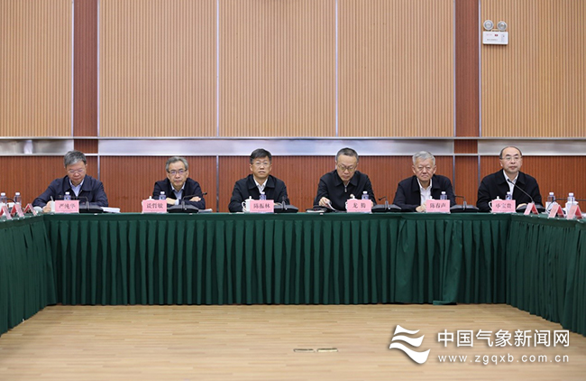
III. CMA’s Practice in Public-Private Engagement
3. Building inclusive public-private partnerships for science
into services
In order to encourage collaborative innovation and integration of meteorological science and education, and to build a whole-chain integration model of industry-university-research for key meteorological core technologies, the National Meteorological Science and Education Integration Alliance was established in April 2023.

Slide 13
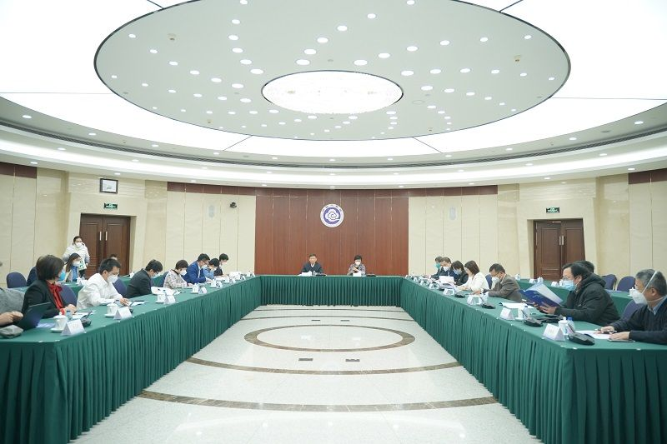
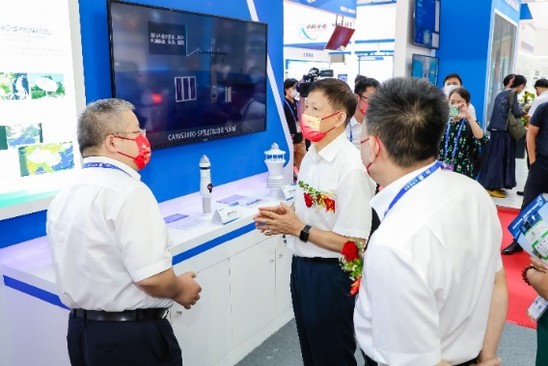
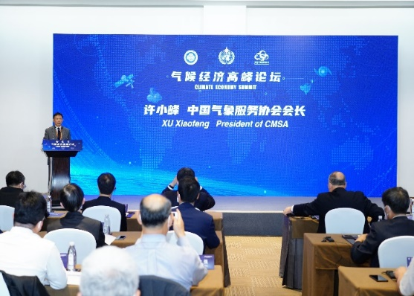
III. CMA’s Practice in Public-Private Engagement
3. Building inclusive public-private partnerships for science
into services
The China Meteorological Service Association(CMSA) collaborates with multiple institutions and enterprises to create a meteorological technology innovation platform.
This platform promotes scientific and technological innovation in the industry, funds applied research, and encourages the transformation and application of the results.
The first batch of the platform has publicly released more than 20 Key Meteorological Science and Technology R & D support projects.

Slide 14
III. CMA’s Practice in Public-Private Engagement
4. Industry self-regulation and market regulation jointly promote fair competition and collaboration between public and private partners
Establish market regulations to ensure the quality of meteorological-related activities and regulate meteorological information service companies.
  e.g., Regulations for lightning protection companies include administrative approval and qualification access, an annual reporting system, quality assessment, a credit system, and other measures.
  e.g., To standardize the quality evaluation of meteorological information service companies through filing of statistics and public announcements.

Slide 15
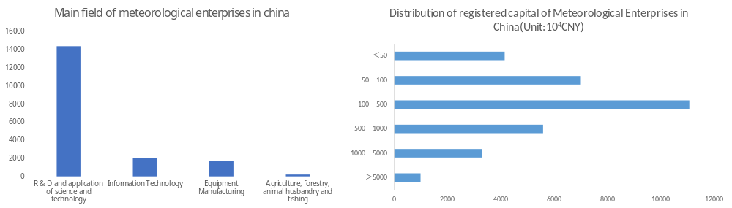
III. CMA’s Practice in Public-Private Engagement
4. Industry self-regulation and market regulation jointly promote fair competition and collaboration between public and private partners
Industry organizations are encouraged to receive operational and policy guidance from the public sector as well as industry regulation from industry organizations. Over the past eight years since its inception, more than 600 member units have joined the CMSA, 60% of which are private sectors.

Slide 16
IV. Way forward
1.
NMHSs are mainly committed to service delivery, development support and disaster prevention. We should develop our own internal capabilities, support national social and economic development, and raise public standards of living.
NMHSs should promote the growth of private businesses and the development of various mechanisms for cooperation, build a crowd-innovation platform for cultivating social forces to take part in the creation and delivery of specialized, individualized, and refined meteorological service products.
NMHSs should uphold the government's leadership role, develop public meteorological service policies, and enhance the financial guarantee system and the supervision in meteorological services.
2.
3.

Slide 17
For a Safer and Better Life
THANK YOU
April 18, 2023

