Slide 1
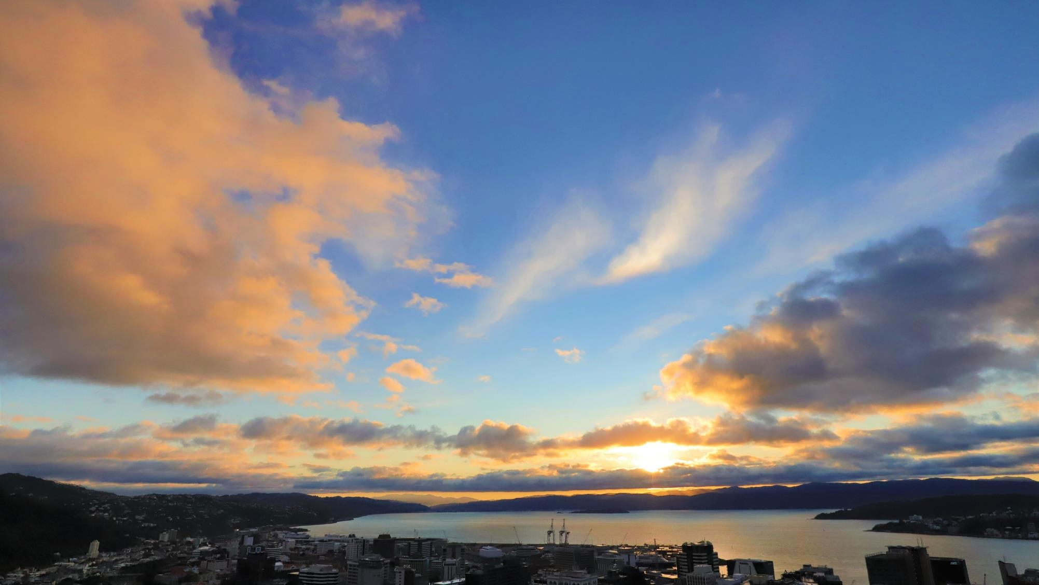
WMO RA II & V PPE Forum
Challenges and opportunities
Stephen Hunt – CEO of MetService
New Zealand
Contact us

Slide 2
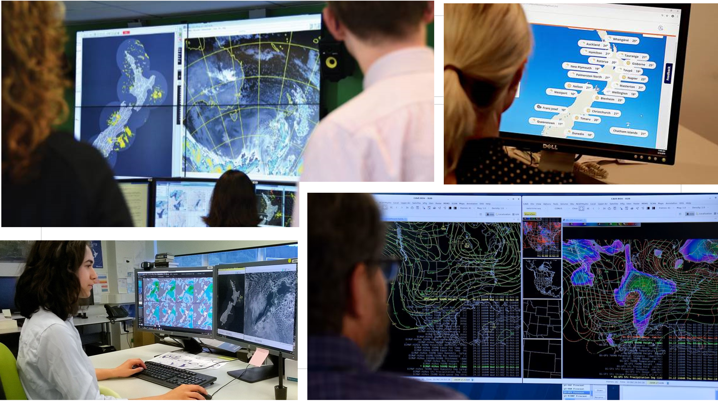
MetService
A fully commercial National Meteorological Service
360 million viewers in over 20 countries
Committed to furthering the WMO objectives

Slide 3
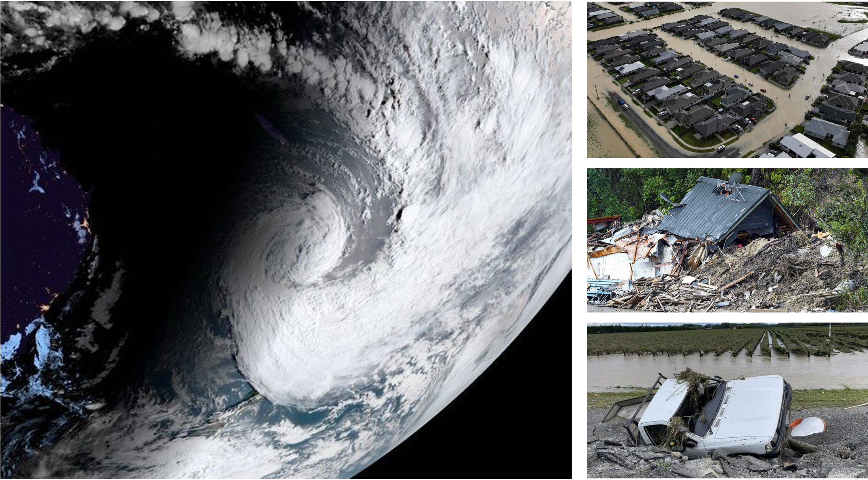
Our context and challenges
Climate change presents communication challenges
Competing sources of weather information
‘Final mile’ communication for impactful messaging

Slide 4
Learnings & opportunities
The right channels to cut through the noise
Indigenous messaging - we’re still learning
We need the right tools, right message & the right channel

Slide 5
Thank you
Contact us at: climate.forum@metservice.com
Contact us

