Slide 1
High-level Regional Forum of the Open Consultative Platform in Regional Associations II and V
Public-Private Engagement – HMEI Perspective
Singapore, April 18, 2023
Ashish H. Raval
HMEI Vice-Chair
President, Synoptic Data – a Public Benefit Corporation

Slide 2

HMEI – Association of Hydromet Industry
Who We Are | Our Core Values | Governance | Activities | Membership | Challenges | Value Proposition | Contact Info
History
March 2000
  Prof. Obasi
September 2001
  Formal Establishment of HMEI
February 2003
  Secretary-General Addresses HMEI
Notes:
March 2000
Prof. Obasi Secretary-General of World Meteorological Organization (WMO) wrote a letter, bringing to the attention of manufacturers of instruments and equipment the possibility of establishing an association of manufacturers as a way to enhance collaboration with WMO.
AMS Meetings in Long Beach, CA, USA, 11 February 2003
Prof. Obasi gave a speech to HMEI. The speech is included on the HMEI Website but there was one statement that he made that I would like to quote to you now.
“It has always been part of the WMO strategy to have an enhanced collaboration with instrument and equipment manufacturers since we both have a common interest, namely the enhancement of global monitoring capacities, which will result in development of and progress in meteorology”.
The key phrases here are enhanced collaboration, common interest, enhancement of global monitoring capacities. This is and should be the basis of our continued relationship

Slide 3
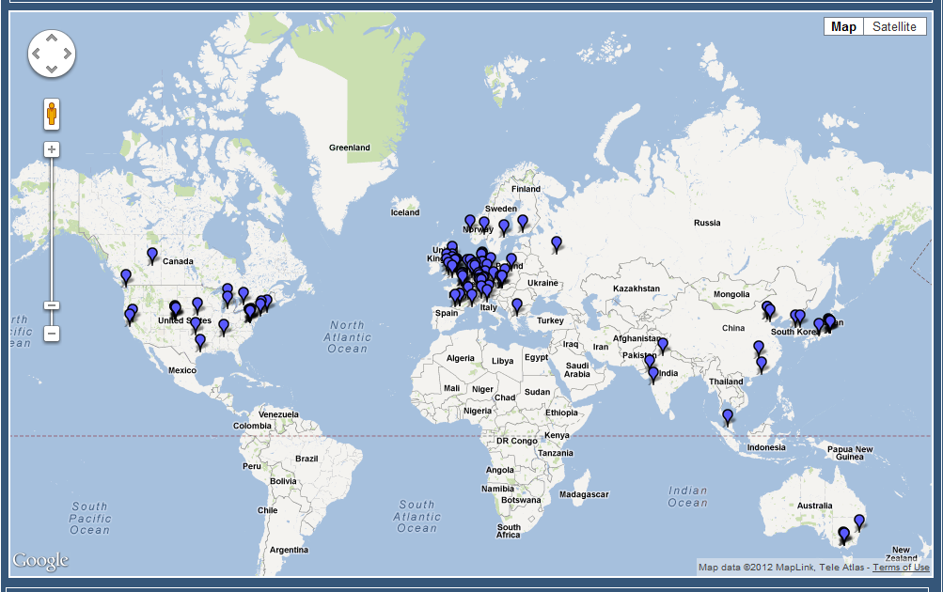
HMEI – Association of Hydromet Industry
Who We Are | Our Core Values | Governance | Activities | Membership | Challenges | Value Proposition | Contact Info
Notes:
Today we have grown to fulfill the dream that Prof Obasi and WMO had in 2000 to become that world wide representative of the Hydro-meteorological Equipment Industry . In 2004 we had 20 Member companies… today 20 years later there are approximately 140 Member companies in HMEI.

Slide 4
HMEI – Association of Hydromet Industry
Who We Are | Our Core Values | Governance | Activities | Membership | Challenges | Value Proposition | Contact Info
Not-for-profit organization representing the interests of our ~140 members who are consultants, developers, manufacturers, and service providers
Strive to advance technologies, standards, operational uses and sustainability of equipment, software, systems, and services supporting the weather, water and climate value chain
Share the goals of development partners to improve human resilience and economic prosperity
Seek to provide fit for purpose & sustainable solutions - software, communication, analytical services and equipment to our customers – in an ethical and collaborative way that fosters transparency and openness
Notes:
20th anniversary - the largest private industry association in our sector – approx 140 members
The only organization with a seat at the table, able to fully represent member interests across the Weather Enterprise
only eight international non-governmental organizations with a formal working arrangement with WMO.

Slide 5
HMEI – Association of Hydromet Industry
Who We Are | Our Core Values | Governance | Activities | Membership | Challenges | Value Proposition | Contact Info
Share our technical expertise¹ with WMO and other international organizations to ensure policies are informed by the best science and practice
Affirm and acknowledge the central role of met services as the single authoritative voice for weather alerts - public health and safety
Support all aspects of the global weather enterprise and seek to bolster the government and academic organizations at its core
Believe & Promote private sector engagement as an effective PPP strategy to improve the quality and sustainability of hydromet services and can help close budgetary, technical and human resource gaps in national public institutions
¹ Publications with WMO & World Bank - Generic Automatic Weather Station (AWS) Tender Specifications; Charting a Course for Sustainable Hydrological and Meteorological Observation Networks in Developing Countries
Notes:
HMEI members affirm and support the central role of met services as the single authoritative voice for weather alerts, especially when it pertains to public health and safety

Slide 6
Who We Are | Our Core Values | Governance | Activities | Membership | Challenges | Value Proposition | Contact Info
HMEI – Association of Hydromet Industry
GOVERNANCE
COUNCIL MEMBERS
General Assembly
Primary governing body
Comprises of one representative per member company
Meets once a year
Chair
Vice Chair
Budget & Oversight
Membership & Recruitment
Website Development & Oversight
WMO Commissions Collaboration
Special Committee, Projects
Representation at WMO Expert Teams
Global Weather Enterprise Coordination
Governing Council
Made up of 9 elected Members
Ensures guidance, coordination, oversight and leads HMEI initiatives & projects
Meets once a month
Secretariat
Ensures day-to-day operations
Staffed with Executive Secretary and Administrator
Located at WMO HQ in Geneva

Slide 7
Who We Are | Our Core Values | Governance | Activities | Membership | Challenges | Value Proposition | Contact Info
HMEI – Key Activities
Thought Leadership
Leverage industry technical, management and policy expertise to advance technologies, standards, operational uses and sustainability of equipment, software, systems, and services supporting the weather, water and climate value chain
Bridge gap between public & private sector
Representation
Represent industry interests, participate in global fora, and other policy organizations to strengthen the industry’s role in the global enterprise
Community
Be the convenor and connector of the industry within itself, to the global weather enterprise and to its stakeholders
Better understand the development sector & how to best leverage expertise for win-win collaborations
Specifically:
Contribute to WMO policy through Congress & EC
Engage in advisory capacity in WMO programmes (SOFF, EWS4ALL, Hydrohub, etc)
Support the design of WMO systems (ie. WIS 2.0)
Support publication of relevant docs¹ with WMO, WB etc
¹ Publications with WMO & World Bank - Generic Automatic Weather Station (AWS) Tender Specifications; Charting a Course for Sustainable Hydrological and Meteorological Observation Networks in Developing Countries
Notes:
our members have served on countless Expert Teams for WMO Commissions where advice from industry has influenced policy decisions and resolutions passed by WMO Council and Congress
Members also work together with WMO on bridging the gap between the Public and the Private sectors.
The first ever development of proper Generic Automatic Weather Station (AWS) Tender Specifications which was developed in collaboration with industry experts from HMEI, WMO personnel with strong financial support from the World Bank. This work was done to assist the National Hydrological and Meteorological Services and our members equally as the foundation of the Global Weather Enterprise is based on quality data fit for purpose that supports worldwide compatibility for worldwide comparability.
Work done by HMEI members made a valuable input to the activities of a new WMO Department dedicated to Public Private Engagement.
In general, more than 30 experts from various companies of the Association are actively involved in the working bodies of WMO and their contribution is highly appreciated.
Over the last decade, HMEI began working on developing a closer working relationship with the World Bank
Strong member participation at many Global Weather Enterprise Forums (GWEF) held at various venues globally.
Most recently, the writing of Charting a Course for Sustainable Hydrological and Meteorological Observation Networks in Developing Countries (Part 3). Our sincere appreciation to seven (7) of our members who invested significant time as contributing authors.
The Association is paying special attention to young scientists and specialists in member companies by establishing and holding a competition for the Young Engineers Award.

Slide 8
Who We Are | Our Core Values | Governance | Activities | Membership | Challenges | Value Proposition | Contact Info
HMEI Membership & Benefits
HMEI welcomes all private sector companies/suppliers (weather & climate value chain) and invites you to join our association
Annual membership contribution is CHF 1,000
Individual Membership is CHF 300
Benefits
Influence global policies that impact weather technology and services sector (join WMO expert teams); better understand the development sector & how to best leverage expertise for win-win collaborations
Increase reach and learn more about industry members – gain valuable insights
Promotional activities (advertise new products & services through press release distribution, website, newsletter, social media) – reaching major development stakeholders & WMO community
Discount at exhibitions (Met Tech World Expo, InterMet Asia, etc)
Online Catalogue of Members’ products & services

Slide 9





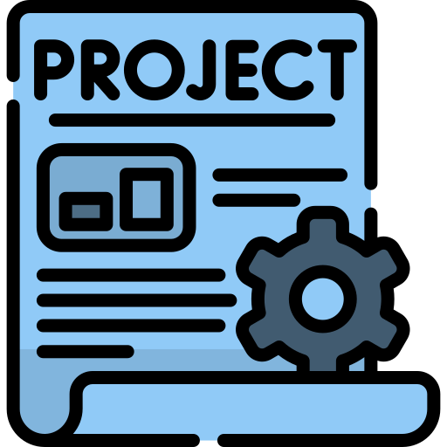
Challenges
Who We Are | Our Core Values | Governance | Activities | Membership | Challenges | Value Proposition | Contact Info
Limited government budgets
Dependence on sporadic donor funding
Limited technical skills & resources
Lack of professional, empowered staff
BUDGETS
PEOPLE
Budgets
People
Trust
Limited ability to deliver services to decision makers & end-users
Lack of credibility
Technology mismatch with capacity
Basic operational constraints
SERVICES
TECHNOLOGY
Services
Technology
Timelines too short
CAPEX funding does not support operations
Absorption capacity not always considered
Procurement timelines & specifications lead to poorly specified systems that do not meet needs
No Exit Strategy
Notes:
First time I heard the term observation gap – It was 2008 and I was the project manager for a Kofi Annan led project called Weather Information for All – it was a public private partnership with Met Services from East Africa, WMO, Ericsson, Zain and IRI Columbia University. We showed the picture with all the red and black dots all over the African continent – showing the lack of data. We did a pilot and installed about 15 stations in millennium villages near the Lake Victoria region – the plan was to scale up AWS installation and follow the Ericsson timeline as they deploy cell towers all over Africa. Due to various reasons, we only managed the pilot.
Now almost 15 years later – even though we know that hydromet services are only as good as the underlying observational data on which they’re built on – findings from the global gap analysis undertaken by WMO in 2020 indicate that the observation gap in some regions is actually larger now – and that’s not even considering the additional deterioration due to the COVID-19 crisis where maintenance has not been done in certain areas.
You are all familiar with the story – basic competing resources make it difficult in certain countries fully commit to upkeep of observing networks. It is difficult to see this changing in a large scale in the foreseeable future.
From a donor standpoint – some have specific companies they want to work with, which sometimes means incompatible equipment, different technologies and training needs. Some donors start from 0 rather than build on what is already existing. While this is getting better – it is still not at the level it needs to be.
National strategic plans exists – but they are not always followed – if the there is no convergence in donor funding and country objectives.
NMHS have significant challenges meeting all the requirements to support observational networks and other operational needs
Mention outcomes from Bali MHEWS Conference - SOFF, GMAS and CREWS are all underpinning
We are here to help bridge that gap – but we need to work together on changing the status quo – we cannot keep doing the same process and expect a different outcome.

Slide 10

Conditions for Sustainable Development Programme
Who We Are | Our Core Values | Governance | Activities | Membership | Challenges | Value Proposition | Contact Info
Fit for Context Technology
Multi-Year Project Investment
Public Private Partnerships
Data Rights and Markets to Enable PPPs
Multi-Stakeholder Approach
Notes:
It was announced that the United Nations would spearhead new action to ensure every person on Earth is protected by early warning systems within five years. He asked the World Meteorological Organization (WMO) to lead this effort and to present an action plan to achieve this goal at the next United Nations Climate Conference, later this year in Egypt. The developing plan is aligned with, and leverages, other mutually complementary COP27 priorities, such as the Action for Water Adaptation and Resilience (AWARE) initiative, particularly in the context of early warnings for floods and droughts – two of the most impactful climate hazards that societies face.
WMO has been working with Members and partner agencies to develop a global architecture for achieving the goal, to present as an action plan, connected relevant financial mechanisms at COP27. This will utilize advanced analysis to improve the understanding of the global status of early warnings, across the full early warning to early action value cycle and will include a mapping of international early warning development efforts already planned for the next 5 years. This work is designed to highlight where outstanding gaps remains, and where the international community should focus and invest additional efforts as a matter of urgency.

Slide 11

Who We Are | Our Core Values | Governance | Activities | Membership | Challenges | Value Proposition | Contact Info
PPP to enhance NMHS infrastructure, capacity & sustainability
  Ownership of observation network equipment
  Data sharing and review/approval
  Increased capacity to fully utilize the systems and services
  Shared data or commercial data buy creates sustainability model
NMHS
Public Private Partnership
Framework
  Implementation and operation of systems and services
  Contractually defined data access
  Co-develop end user services and “last mile” content
  Sales and marketing with revenue sharing for cost recovery to sustain the systems and services
Private Sector
  Share private network data with government entities
  Purchase data and services developed by partnerships
  Industries: Insurance, Aviation, Electrical, Agriculture, Mining, Petroleum, Mobile, and many others
Local
Industries
Partnerships will need to consider sovereign authority, procurement guidelines, institutional mandates, etc

Slide 12
Who We Are | Our Core Values | Governance | Activities | Membership | Challenges | Value Proposition | Contact Info
PPP enables sustainable delivery of hydromet services
Total Operating Cost of Weather Observing Networks
Aviation/Transportation
Operations & Maintenance
Agriculture
Petroleum
Energy
Cost
Infrastructure Investment:
Staffed sites
Instrumentation
Installation
Electricity
Communications
Data centers
Burden Shared by Many/
Donors/Gov’t Bear Entire Burden
Insurance
Tourism
NGOs / Data Providers
Donor/Government
Public Model
Partnership Model
Notes:
Success

Slide 13

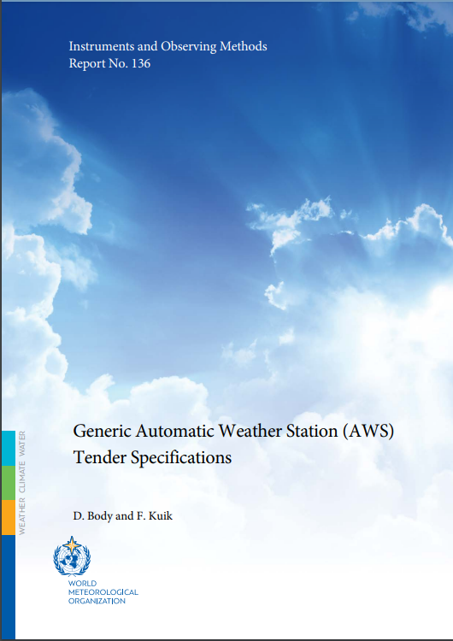
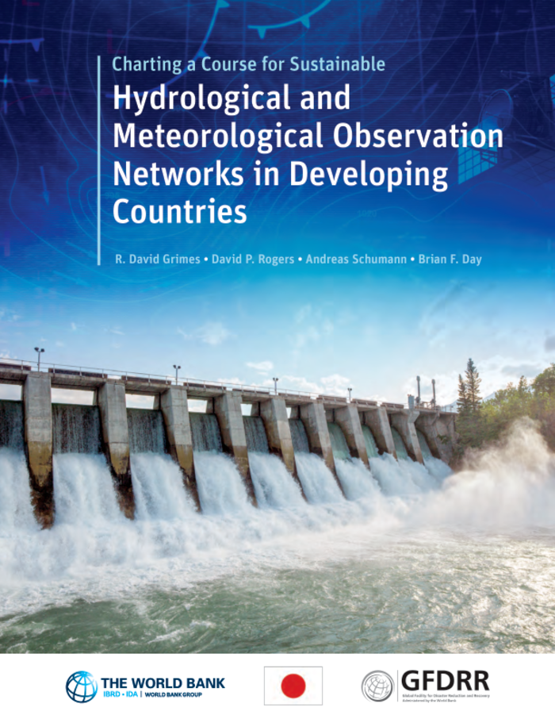
Who We Are | Our Core Values | Governance | Activities | Membership | Challenges | Value Proposition | Contact Info
Presenter
HMEI Vice-Chair
Mr. Ashish Raval
e: Ashish.Raval@synopticdata.com
m:+1(703)624-6957
HMEI Secretariat
Dr. Alexander Karpov Ms. Corine Perreman
Executive Secretary Administrator
e: akarpov@hmei.org e: cperreman@hmei.org
t: +41 22 730 8334
Publications
Generic Automatic Weather Station (AWS) Tender Specifications
IOM-136
Charting a Course for Sustainable Hydrological and Meteorological Observation Networks in Developing Countries
Link to doc

