Slide 1

Regional Forum on Public-Private Engagement
Asia Climate Forum
18 April 2023, Singapore
Public-Private Engagement (PPE)
PPE Office, WMO Secretariat

Slide 2
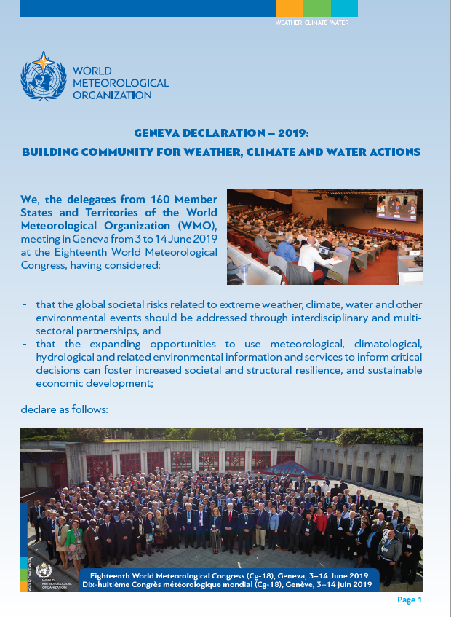
“We WELCOME
- The opportunities for all stakeholders and the broader user community that will result from a closer collaboration among public, private and academic sectors;
- The engagement of all sectors in addressing the societal needs through weather, climate, water and other environmental information and services;”
Geneva Declaration – 2019

Slide 3
Terminology – Public-Private Engagement
Public-Private Engagement (PPE):
Collaboration between NMHSs (and/or other public agents) and private sector entities to produce and deliver weather, climate, hydrological, marine and related environmental information and services while respecting the public interest and the mandates of NMHSs and keeping in mind budgetary constraints. (WMO Guidelines for Public-private Engagement (2021 edition))

Slide 4
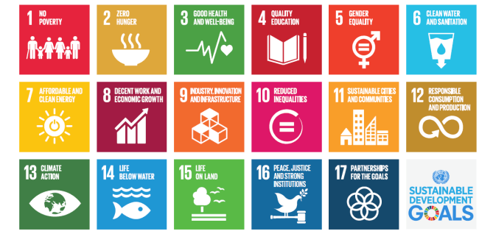
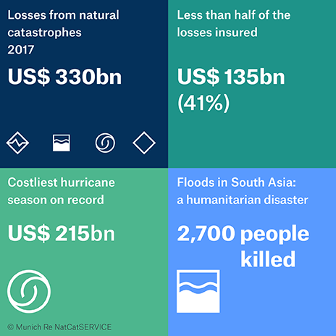
Drivers for Public-Private-Academic Engagement (1/2)
Growing needs
Agenda 2030 / Sustainable Development
Goals (SDG)
  Calling for engagement of non-state actors
Sendai Framework for Disaster Risk
Reduction 2015-2030
  “…There is a need for the public and private sectors and civil society
  organizations, as well as academia and scientific and research institutions, to work more closely together and to create opportunities for collaboration …”
  Paris Agreement
  (int’l treaty on climate change)
    Public-Private sector participation is recognized as a key for integrated, holistic and balanced non-market approaches to assist in the implementation.

Slide 5

Drivers for Public-Private-Academic Engagement (2/2)
Changing environments and technologies
Changing environment, increasing risks
Rapidly changing technologies
New business models & opportunities
Progress
in Science
Public
budget constraints
Growing demands for information and services

Slide 6
Why Public-Private Engagement (PPE)?
In short, this is because PPE will/can be beneficial to every stakeholder, collaboratively providing solutions to materialize further better services to all users, meeting various needs more efficiently/effectively, sustainably, resiliently, and with even higher quality utilizing cutting-edge technology while keeping relevant missions, skills and expertise.

Slide 7
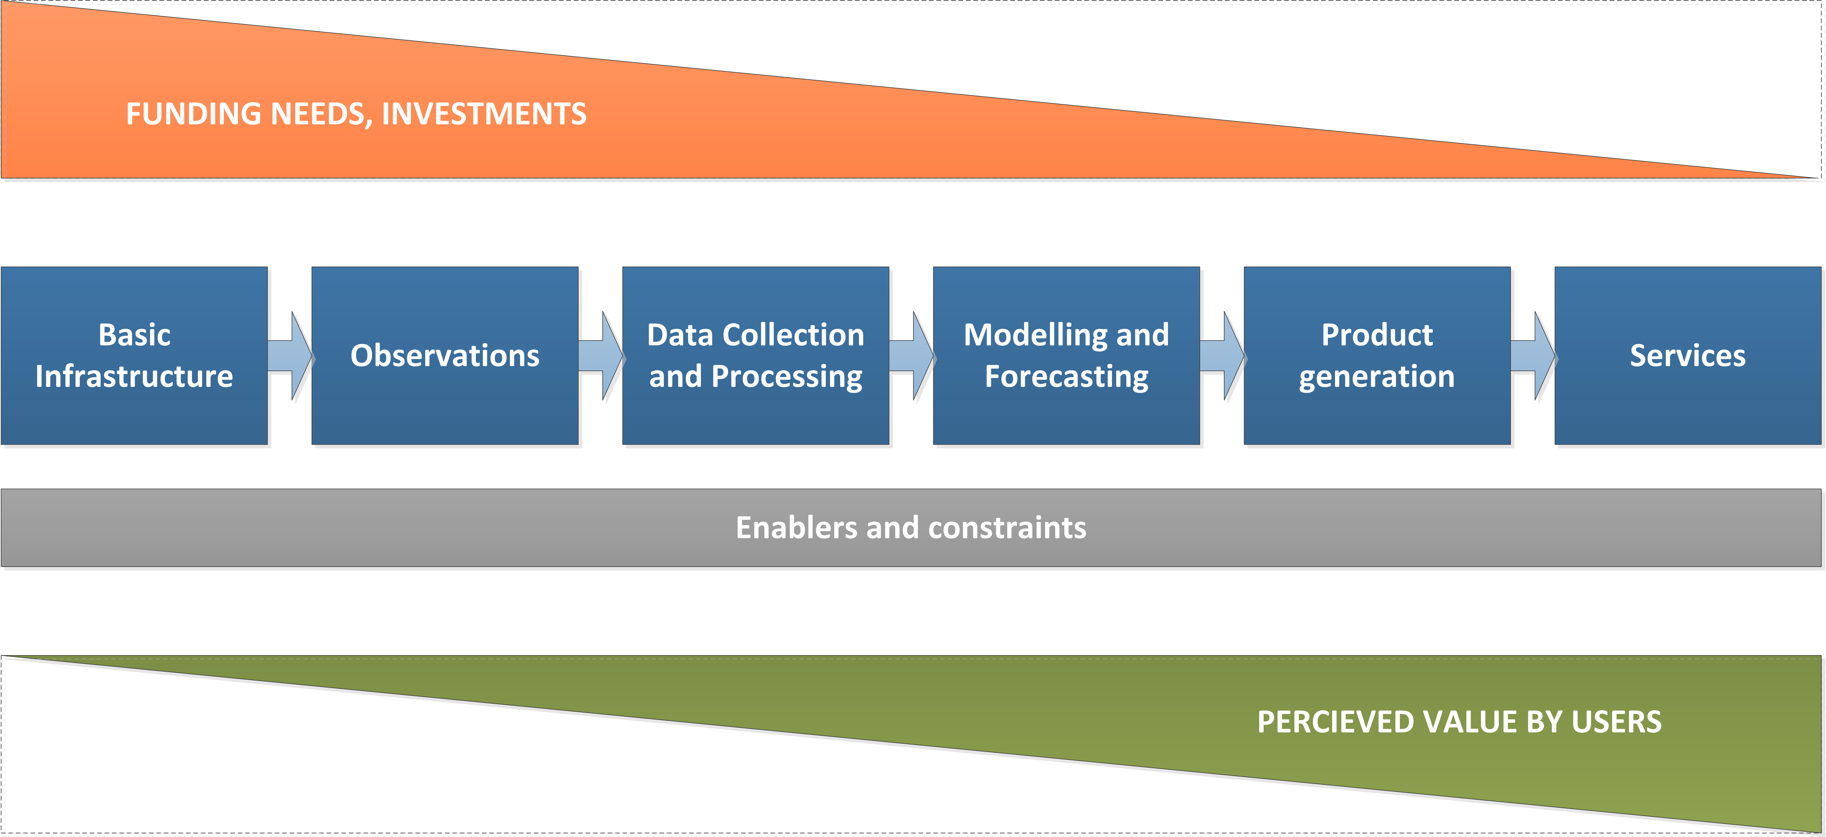
A Variety of Modalities for PPE
There are a number of ongoing practices in many countries in a variety of modalities that fits in each NMHS’s/country’s context.
worth individuals.
Modalities for PPE:
Tailored Services
Public Service
A Value Chain
Modalities for PPE:
End-to-End
DBO Design-Build-Operate
Modalities for PPE:
IaaS Infrastructure as a Service
DaaS Data as a Service
OaaS Operation as a Service
Crowdsourcing
Diversity of modalities and clear interdependence between stakeholders
→ Advocacy on public roles by stakeholders is important!

Slide 8
Innovative Practices in Different Modalities
Evidence is better than debate…
Examples related to Public-Private Engagement Opportunities
  Crowdsourcing (use of non-standard data)
  Data sharing (exchange of standardized data)
  Collaboration (in supercomputing incl. NWP model development)
  Procurement of services from the private sector (IaaS and OaaS)
  Open data (business model change)
  Revenue-sharing with the private sector
  Licensing the private sector
worth individuals.
worth individuals.

Slide 9
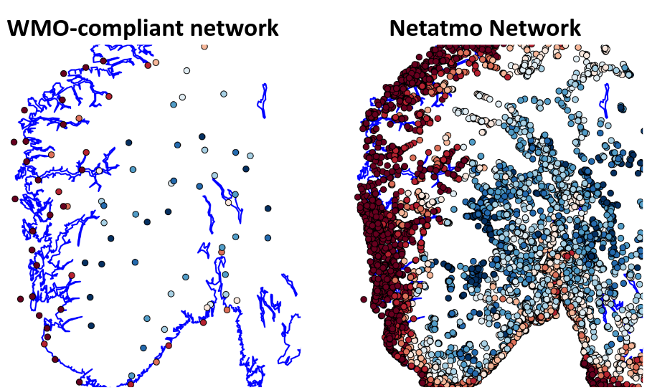
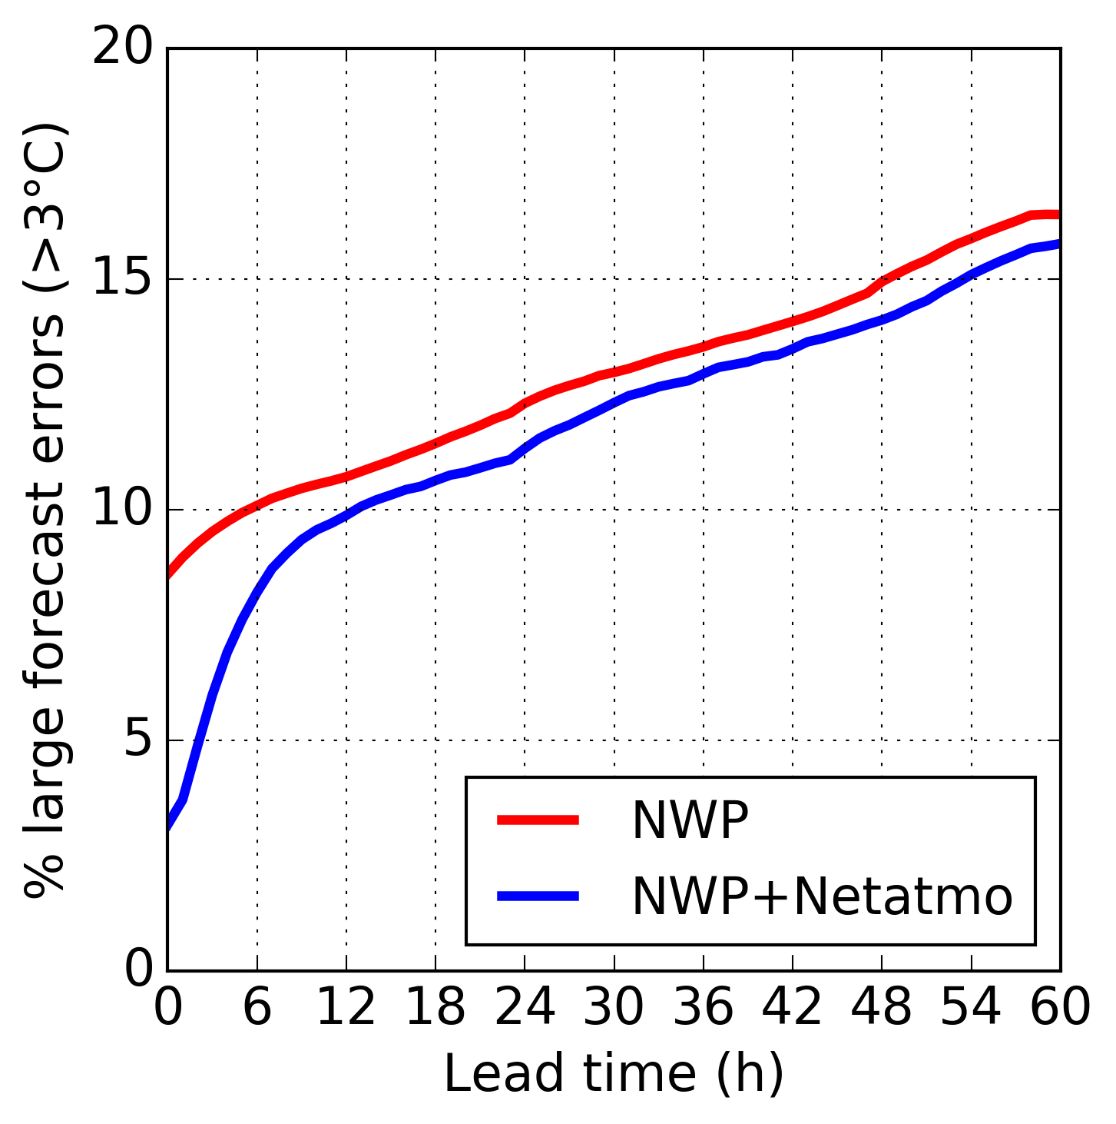
Examples of precedents and practices
Crowdsourcing (use of non-standard data)
MET Norway (Norwegian NMHS) integrates private sector observations from Netatmo’s Network in operational weather forecasting (link).
Details in PPE Resources in the WMO PPE website

Slide 10
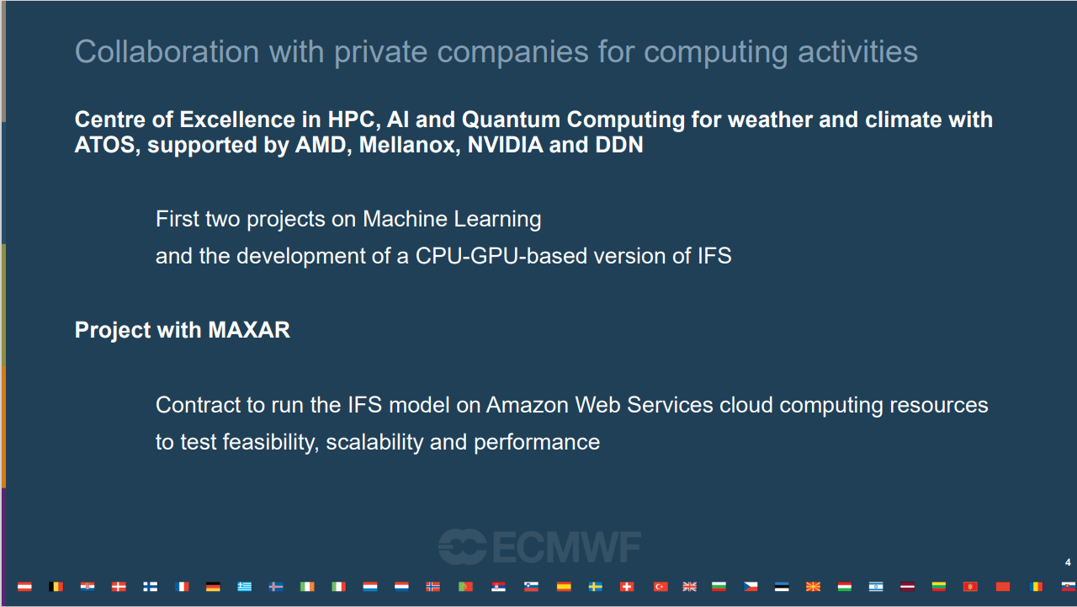
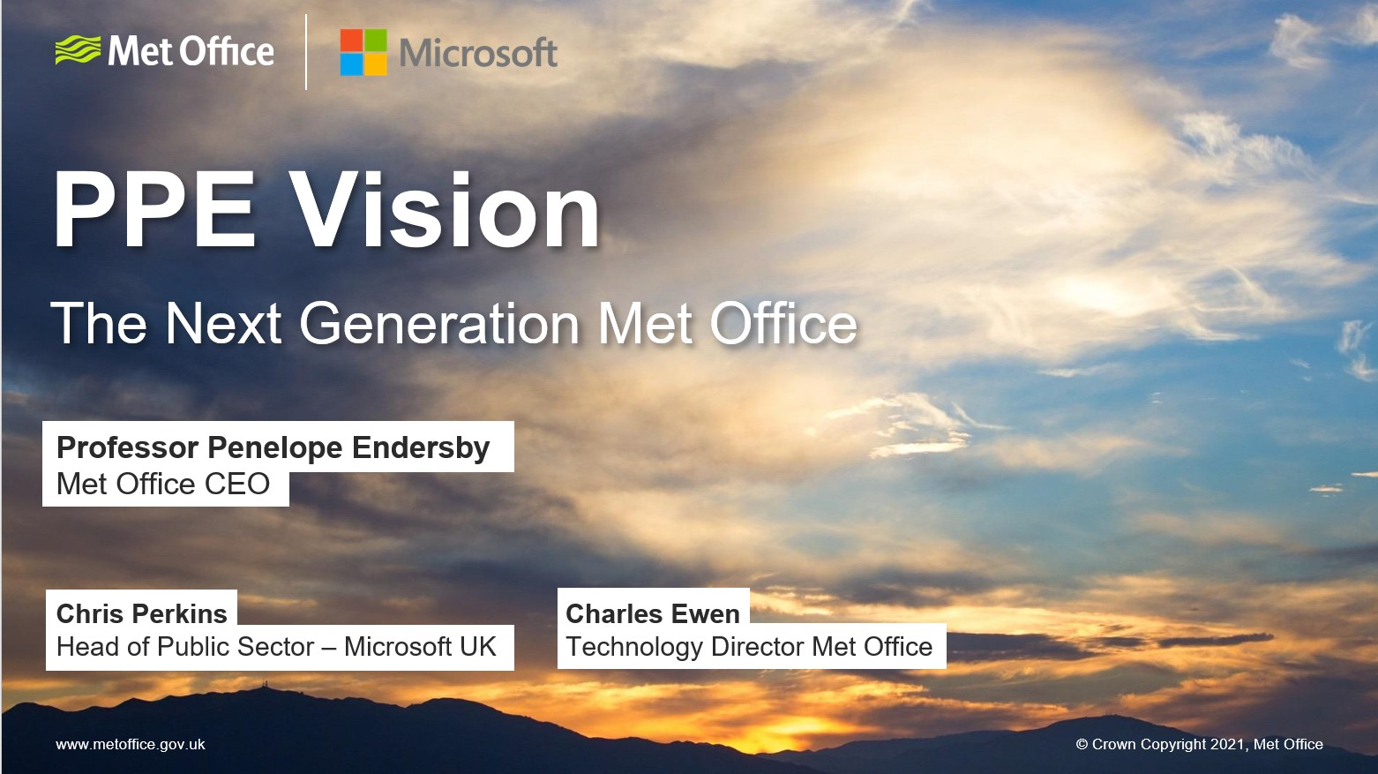
Examples of precedents and practices
Technology innovation
ECMWF and ATOS launched a Center of Excellence in Weather & Climate Modelling to support ECMWF’s medium to long-range weather prediction and global climate modelling by improving access to AI and quantum computing technologies (link 1, 2, 3, 4 & 5)
UK Met Office’s partnership with Microsoft to harness next generation of supercomputing capability and data technologies to deliver innovation for weather and climate forecasting (link 1 & 2)
From the WMO Data Conference Preparatory Workshop on Theme 2: "Business models and data policy issues“ (Oct 2020)
From a WMO OCP Innovation Webinar (Oct 2021)
Supercomputing leap in weather and climate forecasting - Met Office

Slide 11
Legal status of National Meteorological Services
Number of answers: 17/35
Number of answers: 7/24

Slide 12
Legislative act regulating meteorology (or hydrometeorology)
Number of answers: 17/35
Number of answers: 7/24

Slide 13
Legislation provisions concerning private sector participation in the delivery of information
Number of answers: 16/35
Number of answers: 6/24

Slide 14
Role of NMS as authoritative voice of warning services
Number of answers: 17/35
Number of answers: 7/24

Slide 15



Challenges…
The private sector’s evolution in capability and ongoing Digital Transformation (DX) provide opportunities to WMO Members, while in some/many Members there seems to remain deep-rooted fear to the private sector. How can we dispel deep-seated fears?
To go forward in PPE, it is necessary to break through existing barriers such as:
  Lack of mutual trust
  Lack of understanding in opportunities and risks of PPE
  Lack of legislative/ institutional framework
  Insufficient Gov funding (affects data sharing)
Dialogues through the Open Consultative Platform & Regional Forums
Capacity Development through sharing good practices and training
Relevant assistance to WMO Members to ensure regulator/promoter’s roles
Learning from business models; advocates needed

Slide 16
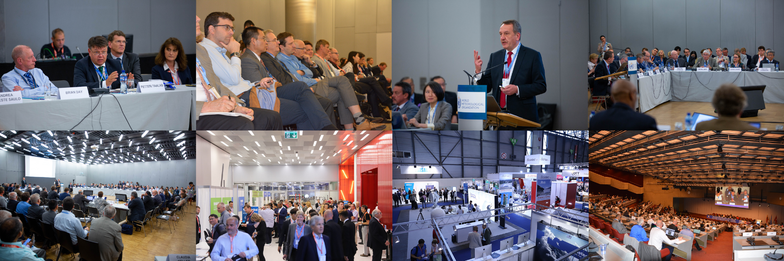
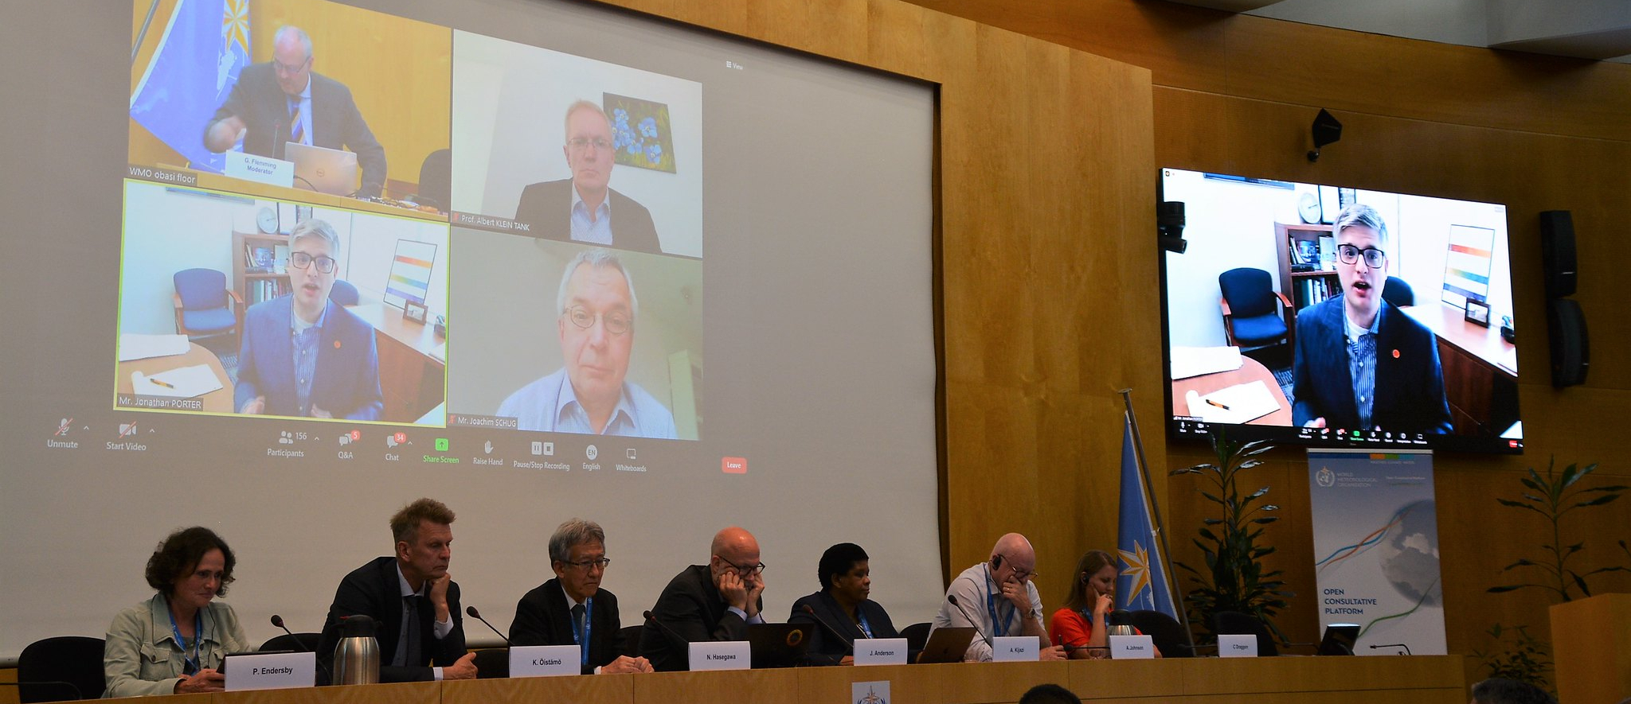
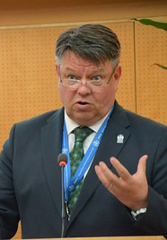
WMO’s Open Consultative Platform (OCP)
“PARTNERSHIP AND INNOVATION FOR THE NEXT GENERATION OF WEATHER AND CLIMATE INTELLIGENCE”
OCP-HL-1 (High-Level Round Table), June 2019
The Open Consultative Platform (OCP), established on the occasions of the 18th World Meteorological Congress in 2019, serves as an open, constructive and participatory framework for addressing the grand challenges of the global weather enterprise.
In the spirit of collaboration, mutual respect, and trust, the Platform enables all stakeholders to stay abreast of issues and opportunities, both institutional and technological, to motivate collaborative, win-win approaches and to nurture innovation.
WMO plays a central global role in facilitating the cooperation of WMO Member states and territories and their weather enterprise stakeholders.
OCP-HL-3 on Evolving Roles and Responsibilities – Future of NMSs, June 2022

Slide 17
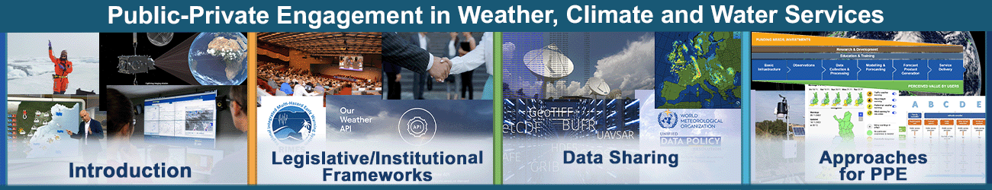
Update on Activities in Support of WMO Members and Stakeholders
A self-directed training course on Public-Private Engagement (PPE)
in Weather, Climate and Water Services
was launched on 27 February 2023
and is now freely available to all at the learning platform of
WMO Education and Training Programme
(WMO ETRP Moodle site, https://etrp.wmo.int/)
Click here!

Slide 18
WMO will continue to facilitate the dialogue between the sectors and work with the private, academic and civil sectors in line with general policy established through the Geneva Declaration and other Guidelines.
Let’s work together.
THANK YOU
https://public.wmo.int/ppe
Your feedback and contribution are welcome to ppe@wmo.int

Slide 20
Other useful slides

Slide 21
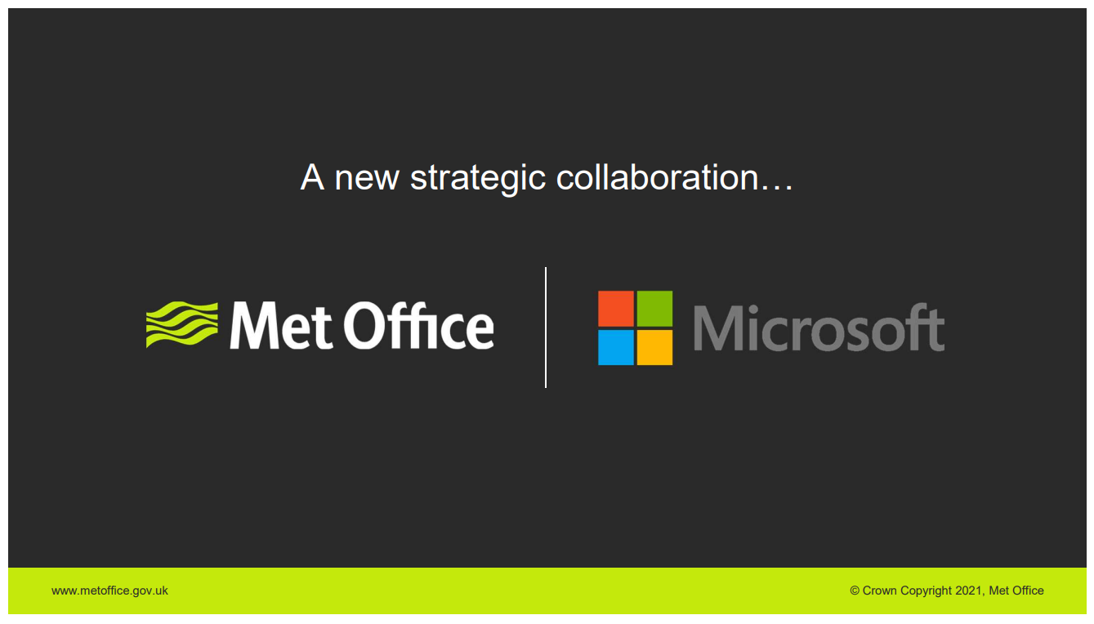
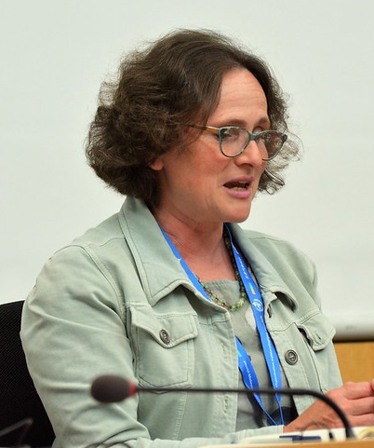
Supercomputing & cloud computing
UK Met Office’s partnership with Microsoft to harness next generation of supercomputing capability and data technologies to deliver innovation for weather and climate forecasting
In April 2021, the UK Met Office signed a multimillion-pound agreement with Microsoft for the provision of a world-leading supercomputing capability that will take weather and climate forecasting to the next level, and help the UK stay safe and thrive.
“Up until recently, the owning and operating of our supercomputing infrastructure have been set as another of those areas that we need to be experts ourselves. But our recent contract with Microsoft reflects the fact that we now see this as an area we can partner with industry to bring the best combination of expertise and capability together.… And moving our supercomputer to be close to a public cloud provides us with opportunities to leverage the elasticity and scalability of cloud and make our really huge data readily available to clients and partners.”
Paragraph 1 and the slide (top right) from a WMO Open Consultative Platform (OCP) Innovation Webinar (Oct 2021); paragragh 2 and the photo from WMO’s third high-level session of OCP (June 2022))
Supercomputing leap in weather and climate forecasting - Met Office

Slide 22
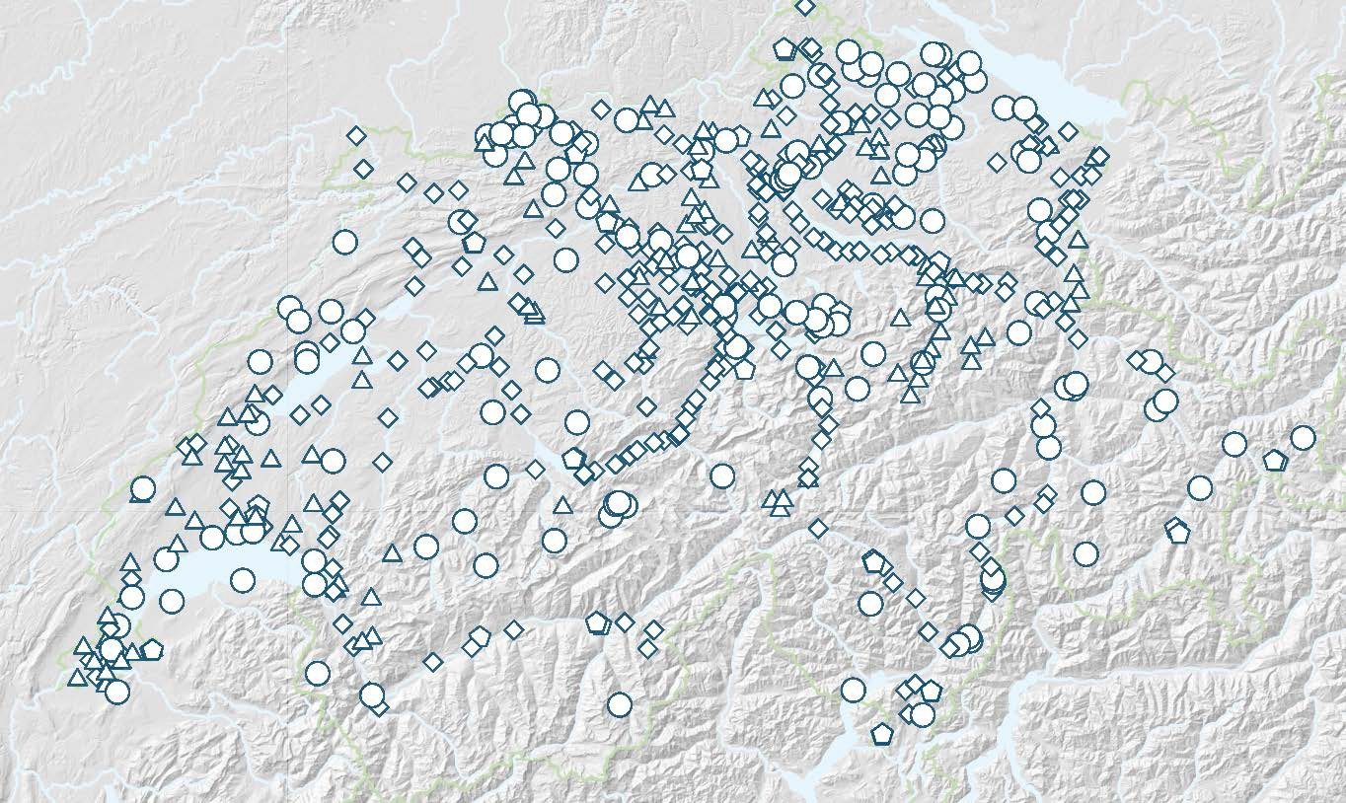
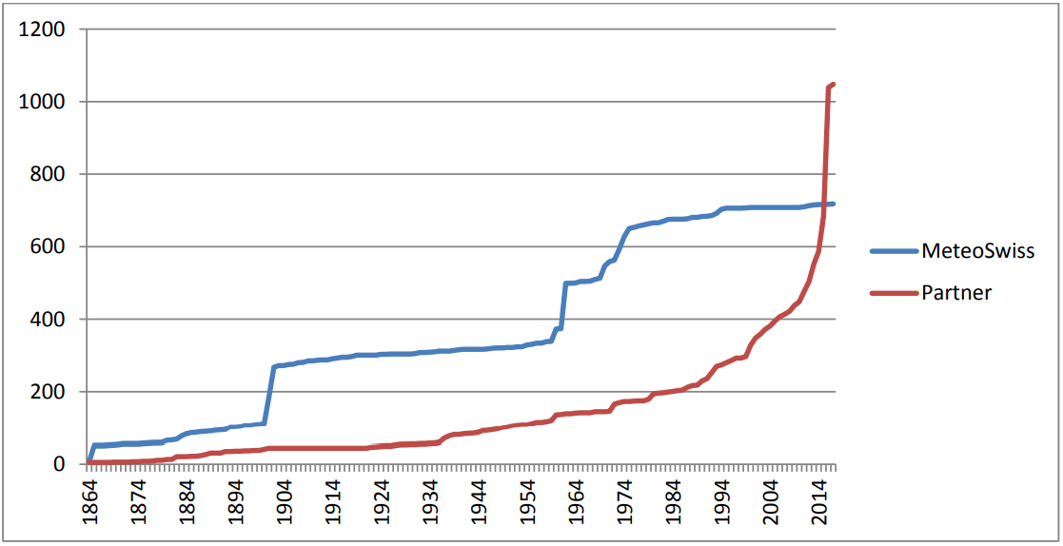
Innovative Scientific Approach
Use of private-sector data for monitoring
Since 2011, MeteoSwiss has collaborated with MeteoGroup (now DTN) and public partners to fill the measurement gaps by integrating partner stations to provide warnings to 140 regions.
In 2009, a warning concept, which divided Switzerland into around 140 warning regions, was operationally put in place with the goal to ensure at least one automatic weather station in each warning region measuring on a near-real-time basis.
Based on an analysis it was shown that the existing gaps could be filled either by expanding the MeteoSwiss automatic weather stations network or by integrating existing partner stations. In addition to the already existing data exchange with public partners, in 2010, MeteoSwiss decided to also start cooperation with private data providers, while developing a procedure to evaluate a station’s quality.
Analyzing MeteoGroup’s (now DTN) weather station network, 50 MeteoGroup stations, together with a number of stations operated by governmental agencies, have been integrated into the central data platform of MeteoSwiss since 2012, adding great value to MeteoSwiss official duty tasks such as forecasts, warnings or verification.
The amount of MeteoSwiss (blue) and partner (red) weather stations in the MeteoSwiss data warehouse.
Current map of private and public partner stations integrated in the MeteoSwiss systems
Details in PPE Resources in the WMO PPE website

Slide 23
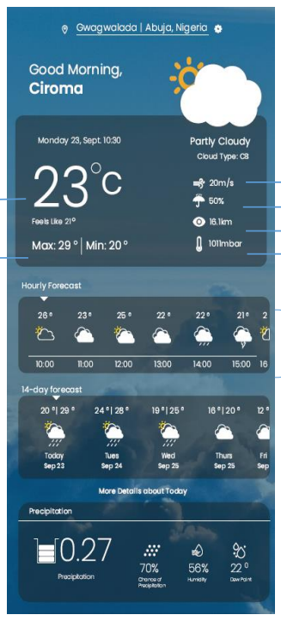
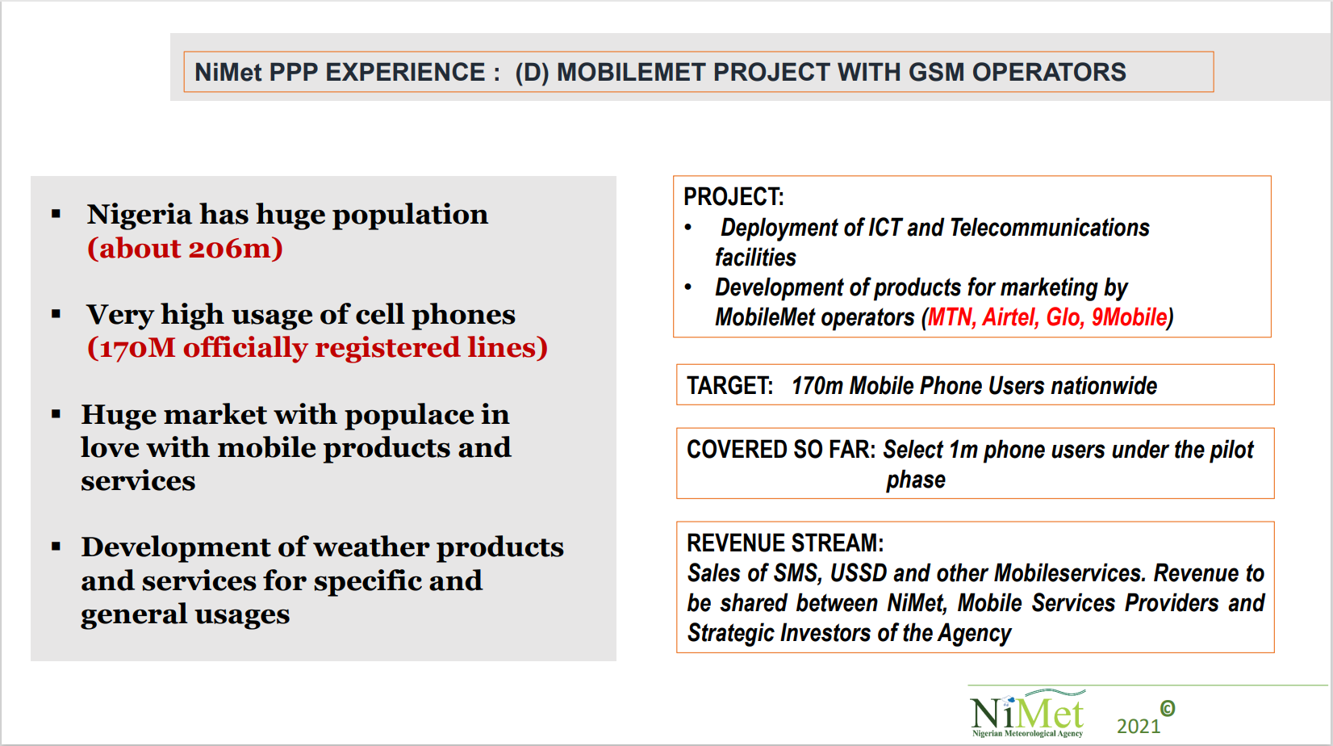
Concession supported by legislation ---
NiMet’s collaboration with mobile service providers
Nigerian Meteorological Agency (NiMet)’s Partnership with the four major GSM service providers in the country, based on which they’ve developed an App that could easily relay information of real-time including short range and long-range forecast to farmers and other users in Nigeria.
NiMeT’s Weather App
Presentation ¦ Video ¦ Summary ¦ Details
from the Second High-level Session of the Open Consultative Platform (OCP-HL-2)

Slide 24
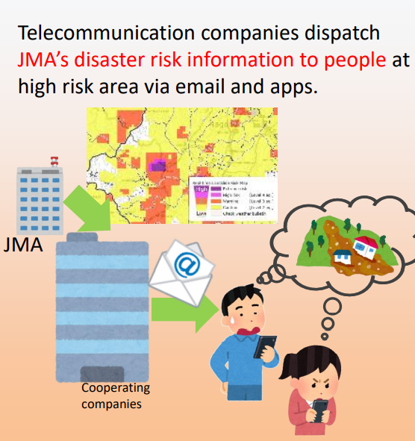
Prompt and Clear Dissemination
Risk notification via Push-type communication
Five companies that responded to a public call for proposals cooperate in the push-type communication of the Japanese Meteorological Agency’s state-of-the-art real-time risk maps.
In May 2019, the Japanese Meteorological Agency (JMA) invited applications from those (i.e., the private sector) who would like to participate in a new push notification service of the state-of-the-art Real-time Inundation Risk Map and Real-time Flood Risk Map.
The new push notification service by five accepted collaborators has started from 2019 summer onwards.
Those collaborators are companies who have been proactive in weather-for-business activities in Japan.
From (1) the Second High-level Session of the Open Consultative Platform (OCP-HL-2) (Presentation ¦ Video ¦ Summary ¦ Details) and a good practice

Slide 25
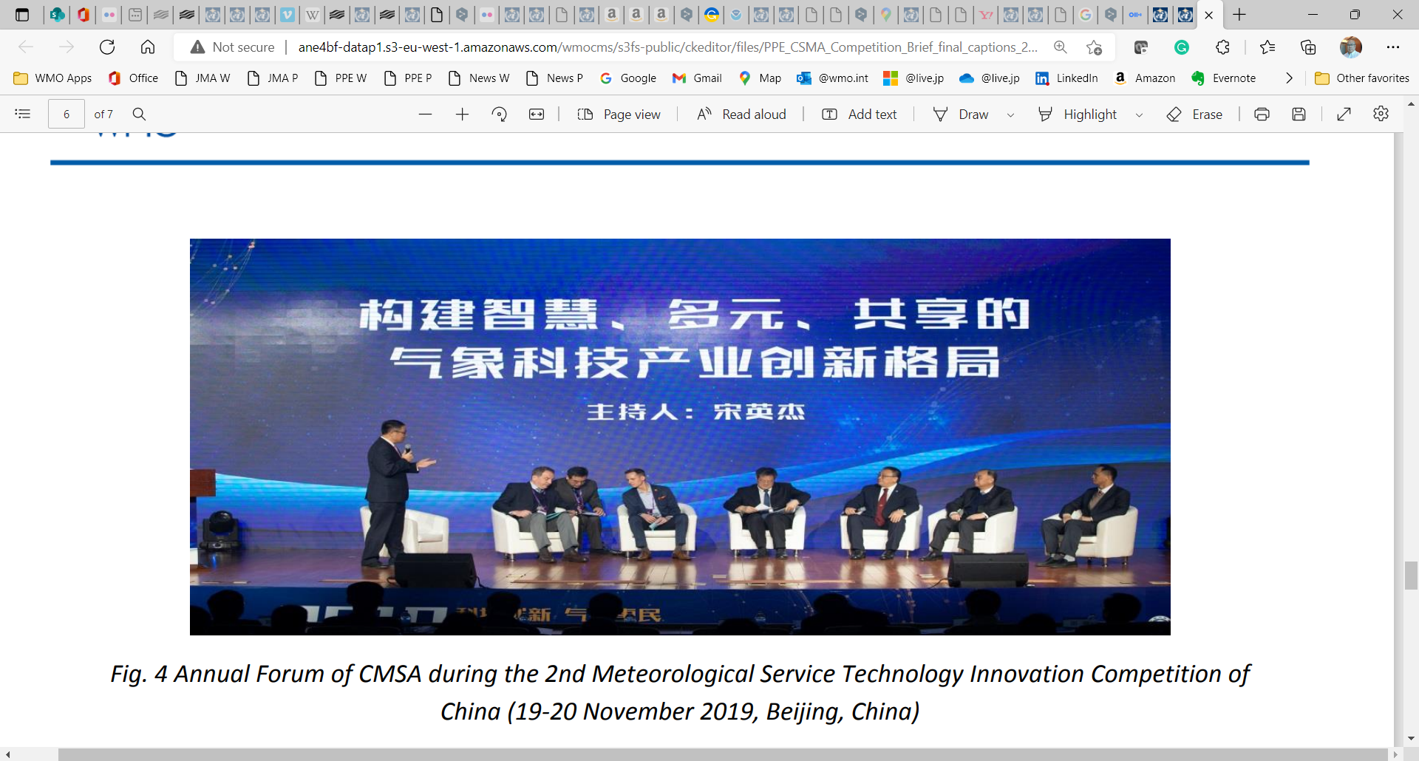
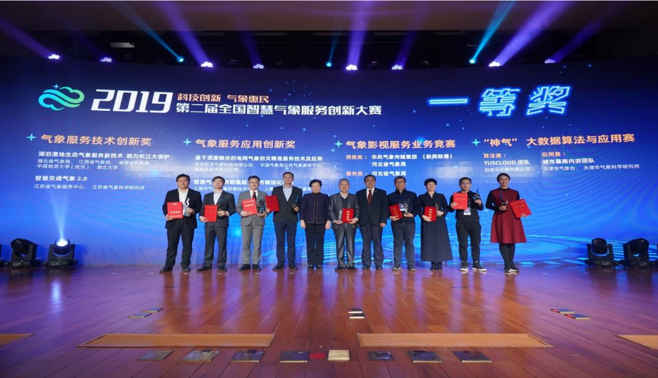
Dialogue among sectors –
National communication platform btw the government and the private sector
The China Meteorological Service Association (CMSA) aims to build a communication platform between the government and enterprises.
China Meteorological Service Association (CMSA), established in May 2015, is the first nationwide industrial and non-profit civil society representing meteorological service providers in China.
The CMSA was founded in a context where the government in China developed policies and took measures to create a favorable environment for business growth, fair competition and quality service.
The CMSA aims to build a communication platform between the government and enterprises, boost the weather service industry's prosperity, and enhance the benefits of weather and climate services to all economic and social sectors.
The CMSA represents the views and concerns of its members and the weather service industry at large, safeguards the legitimate rights and interests of the enterprises, and promotes industry self-discipline and compliance with standards and regulations.
Annual Forum of CMSA
Award-winners at the 2nd Meteorological Service Technology Innovation Competition of China and Annual Forum of CMSA
Photos from a good practice: Boosting innovation and national dialogue: 2nd Meteorological Service Technology Innovation Competition and Annual Forum, Beijing, China (February 2020) in PPE Resources page

Slide 26

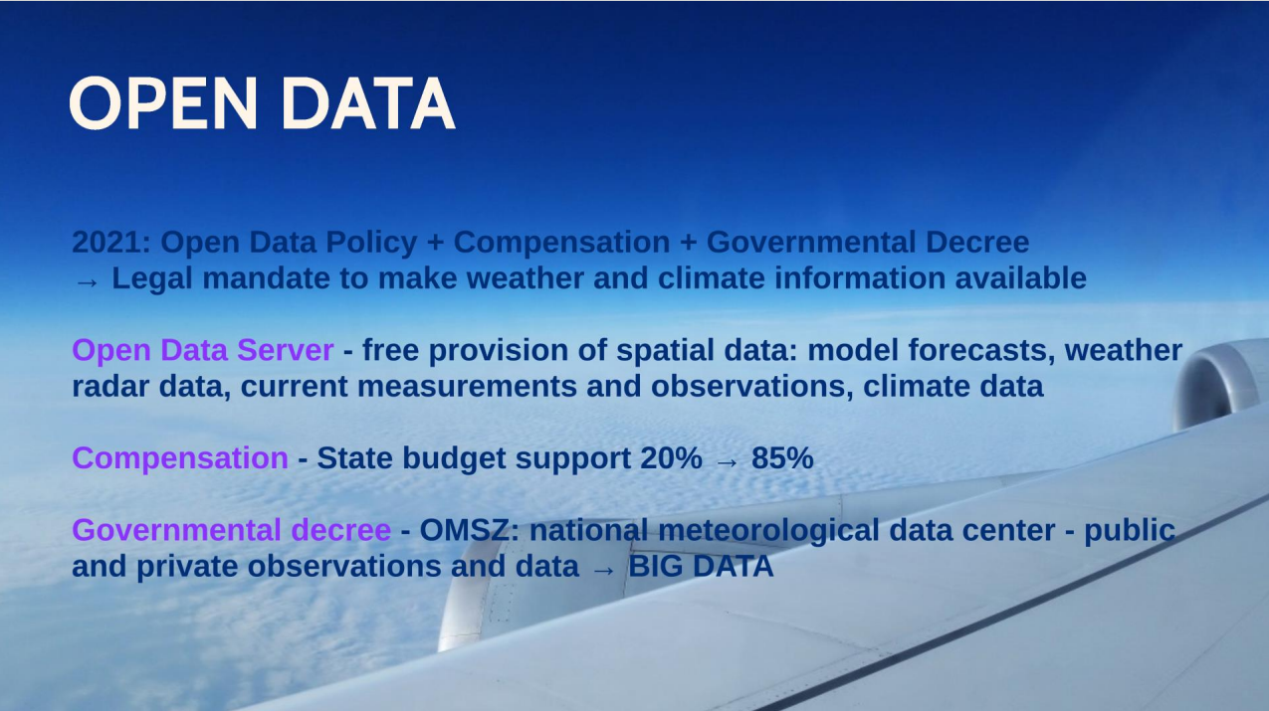
Evolving roles and responsibilities of NMHSs: Open Data
Hungarian Meteorological Service (OMSZ) successfully got significant budget compensation from government by consolidating its legal mandate to make weather and climate information available through an open data server.
“Hungary was the country which has the highest prices for meteorological data and information in Europe. To get out of this tricky financial situation here in Hungary, a new business model has been settled.”
“Recognizing the advantages and importance of free and unrestricted exchange of meteorological data, a consultation has been initiated in 2015 to advocate open data policy in the government. As a result of our efforts, the Hungarian Metrological Service could introduce open data policy from 1 January 2020. We have got the legal mandate to make weather and climate information available through an open data server.”
“As a result of this budget compensation, we received from the government our state budget with a super increase from 20% to 85%.”
Dr Kornélia Radics
RA VI president and PR of Hungary with WMO
From (1) the Second High-level Session of the Open Consultative Platform (OCP-HL-2) and (2) the WMO Data Conference Preparatory Workshop on Theme 2: "Business models and data policy issues“ (Oct 2020)

Slide 27
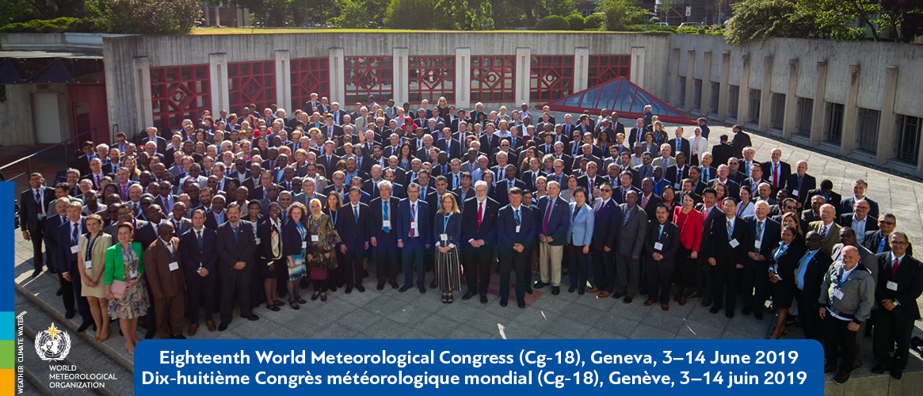
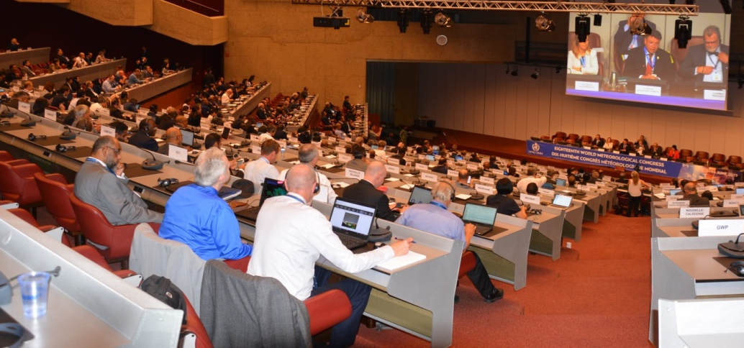
WMO PPE policy
Geneva Declaration 2019:
Building Community for Weather, Climate and Water Actions
A policy act that reflects the new paradigm of cooperation and partnership between stakeholders from all sectors of the weather enterprise needed as a collective response to global societal risks related to extreme weather, climate change, water scarcity and other environmental hazards.

Slide 28
Geneva Declaration 2019:
Building Community for Weather, Climate and Water Actions
We, the delegates from 160 Member States and Territories of the WMO, meeting in Geneva from 3 to 14 June 2019 at the Eighteenth World Meteorological Congress, having considered:
  that the global societal risks related to extreme weather, climate, water and other environmental events should be addressed through interdisciplinary and multi-sectoral partnerships, and
  that the expanding opportunities to use meteorological, climatological, hydrological and related environmental information and services to inform critical decisions can foster increased societal and structural resilience, and sustainable economic development;
  declare as follows: …

Slide 29
Geneva Declaration 2019:
Building Community for Weather, Climate and Water Actions
“We NOTE
- The strong focus of the global agenda on both immediate and long-term challenges related to weather, climate and water, as reflected in the 2030 Agenda for Sustainable Development, the Paris Agreement, and the Sendai Framework for Disaster Risk Reduction;
- That achieving the sustainable development goals will benefit from inclusive partnerships amongst public, private and academic sectors, as well as civil society, at global, regional, national and local levels; …
We WELCOME
- The opportunities for all stakeholders and the broader user community that will result from a closer collaboration among public, private and academic sectors;
- The engagement of all sectors in addressing the societal needs through weather, climate, water and other environmental information and services; …”

Slide 30
WMO PPE Policy, Guidelines and other materials
Based upon the convention of WMO,
related regulations and guidance
Outlines a clear policy direction
Geneva Declaration 2019
Guidelines for Public-private Engagement (2021 edition)
Other materials on WMO PPE Website; training modules being developed
Describe and explain evolving potential of PPE
Outline and promote principles aimed at maximizing the benefits of an inclusive approach
Inform and facilitate action to play evolving roles at all levels
And WMO Unified Data Policy Annex 3 Guidelines on the application of data policy in PPE adopted in 2021

Slide 31

Guidelines and supplementary materials (1/3)
Guidelines for Public-Private Engagement (2021 ed.)
Following the adoption of the Geneva Declaration – 2019, there was an apparent need for guidance to Members on enabling and establishing successful PPE.
The Guidelines were published as a response to this need and are aimed to inform and facilitate global, regional and national actions towards proactive engagement between the stakeholders from public, private and academic sectors, which would result in better service to Members’ governments, economy and citizens.
The Guidelines outline and promote principles aimed at maximizing the benefits of an inclusive weather and climate enterprise approach.
Available in all WMO official languages: English, Arabic, Chinese, French, Russian and Spanish

Slide 32
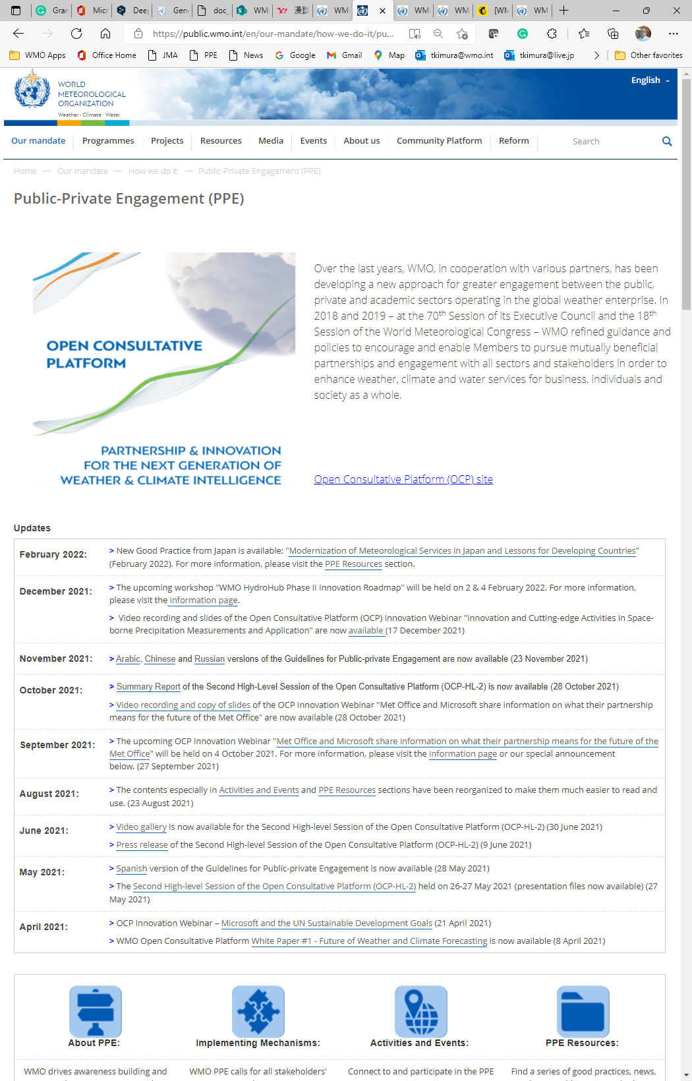
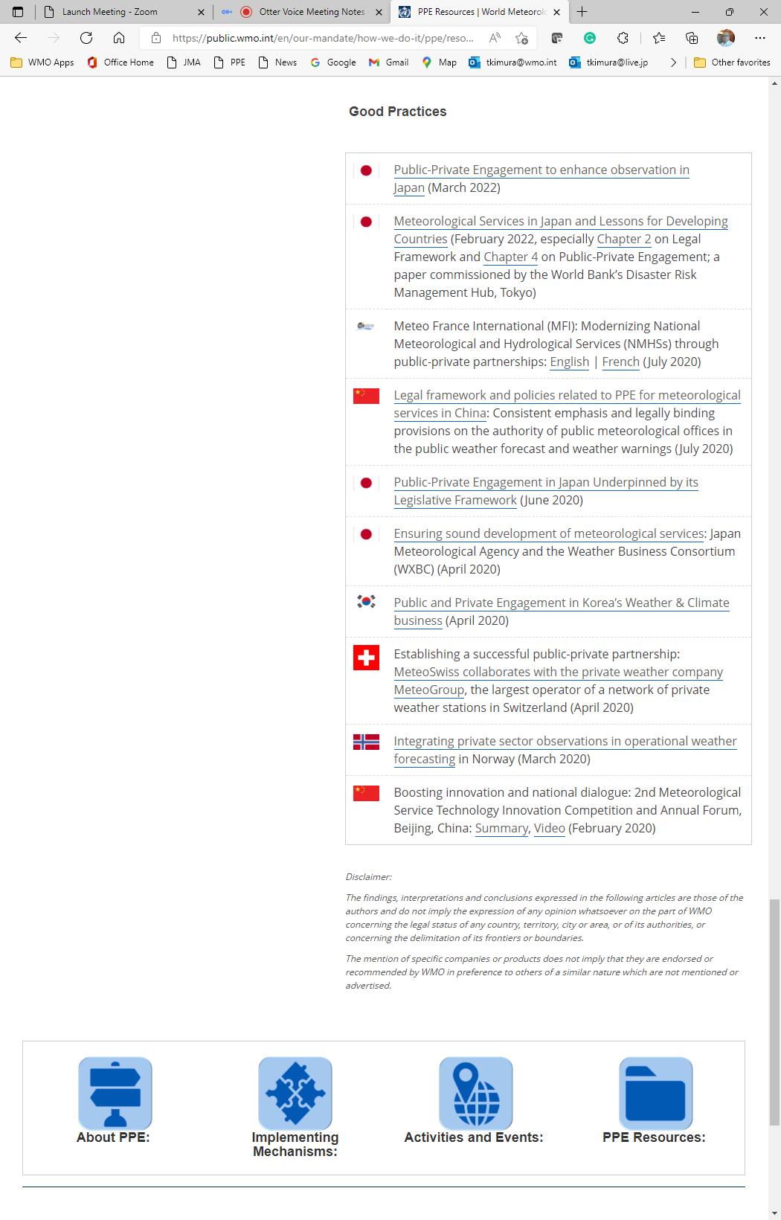
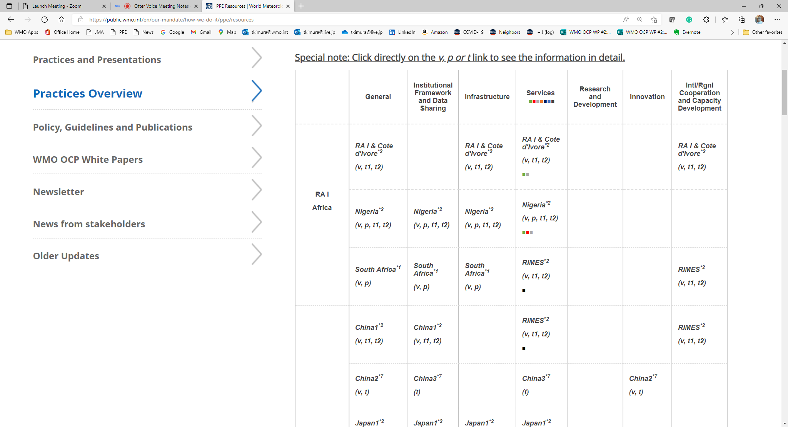
Guidelines and supplementary materials (2/3)
Where Are PPE-related Resources Available?
We have various resources – good practices, newsletters, innovation seminars.
  Web site
PPE main page (public.wmo.int/ppe)
This is the PPE main site. This site is a collection of past decisions, meeting recordings and reports, and good practices from Members and the private sector, (being) organized in various ways to make it easier to use.
This site includes e.g., under PPE Resources page,
Presentations and Practices
    Practices Overview

Slide 33

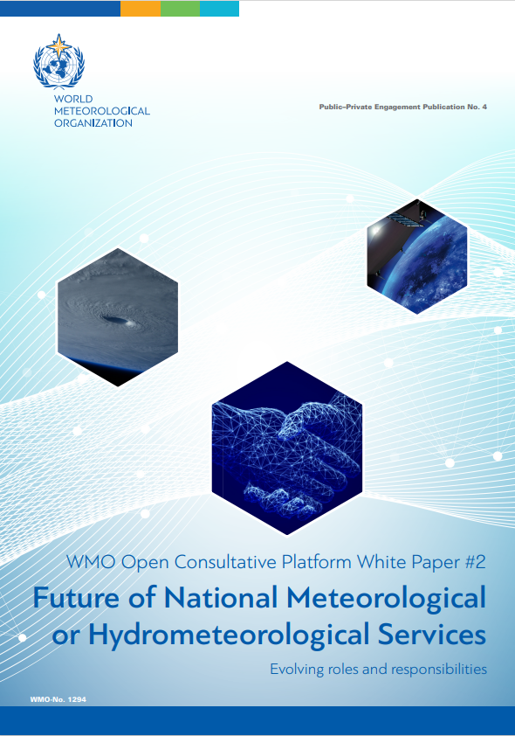
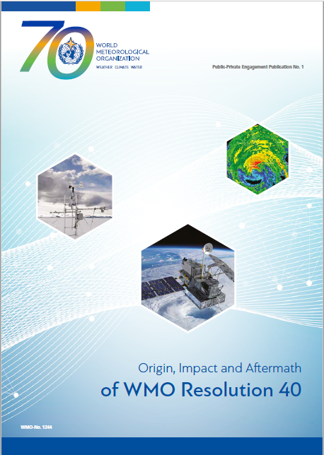

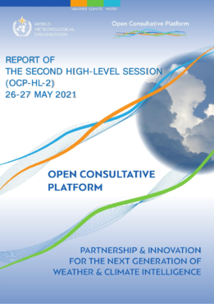
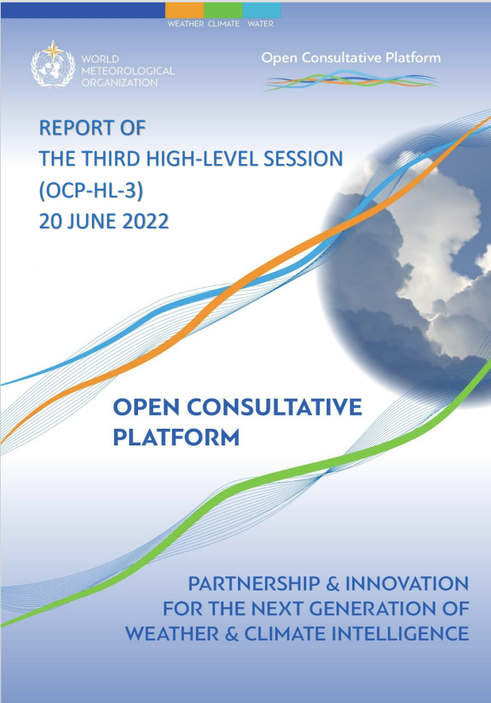
Guidelines and supplementary materials (3/3)
WMO’s Public-Private Engagement Publication
Geneva Declaration – 2019
Guidelines for PPE (2021 edition)
OCP White Paper #1
OCP White Paper #2
PPE Publication No. 1
OCP-HL-1 Report
OCP-HL-2 Report
OCP-HL-3 Report
All resource materials are available at: https://public.wmo.int/ppe

Slide 34
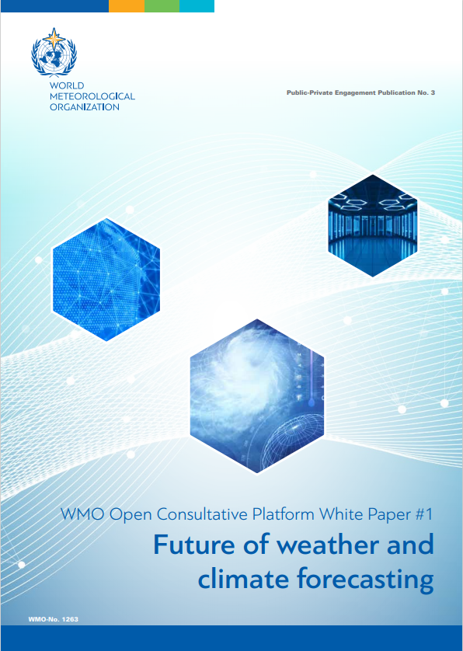
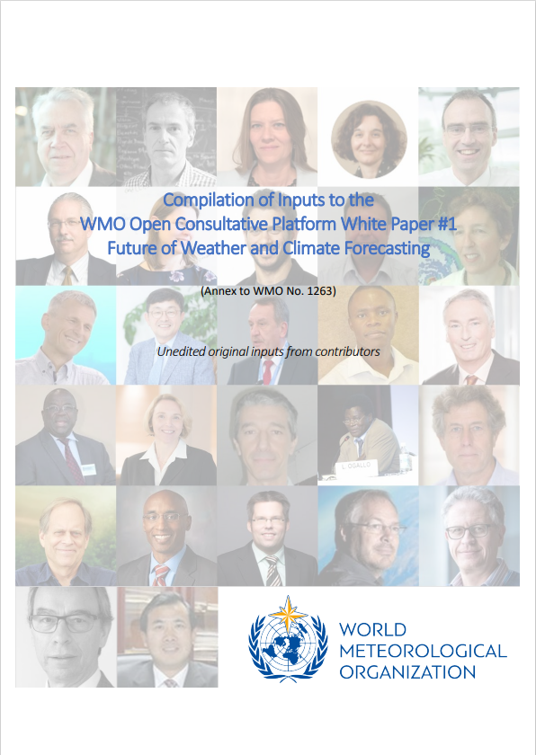
WMO OCP White Paper #1:
Future of weather and climate forecasting
The first OCP White Paper entitled “Future of weather and climate forecasting” was published as WMO-No. 1263 on 1 April 2021.
It is a collective endeavor of more than 30 lead scientists and experts to analyze trends, challenges and opportunities in a very dynamic environment.
The main purpose of the paper is to set directions and recommendations for scheduled progress, avoiding potential disruptions and leveraging opportunities through public–private engagement over the coming decade.
Original written contributions is disclosed (published) as Part II – Compilation of Inputs to the WP.
WMO OCP WP#1 and its Annex

Slide 35
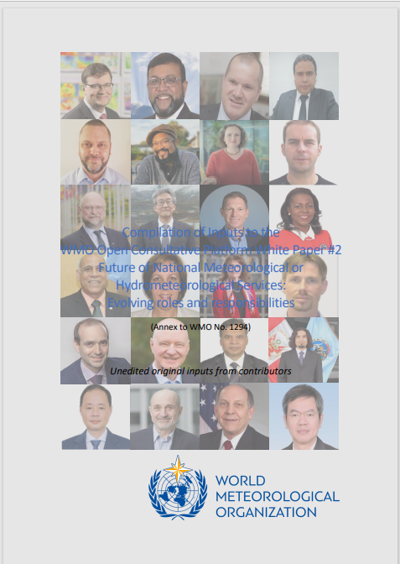
WMO OCP White Paper #2
Future of National Meteorological or Hydrometeorological Services: Evolving roles and responsibilities
Published in June 2022.
WP#2 addresses identified issues and challenges under the overarching question “How do you see the NMSs in 2030?” and is a collective endeavor of more than 30 lead experts.
The conclusions present key messages and recommendations derived from the comprehensive analysis of the evolving societal needs and observed trends in the technological and operational ecosystems in which NMS operate, such as
“In the coming decade … progress will require inclusive multisectoral partnerships, leveraging the strength of the public and private sectors, supported by the research community and civil society, operating in tandem and effectively working through challenges to meet the increasing weather, climate and water needs”.
Original inputs from contributing authors are also available as Annex (Part II).
WMO OCP WP#2 and its Annex

Slide 36
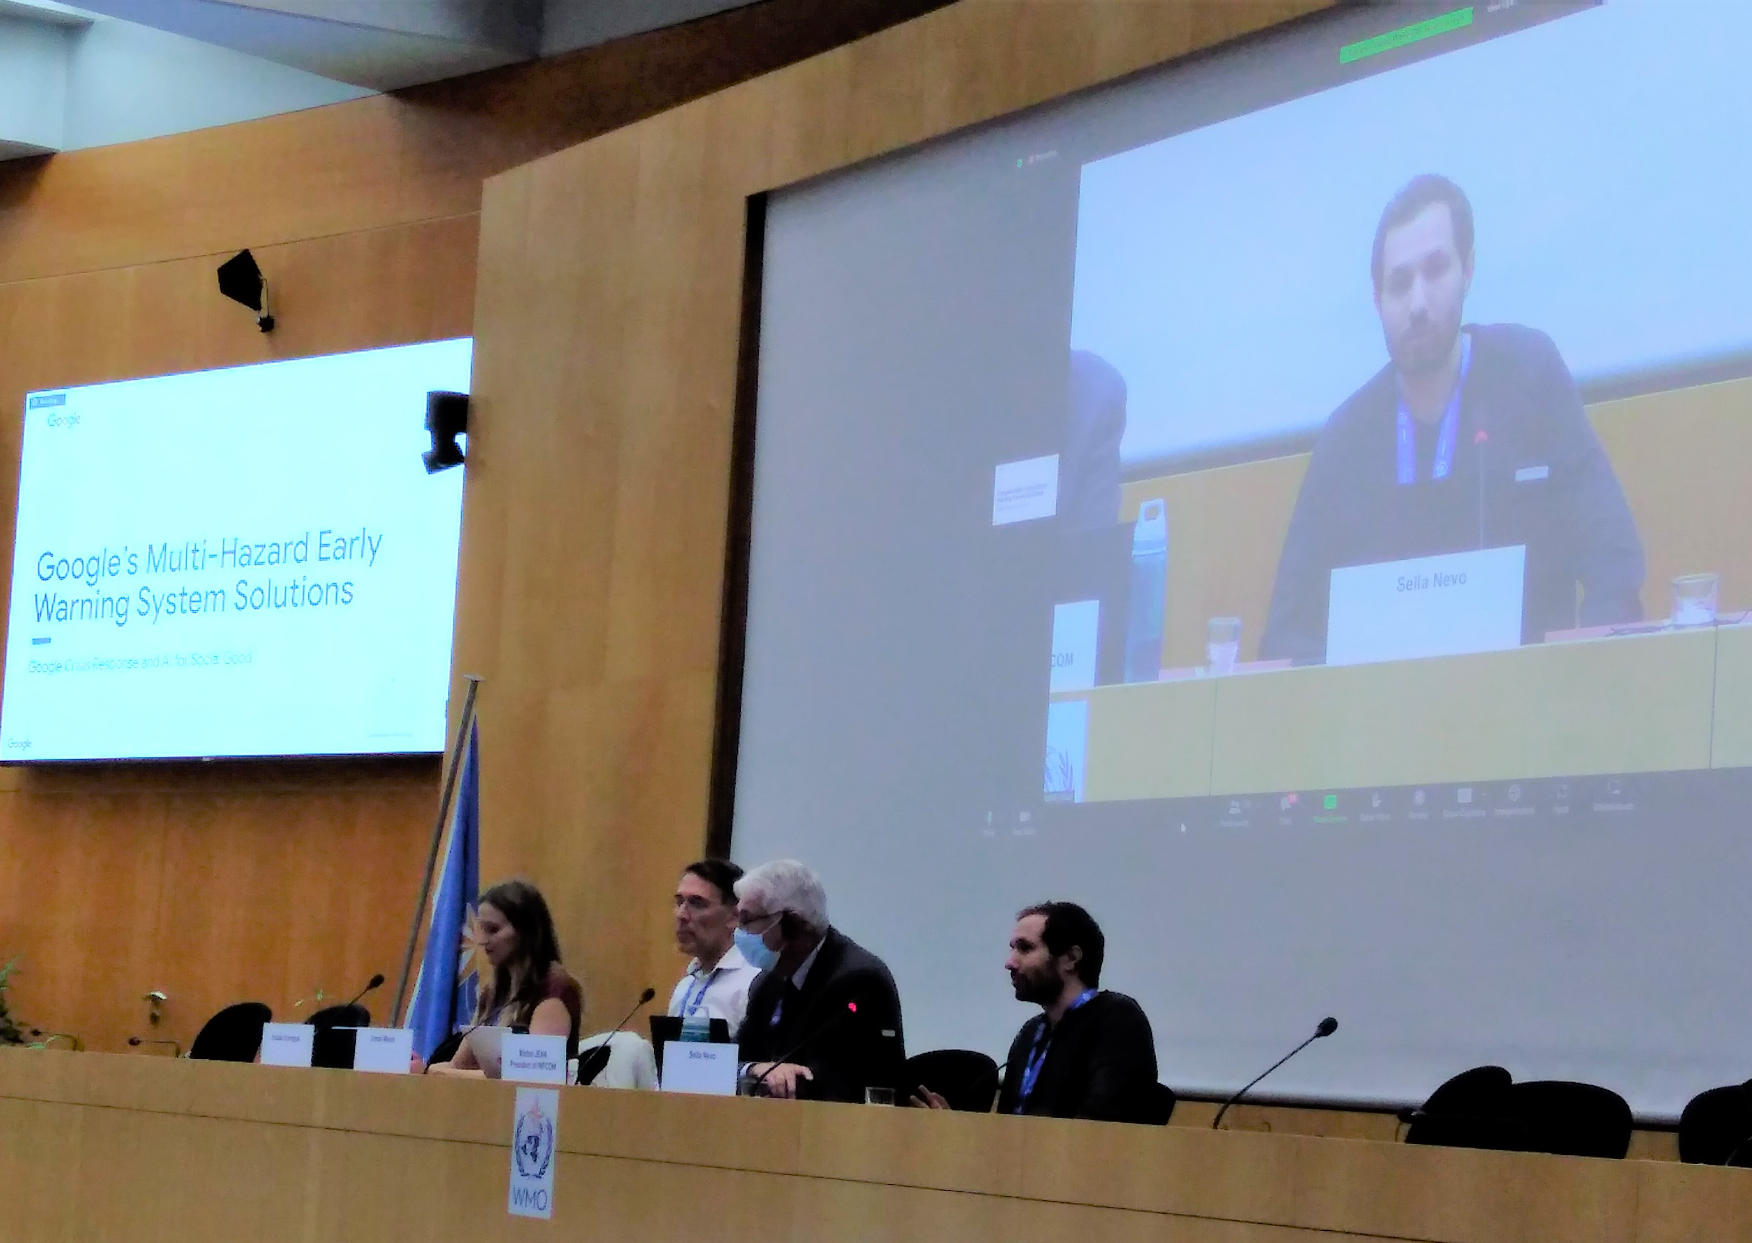
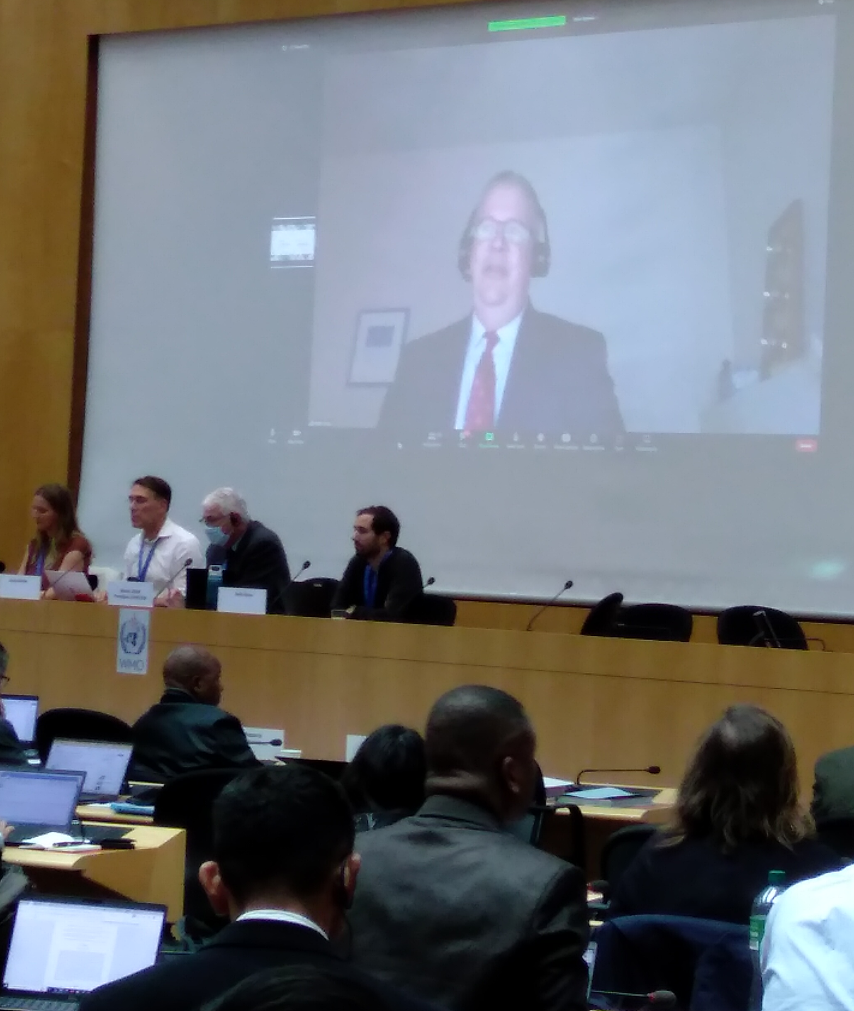
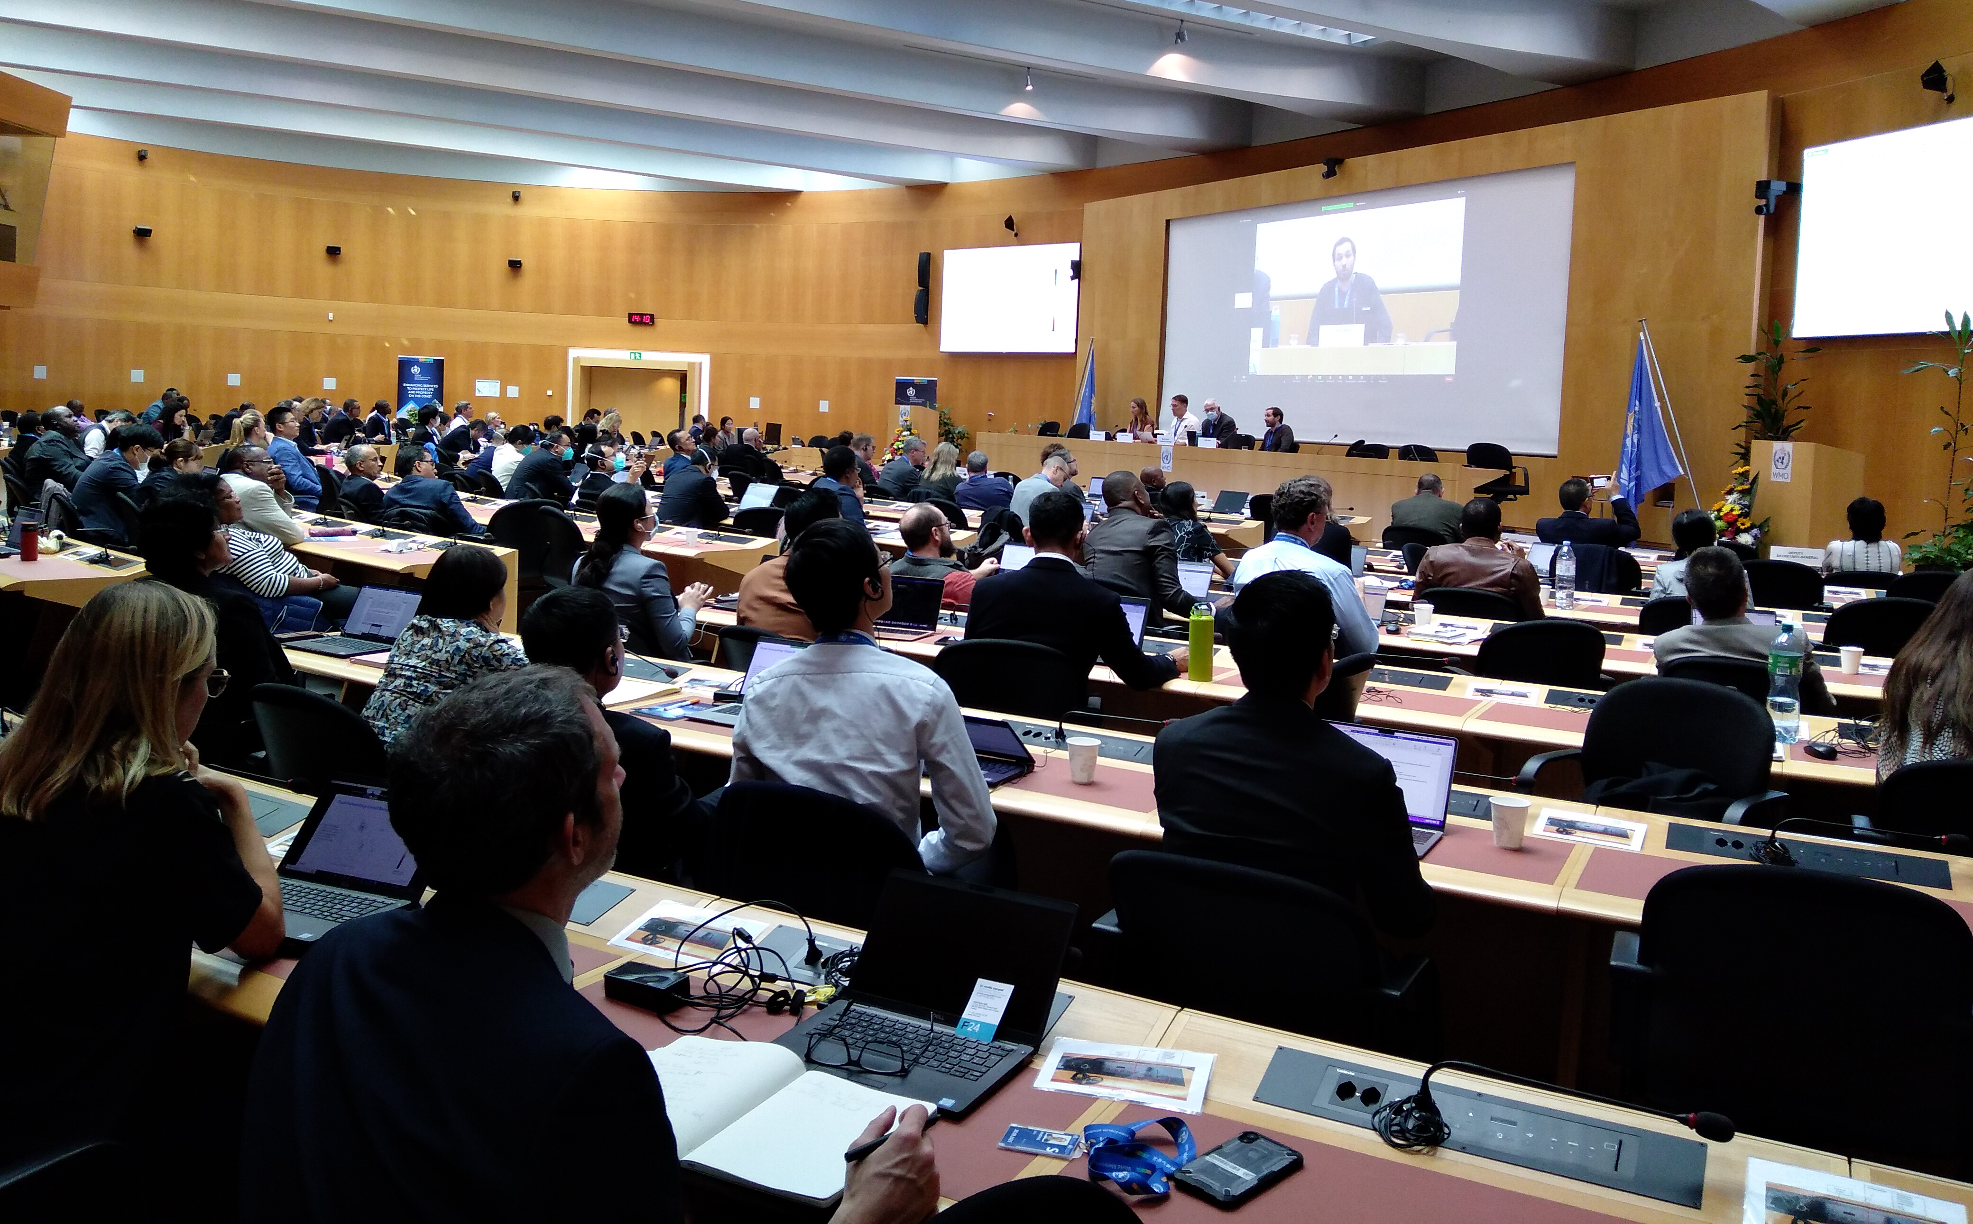
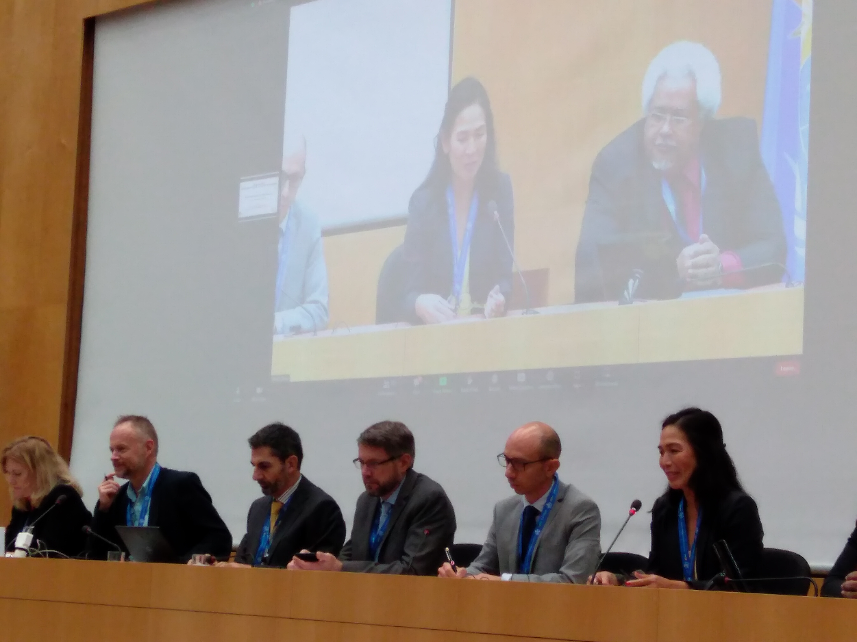
WMO Technical Conference on the UN Global Early Warning Initiative for the Implementation of Climate Adaptation: Early Warnings for All (22nd Oct 2022)
Google representative, Mr Sella Nevo
Microsoft representative, Mr Matt Corey
Aimed to facilitate a dialogue between WMO, National Meteorological and Hydrological Services, other UN entities and the private sector on the potential contributions of technological advancements, big data, and the continued rise of social media and related digital platforms.
Association of Hydro-Meteorological Industry (HMEI) representative, Ms Jay Wilson
Representatives of private sector organizations including Alibaba, F24, Google, IBM, Microsoft and Smart Communications all voiced commitments to the Early Warnings for All Initiative.
Notes:
[additional text]
The private sector, including Big Tech companies, are joining the WMO, development and disaster risk reduction communities in rallying behind the new United Nations campaign to ensure that every person in the world is protected by early warning systems within the next five years.

Slide 37
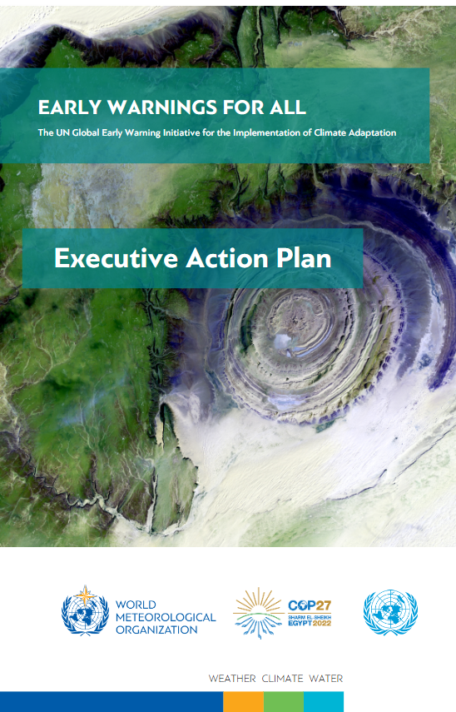
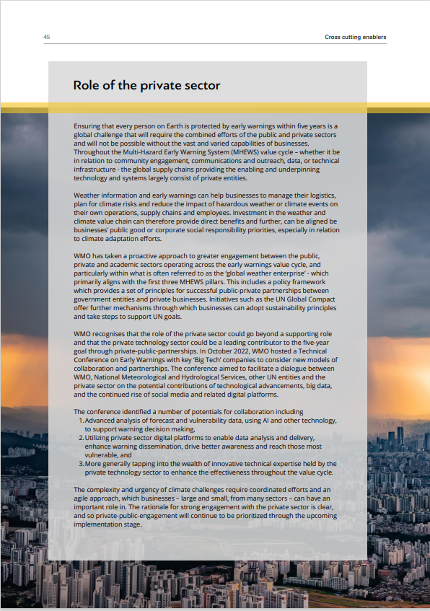
Role of the private sector in the Early Warnings for All
“The complexity and urgency of climate challenges require coordinated efforts and an agile approach, which businesses – large and small, from many sectors – can have an important role in. The rationale for strong engagement with the private sector is clear, and so private-public-engagement will continue to be prioritized through the upcoming implementation stage.”

Slide 38
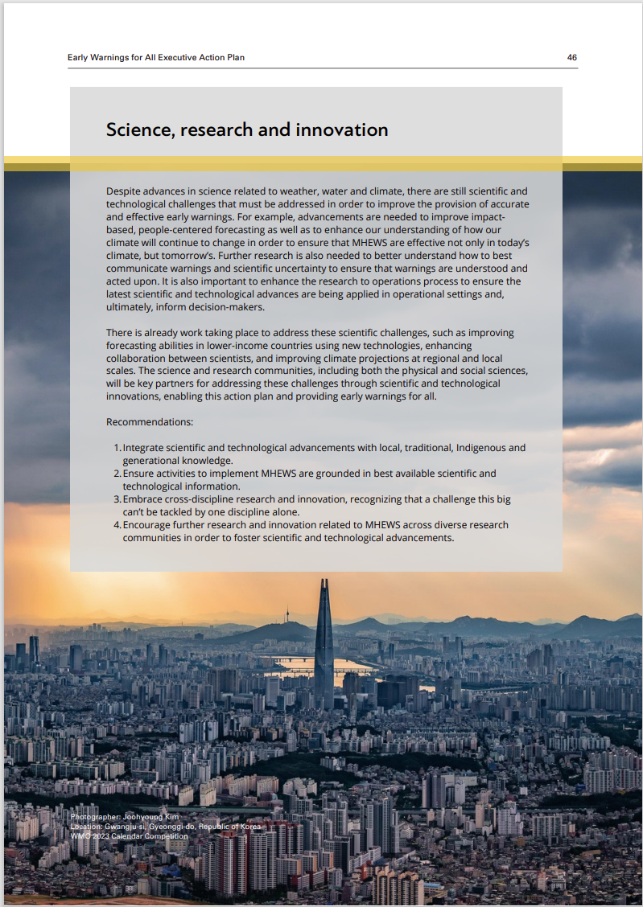
Science, research and innovation in the Early Warnings for All
“There is already work taking place to address these scientific challenges, such as improving forecasting abilities in lower-income countries using new technologies…. The science and research communities, including both the physical and social sciences, will be key partners for addressing these challenges through scientific and technological innovations, enabling this action plan and providing early warnings for all.”

Slide 39


Ongoing activities to further promote public-private engagement
Training Modules on PPE (Released in February; translation to French and Spanish will be completed in Summer, 2023)
Code of Ethics (with HMEI)
Analysis on institutional frameworks to define better the mandate & functions of National Meteorological and Hydrological Services and to unlock the potential of all sectors.
Notes:
WMO Information Day for Commercial Satellite Data Providers
WMO is organizing an information day for private companies providing Earth Observation Satellite Data to engage with WMO and HMEI.
This event is part of the activities of the WMO Open Consultative Platform.
During the event, the WMO Unified Data Policy will be introduced and how it relates also to private sector data together with presentations on WMO Information System and WMO Integrated Global Observing System.
Training Module summarizes WMO Policy, Guidelines, etc for PPE.
Code of Ethics is being made in accordance with the working arrangements with HMEI.

