Slide 1

Early Warnings for All
Chris Sharrock
Vice President
United Nations Affairs & International Organizations

Slide 2
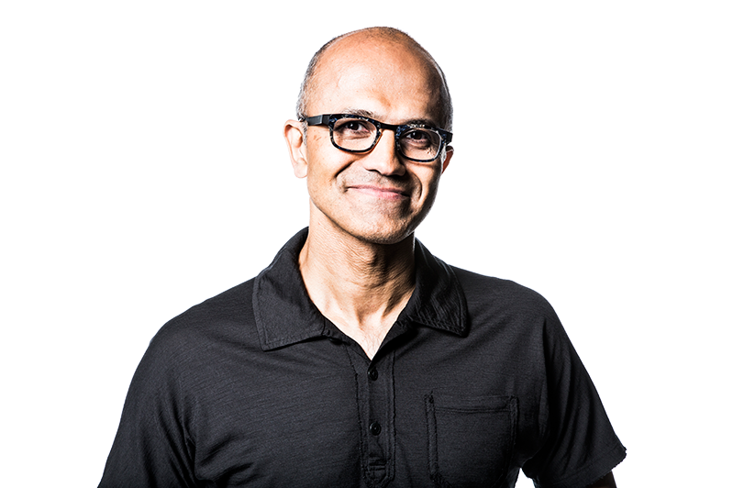
Companies that can do more, should do more
At a time when many are calling attention to the role technology plays in society, our mission remains constant.
It grounds us in the enormous opportunity and responsibility we have to ensure that the technology we create benefits everyone on the planet”
– Satya Nadella, Chairman and CEO, Microsoft

Slide 3
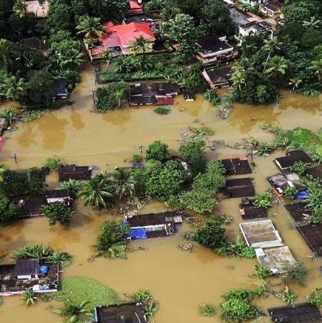
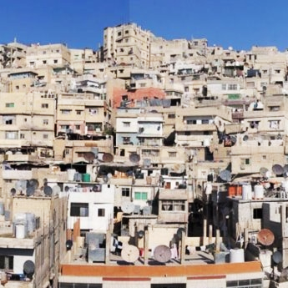
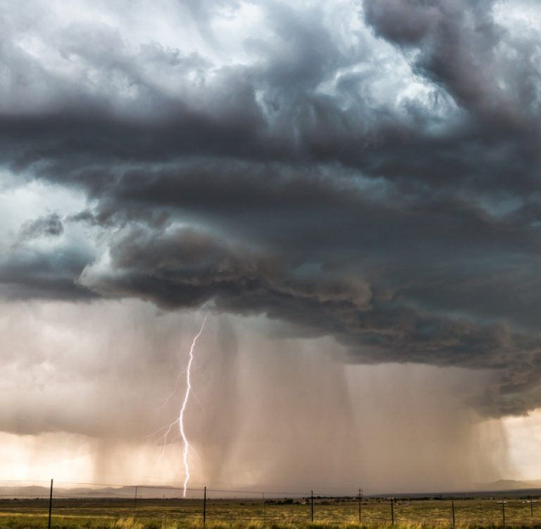
Early Warnings for All
Microsoft is committed to the success of the Early Warnings for All initiative.
This initiative reflects our experience that access to timely, accurate information in times of crises is crucial to save lives.
Every year
natural disasters endanger millions across the globe and cause trillions in losses
We must Adapt and plan for climate-induced crises
A global effort is needed to protect the most vulnerable​

Slide 4
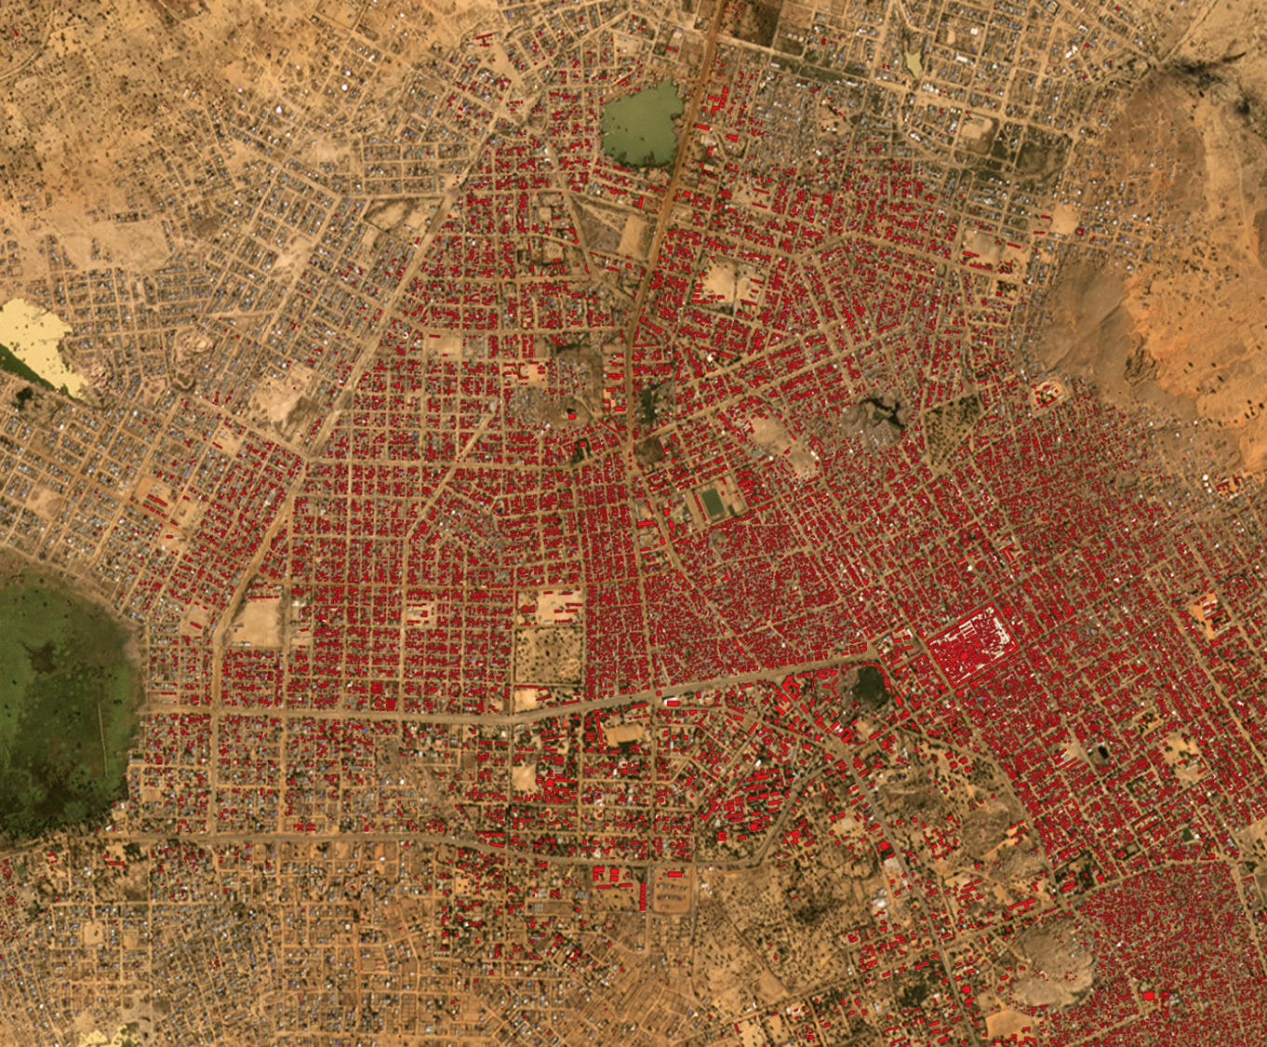
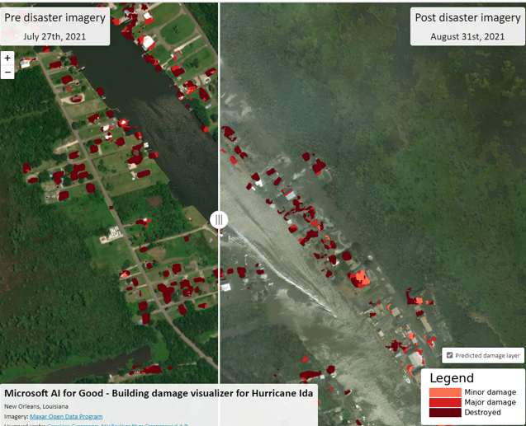


Early Warnings for All Opportunities
The power of AI, satellite imagery, predictive modeling, and the Microsoft device ecosystem can contribute to assisting vulnerable communities before and after disasters strikes
Population Patterns
Internet Connectivity
Notifications to Devices
Post-Disaster Building Damage Assessment
Understand populations and migration patterns
Understand internet access, availability, and speed
Notifications to
1+ Billon Microsoft devices
Identify damaged buildings to prioritize resources

Slide 5
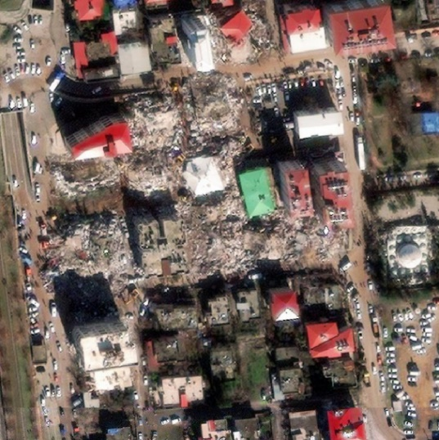
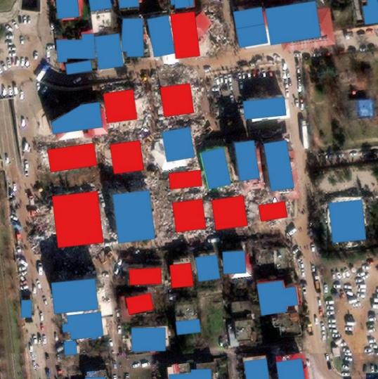
Post Disaster Building Damage
Microsoft is developing tools that use AI and high-resolution satellite images to swiftly identify damaged and destroyed buildings in the aftermath of disasters.
Three days after the initial earthquake in Turkey and Syrah, our tools revealed that approximately 3,849 buildings were damaged or destroyed in four cities.
9 destroyed apartment buildings in downtown Islahiye Maxar Technologies, Feb 7th

Slide 6

When we work together, we can do more

Slide 7
Thank You
Chris Sharrock
Vice President
United Nations Affairs & International Organizations

